Slide 1

School-Based ACCESS Program (SBAP)
Compliance Session
FY 2023-2024 Statewide Training
Notes:
Hello! Welcome to the compliance session for the fiscal year 2023-2024 statewide training for the school-based access program. The 2023-2024 fiscal year will prove to be an exciting and yet scary year as we navigate through the new changes that will occur while we adjust to our new solo vendor Sivic Solutions Group or SSG.

Slide 2
SBAP Coordinator
Debra J. Buffington, RN, MRE
Department of Human Services
Bureau of Program Integrity
Division of Provider Review
Notes:
I am Deb Buffington and I am the SBAP Coordinator with the Bureau of Program Integrity.

Slide 3
Compliance Training Objectives
Learning Objective: Upon completion of this session, participants will be able to recognize the documents that should be kept on hand and readily available in the event of an audit and recognize commonly identified issues/errors found during an audit of School-Based ACCESS Program (SBAP) services billed by the Local Education Agencies (LEAs).
Notes:
The Department of Human Services and the Bureau of Program Integrity strive to ensure that the LEA’s have a good understanding of the School-Based ACCESS Program. One of the ways we attempt to accomplish this is by holding these Fall trainings.

Slide 4
Compliance Training Agenda
  Key Topics:
  Maintaining Documents Relevant to the SBAP Program
  Downloading PCG Data by September 30, 2023
  Common Audit Findings
Notes:
Although there will be many changes this upcoming school year, compliance is an area that will basically stay the same. My presentation will focus on reviewing the documents that should be maintained because they are relevant to the SBAP program. As a reminder to staff I have a few slides regarding downloading PCG data because it must be completed by September 30th. Finally, I will be going over the common audit findings from the audits that were completed this past year.

Slide 5
Maintaining Documents
Documents to Maintain
Notes:
Documents to Maintain

Slide 6
Maintaining Documents
LEAs must maintain any and all documents relevant to the services provided.
Parental Consent
Individual Educational Program (IEP)
Medical Practitioner Authorization Form (MPAF)/Order/Prescription
Daily Service Provider Logs
Special Transportation Logs
Credentials
-Licenses
-Certifications
Attendance records
-Student
-Provider
Evaluations
Notes:
This list outlines the documents the LEAs must maintain because they are relevant to the services provided and would be requested in the event of an audit. I have highlighted the Daily Service Provider logs and the special transportation logs as a reminder that the LEAs should be downloading, or should have already downloaded these 2 reports that DHS shared instructions for on September 5^{th.}

Slide 7
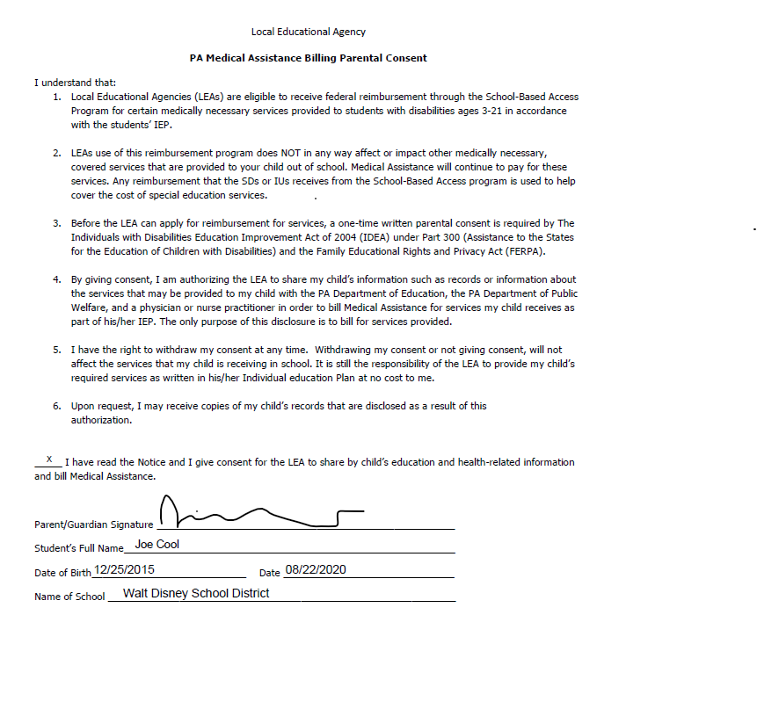
Parental Consent
Notes:
The parental consent only needs to be signed 1 time and it is considered best practice to obtain the consent during the initial IEP meeting. However, each LEA should establish their own protocol for obtaining the consent. Yearly notices are to be given to the parents notifying them that they may withdraw that consent at anytime. Make sure they check the line that gives consent and they sign and date it. Services delivered per the IEP prior to the date of the parental consent are not compensable.

Slide 8
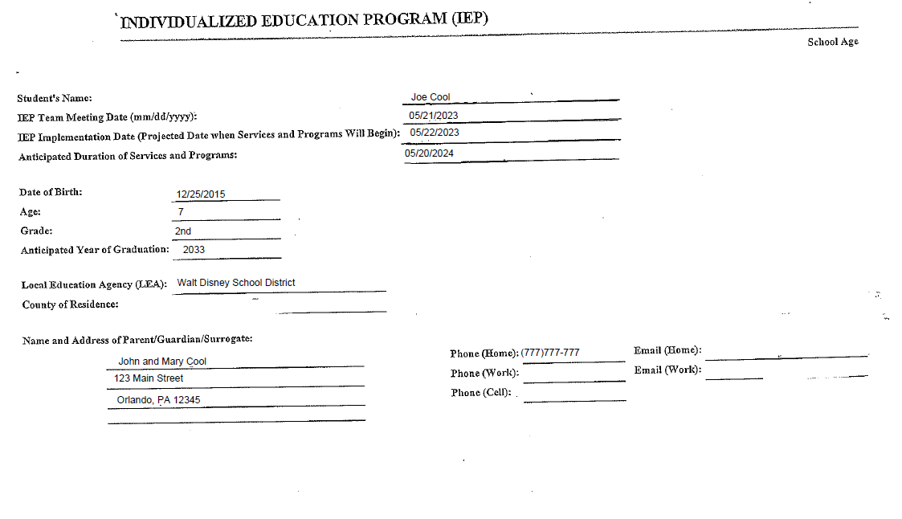
Individualized Education Program, (IEP)
Notes:
The Individualized Education Program (IEP) is a Pennsylvania Department of Education (PDE document. It is a recommendation of services that would benefit children in the Special Education Program. Once the staff meet and decide what programs would benefit the child, then the next step would be to obtain the Medical Practitioner Authorization Form (MPAF). It is important to keep any treatment plans, behavioral plans, or nutritional plans as well if they are a part of and described in the IEP.

Slide 9
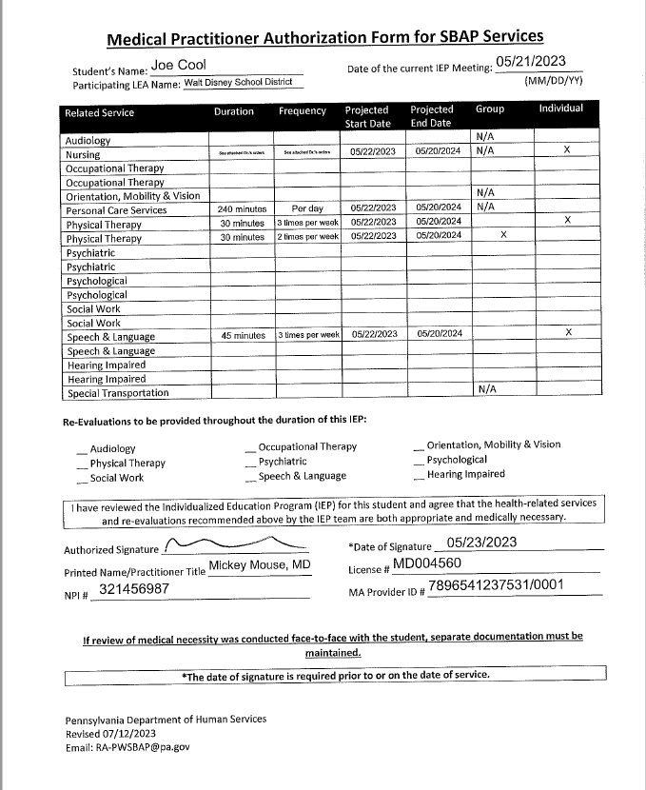
Medical Practitioner Authorization Form, (MPAF)
Notes:
The Medical Practitioner Authorization Form (MPAF) or Med Auth, is essentially the doctor’s order authorizing the providing of the ordered services. It should match the recommendations from the IEP. The MD/DO, PA, CRNP should be reviewing the IEP when filling out this form. If there are orders for nursing services, such as prescriptions for medications or other medically ordered services, then those should be attached to the MPAF.

Slide 10
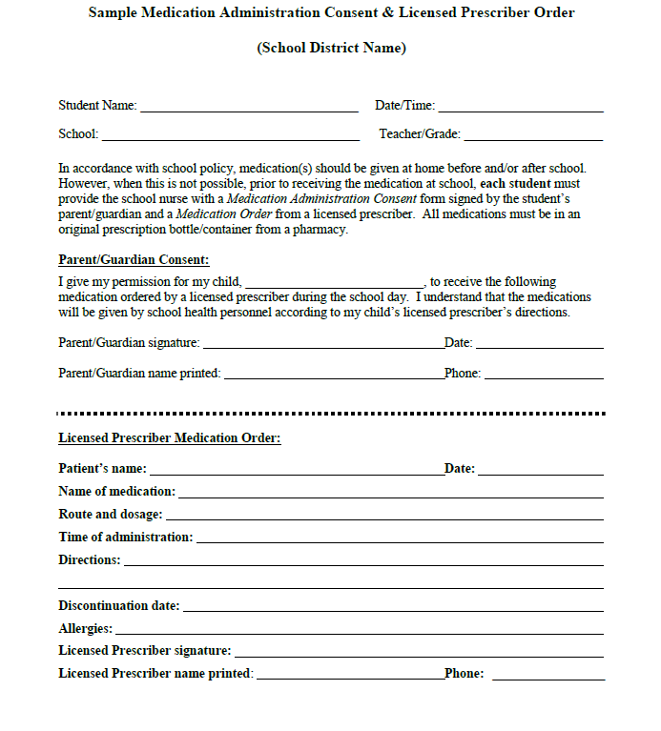
Sample Medication Administration/Licensed Prescriber Example
Must be signed by a licensed provider
Notes:
This is an example of a form found within the PA School Medication & Emergency Care guidelines and is from the Department of Health. It is posted to the SBAP website as well so it is convenient to all LEAs. All schools should have a policy in place with regards to health emergencies, handing out medication, etc. This form must be signed by a Licensed Prescriber. It is not acceptable if the parent fills it in and signs it without obtaining the licensed providers signature.

Slide 11
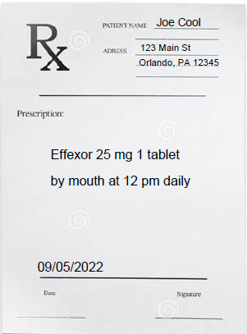
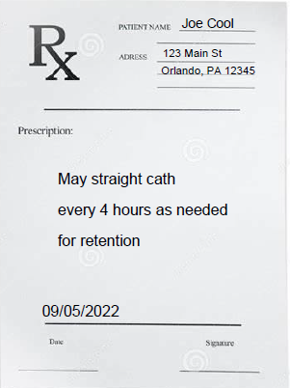
Prescription Example
Notes:
These are an example of a Prescription the student might receive from their doctor. The form on the previous slide and/or the prescription should be kept with the MPAF for verification.

Slide 12
Service Provider Logs
Each service should have a log that is used to document the service that was provided
There are log templates approved by DHS for each service area on their website. LEAs can create their own logs. The LEA logs must include all of the components listed in the self-designed logs:
  Name
  DOB
  School
  Diagnosis/Symptoms
  Service Start Time
  Service Stop Time
  PA Secure ID
  Date
  Signature and Title of the provider
  Signature of the Supervisor (if applicable)
  Treatment and Progress Indicator keys
  Service Type “(including delivery method-whether telemedicine or in-person) and Description of Service”
Notes:
The Service Provider logs are an essential component of the SBAP program. Documentation of a performed service is needed to verify that a service was provided. DHS has updated their logs and you can find them on the SBAP page on the DHS website. LEAs are encouraged to use these logs, but it is ok if they create their own. Just make sure that all of the components listed are included. This is not something new. This has been brought up at previous trainings and is found in the handbook. Unfortunately if the LEA fails to save all the necessary documentation and they are audited, any claims without appropriate documentation will be denied.

Slide 13
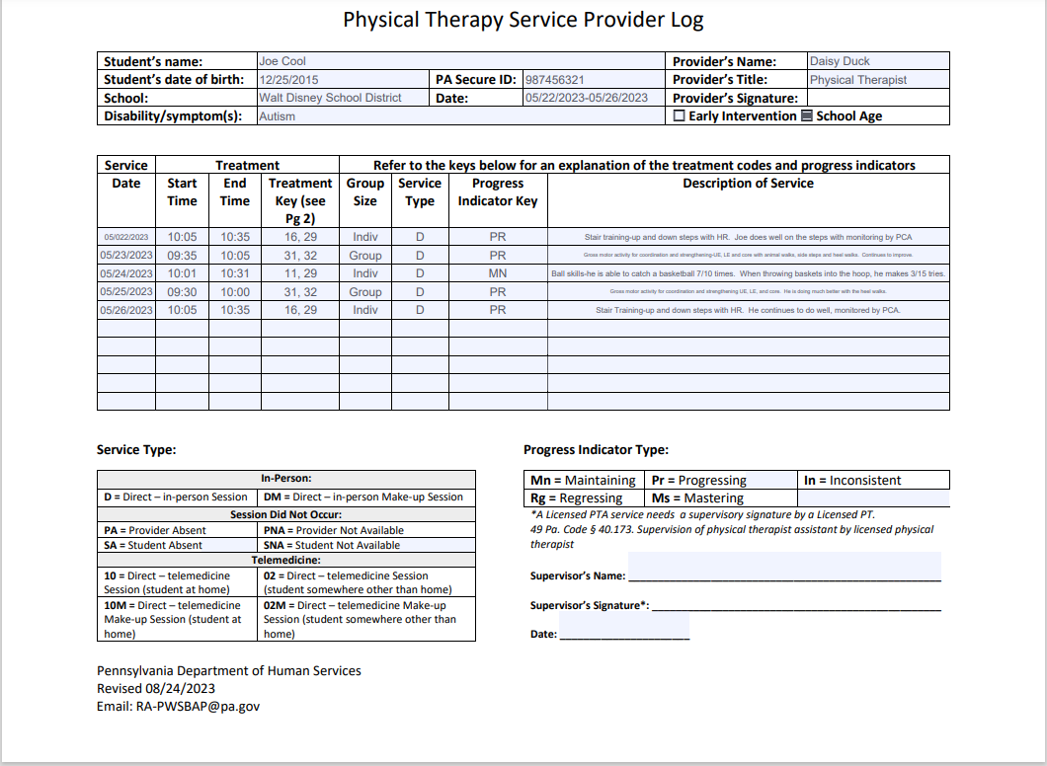
Service Provider Logs (Cont.)
Notes:
The Service provider logs must indicate whether the service type is Direct: In Person or Direct: Telemedicine when documenting the service and how it was provided. The service provider logs are daily progress notes and they should provide a complete picture of what the direct service provider did with the student, how the student is doing, any adjustments that might be needed, and the continued need for services supporting medical necessity.
The logs are required to contain Exact start and stop times, rounding off or rounding up of service minutes is prohibited. That means I should expect to see times such as ‘9:02-9:17’ and not always ‘9:00-9:15’. Most SBAP services are based upon a 15-minute billing unit. The only exceptions to the 15-minute billing unit would be evaluations, medication administration and transportation services.
Service minutes may accumulate on a date of service if the same service is being provided to the same student.

Slide 14
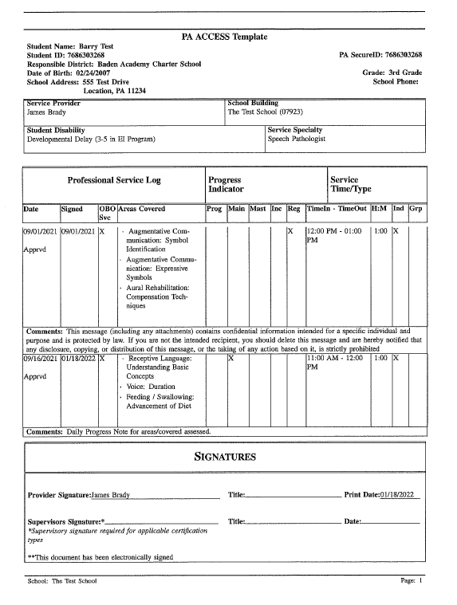
Service Provider Logs (Cont.)
Notes:
One thing I would like to point out, is that if the Access Coordinator is entering logs into the claiming site “on behalf of”, let’s say for example the PT, if in the comment section of the log they put “See daily log”, then if records are requested for an audit, those original logs would need to be sent with the records. Reminder, if the log starts out as a paper log, that is not considered an electronic document and the hard copy original logs must be maintained. Those would need to be sent during an audit.

Slide 15
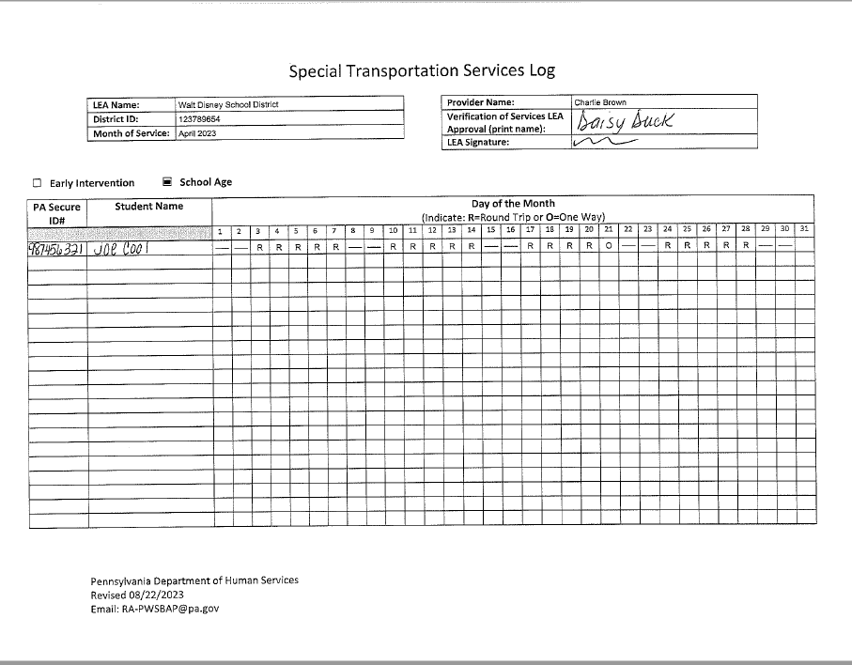
Special Transportation Logs
Notes:
This is an example of the Special Transportation log that was approved for use by DHS. Please encourage the bus drivers to at least put their name on or sign the document, and make sure the correct month and year are on the log. There are also blocks for the LEA name and signature for approval. If being reviewed by the LEA, (which I hope they are) it would be good practice if they signed it as well. As another reminder, the daily logs and the special transportation logs can be captured for FY2014-2015 through FY2022-2023 by using the download instructions that the LEAs should have received September 5th.

Slide 16
Credentials
Service Providers requiring PA State Licensure Only
Audiology Services
Nursing/Nurse Practitioner Services
*Occupational Therapy Services
*Physical Therapy Services
Physician Services
Psychiatric Services
Social Work and Counseling Services
Notes:
Credentialing is a very important part of the SBAP program. Any provider should have the proper credentials and they must be current. A good practice would be to scan the credential into a folder whenever it is received so that in the event of an audit, all that would need to be done is to make a copy of the credential showing it was valid during the review period. The next 3 slides are designed to help distinguish those services that require a PA State License, those that require a PA State License OR another form of credential and those that require other credentials. This slide lists those services that require a PA State license only. Those services that you see with an asterisk allow assistants and must have a supervisory signatures on their logs. More detailed credentialing information for each service type can be found in section 3 of the SBAP handbook.

Slide 17
Credentials (Cont.)
Service Providers that require PA State Licensure OR Other Credential
Psychological Services – PDE-Certifications are acceptable credentials as well as Department of State licensure.
Speech/Language Services – ASHA CCC's Certifications are acceptable credentials as well as Department of State licensure.
Notes:
The service providers on this slide require either a PA State License OR for Psychological services a PDE certificate, and for Speech and Language services their ASHA 3 C’s certification.

Slide 18
Credentials (Cont.)
Service Providers that require Other Credentials
*Personal Care Services – First Aid AND CPR Certifications
High School Diploma or GED
Hearing Impaired Services – Certificate issued by the Council on Education of the Deaf (CED) OR a Master’s degree, from an accredited college or university, with a major in teaching of the hearing-impaired or in a related field with comparable course work and training.
Orientation, Mobility and Vision Services - Orientation and Mobility Specialist certified by the Academy for the Certification of Vision Rehabilitation and Education Professionals (ACVREP) or the National Blindness Professional Certification Board (NBPCB).
Notes:
The providers on this slide require other credentials. Please note that PCA’s need Both First Aid and CPR Certifications. The certificate should reflect certification in both areas.

Slide 19
Other records to maintain
Attendance records
  Student
  Provider
Evaluations
Notes:
Attendance records are important for verifying the student or provider were indeed present the day the claim is submitted for. I have had a few instances where the student or provider were absent, but a claim was submitted.
Evaluations are important to maintain because they show the need for the specific services to be provided. This includes assessments and any testing performed to evaluate IEP needs and/or that lead to the creation of the IEP.

Slide 20
Downloading PCG Data by September 30, 2023
Downloading PCG Data
Notes:
Downloading PCG Data

Slide 21
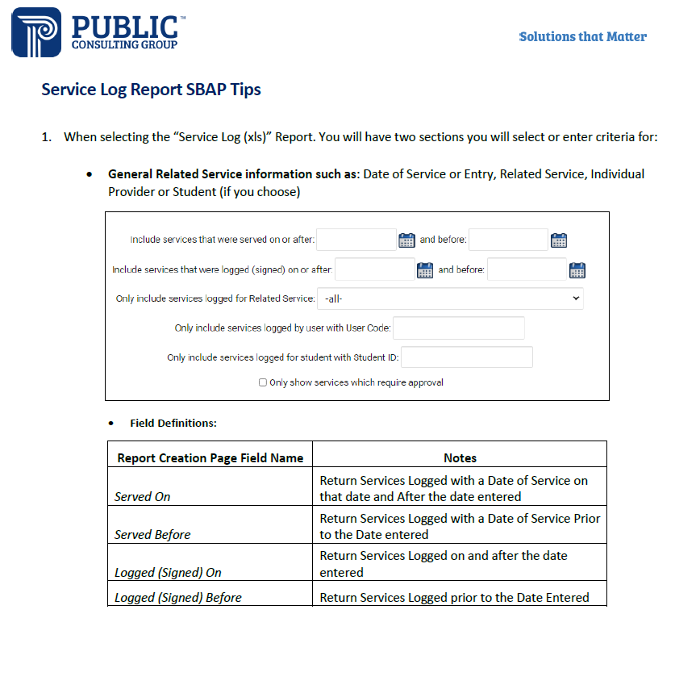
Downloading PCG Data by September 30, 2023
Notes:
On September 5th, 2023, DHS shared instructions for downloading two important reports from PCG’s systems: the Service Log Report and the Standard Service Log Report.

Slide 22
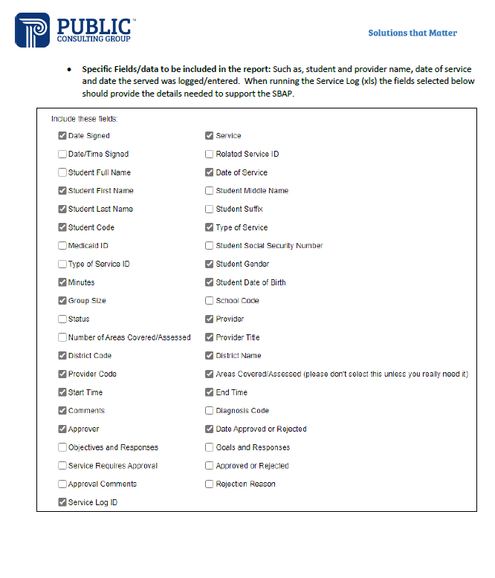
Downloading PCG Data (Cont.)
Notes:
These two reports, when used together, will provide all of the data that was included on the logs.

Slide 23
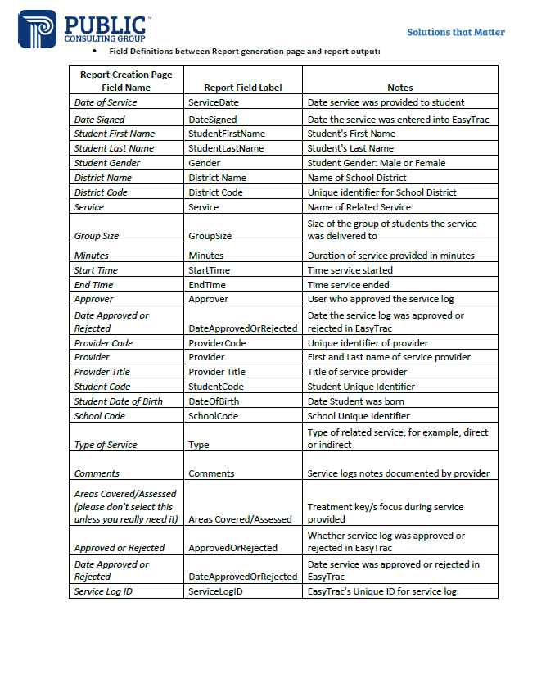
Downloading PCG Data (Cont.)
Notes:
In the case of future audits, these reports can be used in conjunction with additional documents (such as the IEPs, MPAFs and doctor’s orders we have covered).

Slide 24
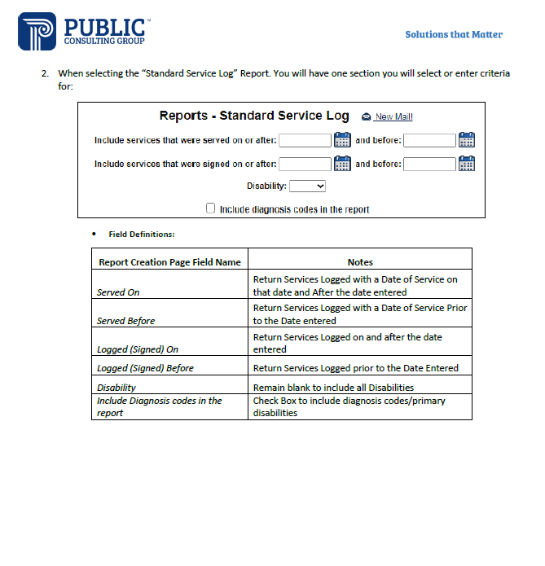
Downloading PCG Data (Cont.)
Notes:
DHS highly recommends downloading these two reports going back through at least 2018-2019, but preferably through 2014-2015 if you are able to before the September 30th deadline.

Slide 25
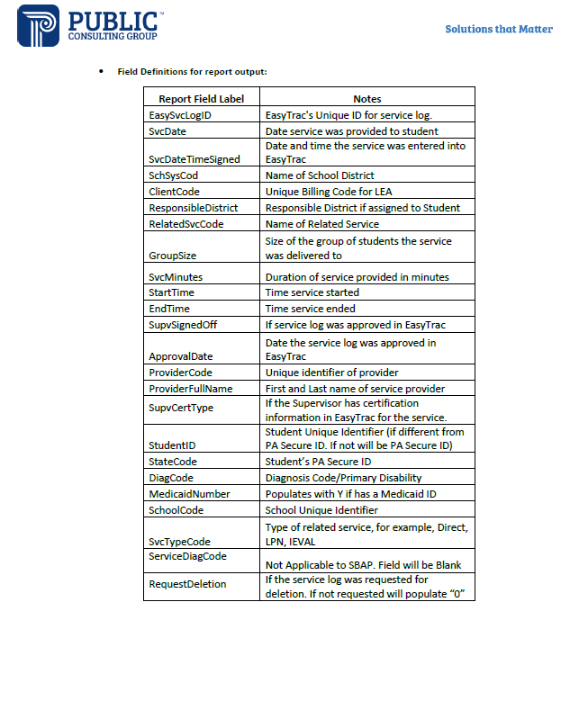
Downloading PCG Data (Cont.)

Slide 26
Downloading PCG Data (Cont.)
Any questions you have about system support for PCG systems and downloads should be directed to the PCG Help Desk at SBAPsupport@pcgus.com
or (866) 912-2976.
Notes:
If you have any questions regarding system support for PCG systems or downloading the information, please direct them to the PCG Help desk.

Slide 27
Common BPI Audit Findings
Common BPI Audit Findings
Notes:
At this time I would like to review some common BPI audit findings that continue to be found during audits.

Slide 28
Common BPI Audit Findings
Group vs Individual
More units billed than authorized
MPAF Errors
IEP and MPAF do not match
IEP and/or MPAF do not list duration
Notes:
Group vs Individual, More Units billed than authorized, MPAF errors, IEP and MPAF do not match, IEP and or MPAF do not list duration

Slide 29
Common BPI Audit Findings (Cont.)
Group or Individual Not Specified in the IEP and/or MPAF
Group vs Individual sessions on IEPs and MPAF/order/prescription should be listed as follows:
  LEAs should be writing for what is medically necessary for the student. If the student requires only individual, then that is what should appear on the IEP and MPA/order/prescription (Example- Speech therapy individual 30 min 3x per week).
  If the student requires group only, then that is what should be placed in the IEP and on the MPAF/order/prescription (Example- OT group 30 min 2x/week).
  If the student requires a combination, then we would expect to see both on the IEP and the MPAF/order/prescription (Examples- OT individual 30 min 2x per week, OT group 30 min 4x per year).
Notes:
If it is not specified in the IEP or the MPAF whether the service is to be group or individual, then the services will be denied, so it is very important to make sure it is specified. That is what should be reflected in the IEP/MPAF.

Slide 30
Common BPI Audit Findings (Cont.)
Order is for individual, but billed as group or Order is for group, but billed as Individual
Individual and/or group must be clearly identified on both the MPAF and the IEP with the frequency and duration specified for each type of session and should be billed as such
Do NOT bill for a service if you are providing the service as an incidental group or individual service that is not recommended in the IEP and authorized/prescribed by the MPAF
If Group therapy has been ordered for the student and everyone is absent except for that student, then unless the student has an order for individual therapy, the choice would be to reschedule the group session for later that week or provide a make-up session (be sure it is documented as a make-up session).
This is addressed in the SBAP Handbook Section 4.3
Documenting Individual and Group Therapy
Notes:
The decisions regarding whether the student receives the services either individually or in a group are expected to be based on what is medically necessary for the child, and so therefore are not interchangeable. Those submitting claim data should be careful to avoid a costly mistake.
This slide also gives some examples pertaining to group vs individual sessions.
To be considered a group, 2 or more students must be present. If a student is ordered group therapy, but there is only 1 student present, that session could not be billed as a group session. It would be billed as individual, BUT, if the IEP does not have an authorization for individual therapy, you CAN NOT bill MA. You may reschedule or provide a make-up session (be sure to document it as a make-up session).
The same applies for Telemedicine: If the IEP and MPAF authorize group therapy and you are providing 1 to 1 therapy via Zoom because only 1 student was available, you should not be billing MA for that service if the student does not have an order for individual services.
.

Slide 31
Common BPI Audit Findings (Cont.)
Billing for more units than authorized
Units of service billed must be equal to or less than the units of service authorized on the MPAF
You are highly encouraged to verify through the self-audit process that the duration and frequency of the services billed are equal to or less than the duration and frequency recommended in the IEP and authorized on the MPAF
Notes:
Units of service must be equal to or less than the units of service that are authorized on the MPAF. If the MPAF has authorized a service for 30 minutes, but the therapist meets with the student for 45 minutes because they feel the child would benefit from the extra time, that is certainly fine, but the therapist is unable to bill for those extra 15 minutes.
There are no edits in place within the system to stop you from claiming that extra unit. This is one of those instances where performing a self-audit would be beneficial.

Slide 32
Common BPI Audit Findings (Cont.)
MPAF Errors
MPAF was not signed by the MD before services were billed
    The MPAF is essentially the doctor’s order, and the date that the MD signs the MPAF is the date that services may be billed.
    Services that are provided to students prior to the date the MPAF is signed and dated are NOT compensable.
MPAF MD/CRNP signature/licensing info/date is not legible
    These are important areas. If the name and licensing information are not legible, it is difficult to verify credentials. If the date the MD/CRNP is signing the MPAF is not legible, then services could be denied
Notes:
The errors on this slide pertain specifically to the MPAF which have been found during record reviews. These are very important issues that could lead to the denial of all claims for the particular student if the MPAF is not correct, which could be a very costly error.
Providing services prior to the date the doctor signs the MPAF is considered providing services without a doctor’s order and that is a violation of MA regulations.
Any entries to the record should be legible. If you can’t read them, then chances are the person auditing the record will not be able to read them either.

Slide 33
Common BPI Audit Findings (Cont.)
The IEP and the MPAF do not match
The IEP and MPAF should mirror each other.
Example #1:
  The IEP reads: Physical therapy-Individual-2-30-minute sessions per week
  The MPAF reads: Physical therapy-30 minutes 2x/per week-Individual
Even though the wording is not exactly the same, the recommendation and the order are the same. This is acceptable from an audit standpoint.
Example #2:
  The IEP reads: Speech/Language Therapy-group-120 minutes/month
  The MPAF reads: Speech/Language Therapy- Up to 120 minutes per month-group
These 2 statements are not alike, so the claims would be denied.
Notes:
Ideally, the IEP and MPAF should contain the same wording.
Example #1 might not be the exact same wording, but they both mean the student will receive PT for 30 minutes 2 times per week.
Example #2 shows 2 totally different statements, therefore any of those claims would be denied.
If the service is truly medically needed, then the orders should reflect that. Also, when reviewing the IEP and writing those orders onto the MPAF they should be written exactly as they are written in the IEP. Avoid the use of the words “Up to”, especially in services such as OT, PT, and Speech to name a few. Their use should be reserved for special circumstances, such as instances when it is difficult to gauge how long a service must be provided.

Slide 34
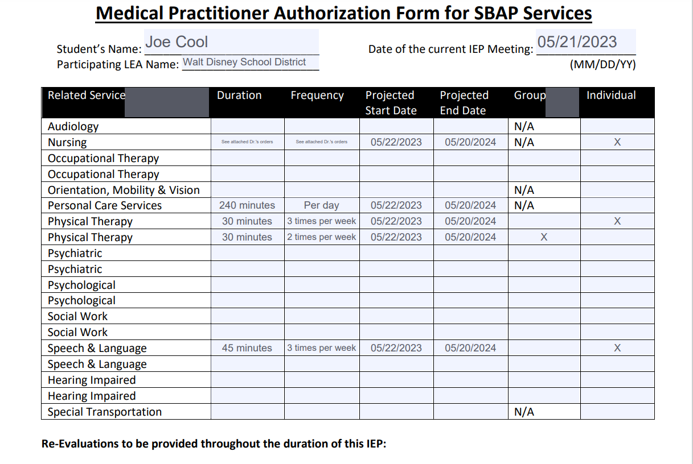
Common BPI Audit Findings (Cont.)
The IEP and/or the MPAF do not list duration
Notes:
Duration and Frequency are needed components for the IEP and MPAF. Duration tells how long the session should be; 30 minutes, 2 hours?
Frequency tells how often the service will be conducted; per day, 3 times per week? Do not confuse the Projected start and end dates as the duration. Too often I see frequency listed but no duration.

Slide 35
Resources
SBAP Handbook
https://dhs.pa.gov/providers/Documents/School-Based%20Access%20Program/SBAP-2022_Handbook.pdf
SBAP Resource Account
RA-PWSBAP@pa.gov
Verification of State Licenses
BPOA-Pennsylvania Licensing System (PALS)
https://www.pals.pa.gov
Pennsylvania Department of Education website for PDE certificate verification
https://www.education.pa.gov/ Educators/Certification/Pages/TIMS.aspx
American Speech-Language-Hearing Association website
https://www.asha.org
Notes:
The SBAP handbook is a great resource. Reach out to the resource account with any questions you have. I have included a few other resources as well on this page and the next.

Slide 36
Resources (Cont.)
  Orientation, Mobility and Vision Services – Credential verification
  Academy for Certification of Vision Rehabilitation & Education Professionals-ACVREP
  https://www.acvrep.org/
  National Blindness Professional Certification Board
  https://www.nbpcb.org

Slide 37
A Few Things To Remember
  Reduce Risks with Preparation
    Stay up to date with changes to rules and regulations
    Train all staff for compliance
    Take advantage of training opportunities (vendors, annual training, SBAP, etc.)
    Regularly conduct self-audits
    Reach out to BPI with any questions
Notes:
You can reduce the risk of mistakes by being prepared. Be sure to stay up to date with changes to the program and any changes to the rules and regulations that govern the program. Train your staff to maintain compliance. Be sure to take advantage of any and all training opportunities and encourage your staff to do this as well. Routinely conducting self-audits is a great idea. And finally, reach out to BPI with any compliance questions.

Slide 38
Presenter Contact Information
Debra J. Buffington, RN
Bureau of Program Integrity
(717) 772-4631
debuffingt@pa.gov
Notes:
Thank you for taking the time to watch my presentation and for your commitment to ensuring that your district is in compliance with the rules and regulations that govern the School –Based ACCESS Program.

