Slide 1
Welcome to today’s webinar:
Indicator 13:
What LEAs Need to Know for CMCI
Handouts for the presentation:
Power Point
File Review Guide
Indicator 13 Checklist
Please have on hand:
Student IEP with invitation (from your LEA)
Notes:
Hello and Welcome to today’s webinar, “Indicator 13: What LEAs Need to Know for CMCI
My name is Hillary Mangis and I work with the Pennsylvania Training and Technical Assistance Network on the secondary transition initiative. Also presenting today are Ryan Romanoski from our Harrisburg office in the Central Region, and Kim Cole from our office in the Eastern Region.
Participants on this call should be representatives from those LEAs who will be participating in cyclical monitoring for continuous improvement as identified on the July 5, 2019 Penn Link.

Slide 2
Indicator 13: What LEAs Need to Know for Cyclical Monitoring for Continuous Improvement (CMCI)
September 13, 2019
9:00 AM – 11:00 PM

Slide 3
How to Zoom!
Using your Zoom link, click join via computer
If you have trouble hearing, dial teleconferencing number and enter the meeting ID
Use these controls to mute/unmute, chat or share.

Slide 4
PaTTAN’s Mission
The mission of the Pennsylvania Training and Technical Assistance Network (PaTTAN) is to support the efforts and initiatives of the Bureau of Special Education, and to build the capacity of local educational agencies to serve students who receive special education services.

Slide 5
PDE’s Commitment to Least Restrictive Environment (LRE)
Our goal for each child is to ensure Individualized Education Program (IEP) teams begin with the general education setting with the use of Supplementary Aids and Services before considering a more restrictive environment.

Slide 6
Today’s Agenda
Part I: Regulatory Requirements
Transition Background
State Performance Plan and Transition Related Indicators
Part II: Cyclical Monitoring File Review Questions
Suggestions
School District Reflection
Notes:
Acknowledge new web site and issues with registration.

Slide 7
What are the Secondary Transition Regulatory Requirements for Students with Disabilities?

Slide 8
Individuals with Disabilities Education Act IDEA 2004
To ensure that all children with disabilities have available to them a free appropriate public education that emphasizes special education and related services designed to meet their unique needs and prepare them for further education, employment, and independent living H.R.1350
(IDEA 2004)
Notes:
IDEA require Secondary Transition Services for students who have disabilities. §300.320(7) (b)Transition Services
Have participants read silently.
Federally, The Individuals with Disabilities Education Act, (IDEA) reauthorized in 2004, states that children with disabilities have the right to services to prepare them for post secondary education, employment and independent living.

Slide 9
What is Secondary Transition?
“a coordinated set of activities for a child with a disability that is designed within a result-oriented process, that is focused on improving the academic and functional achievement of the child with a disability to facilitate the child’s movement from school to post-school activities, including post-secondary education, vocational education, integrated employment (including supported employment), continuing and adult education, adult services, independent living, or community participation.”
IDEA §300.43
Notes:
Chapter 14 of the PA State Code, (Special Education Services and Programs) only varies from the federal regulations in one area: age. In pa Sec Transition must begin at age 14, not like the federal age of 16.
Process of preparing students for life after they leave high school, including participation in post-secondary education or training, employment, and community living.

Slide 10
Age Requirement in PA
Transition services must be addressed in the IEP of the student in the year in which the student turns 14 years of age
The IEP team does not have to wait until the student’s approaching 14th birthday year to consider the student’s transition needs
Pennsylvania Chapter 14 Regulations July, 2008
Notes:
10
With regard to transition, Chapter 14 (PA Special Ed Code) only varies from the federal regulations in one area: age. In pa Sec Transition must begin at age 14, not like the federal age of 16.
Process of preparing students for life after they leave high school, including participation in post-secondary education or training, employment, and community living.
10

Slide 11
So What is Indicator 13?
Notes:
"Percent of youth with IEPs aged 16 and above with an IEP that includes appropriate measurable postsecondary goals that are annually updated and based upon an age appropriate transition assessment, transition services, including courses of study, that will reasonably enable the student to meet those postsecondary goals, and annual IEP goals related to the student's transition services needs. There also must be evidence that the student was invited to the IEP Team meeting where transition services are to be discussed and evidence that, if appropriate, a representative of any participating agency was invited to the IEP Team meeting with the prior consent of the parent or student who has reached the age of majority." (20 U.S.C. 1416(a)(3)(B))

Slide 12
State Performance Plan (SPP/APR)
Required for each State
Evaluates the State’s efforts to implement the requirements and purposes of IDEA
Describe how the State will improve IDEA implementation
6- Year Plan
17 Indicators related to the 3 priorities
Annual Performance Report (APR) for State and each LEA
Notes:
The Individuals with Disabilities Education Act (IDEA 2004) included many provisions designed to improve the education of students with disabilities. The framework that many states are using to make improvements is the State Performance Plan (SPP)/Annual Performance Report (APR). Under IDEA 2004, all states are required to submit an SPP/APR to the U.S. Department of Education, Office of Special Education Programs (OSEP). It is built around 17 federally required indicators of compliance and performance. States set measurable and rigorous targets for each year of the SPP/APR, and implement effective improvement strategies to reach the targets. States must report annually on their performance in meeting the targets. They must also report to the public on the performance of all local education agencies (school districts, charter schools, and preschool programs) on these targets. The indicators were set by OSEP, but each state sets its own targets. Stakeholders are actively involved in setting targets and in determining whether the targets continue to be appropriate.
So as was mentioned, Indicator 13 is related to the state’s performance plan which is a requirement of the federal government through the Office of Special Education Programs (aka OSEP).

Slide 13
Graduation
Drop-Out
Participation and performance on statewide assessments
Suspension and expulsion
LRE school age students (6-21)
LRE Preschool Early Intervention (3-5)
Preschool Child Outcomes
Parent involvement
Disproportionality by race/ethnicity
Disproportionality by race/ethnicity/disability
Evaluation timelines
Early Childhood Transition (3-5)
Transition goals (16-21)
Post-school outcomes
Mediation sessions
Resolution sessions
State Systemic Improvement Plan
Normal text – Indicator includes SA only data
Underlined – Indicator includes SA and PS data
Italics – Indicator includes PS only data
Notes:
Remember, as we have presented in each session, the State Performance Indicators as identified by the Office of Special Education Programs (OSEP). States are responsible for reporting their progress on meeting these targets. Again, these are the Indicators which focus on school age students and students with disabilities. The focus of our session today, is to address Indicator 13, which is all about ensuring appropriate and effective transition services for students with disabilities., As you can see, many of the state performance indicators are related to transition . We know that good secondary transition plans (indicator 13) lead to higher graduation and lower dropout rates, particularly when families are involved (indicator 8), which leads to better post school outcomes (Indicator 14).
Today we will talk about your LEAs obligation for collecting data for the state, which is reported to OSEP, on post school outcomes.

Slide 14
Every student by name regardless of background, condition or circumstance… Proficient in core subjects Graduates from high school, ready for post-secondary education and career Achieves high outcomes
Indicator 14:
Students achieving their post-secondary goals
Indicators 1, 2 and 17:
Students actively engaged, staying in school and graduating
Indicator 13
High quality IEPs designed to help students achieve their post-secondary goals
The foundation:
High quality, rigorous, standards-aligned secondary school programs for all students
Notes:
This slide shows the connection between the various indicators specifically related to secondary transition. And I ask that you look at these starting at the bottom and working your way up.
In general however, these four indicators should be looked at together when making informed decisions regarding secondary transition program successes and areas of need.
So we start with the foundation of high quality, rigorous, standards aligned secondary school programs for all students. Many of you are used to seeing a three tiered system for instruction or behavior. Well we also have one for transition and this is the tier 1, foundational pieces that we have in place for all students, not just students with disabilities. Indicator 13 is what looks specifically at high quality IEPs designed to help students achieve their post-school outcomes. And think about it, if these two things are in place within an LEA, we have a much better shot of ensuring our students do not drop out but rather they graduate from our schools (which are Indicators 1 and 2). And additionally, if our planning has been individualized and effective and intentional planning and preparation has been done, then our students have a better shot of being in the right place post high school and meeting their individualized post-school outcomes one year outside of high school.
And as we know, in Pennsylvania our expectation is that all students regardless of background, condition or circumstance are… Proficient in core subjects Graduate from high school, ready for post-secondary education and career Achieve high outcomes

Slide 15
BUT WE’VE HAD THIS TRAINING BEFORE… Target 100%
YEAR | SSP Indicator 13 Data
2009 | 76.10%
2010 | 81.40%
2011 | 86.60%
2012 | 83.20%
2013 | 73.16%
2014 | 84.19%
2015 | 83.07%
2016 | 84.32%
2017 | 82.18%
Notes:
So many of you participating in this training may have had a variant of this training one or more times in the past. This slide shows the statewide data that has been reported to OSEP with regards to indicator 13 compliance. As you can see, the target is 100%.
Now, some may see this data and wonder what affects the variance across years. Remember, this data coincides and is collected with the cohort of LEAs going through cycle monitoring for continuous improvement. Therefore cohorts are reported once every 6 years. So the group surveyed in 2009 is theoretically the same group reported in 2015. So there was cohort growth of 6.97%. However, different cohorts were assessed in 2010, 2011, 2012, 2013, and 2014.
But, no matter how you look at the data, the reality is, PA is not at 100% and we must continue our efforts to educate LEAs on the requirements.

Slide 16
Compliance Monitoring for Continuous Improvement (CMCI) File Review Questions Related to Secondary Transition

Slide 17
Compliance Related to Transition
Cyclical Monitoring File Review
10 files selected (exceptions: Philadelphia and Pittsburgh)
Includes: IEP, ER, RRs, Invitations, etc.
3 must be ages 16-21
1 student must be 14-15
1 student in an APS
340 education questions (related to all compliance areas of special)
File Review directly related to transition (added in 2015)
10 additional files (students age 14+)
10 questions related to transition

Slide 18
From a Transition Lens: File Review Questions
245- Transition Planning & Services (Parent Invited)
246/270 – Agency Invitation/Participation
247 – Student Invitation to IEP
264 – Documentation of student participation in IEP
268/269 - Documentation of CTE participation (when applicable)
288 – CTE program CIP Code (if applicable)
289 – Age Appropriate Assessment
290 – Post-Secondary Goals for:
Education/Training
Employment
Independent Living
291 – Post-Secondary Goals are updated annually
292 – Transition “Grid” Completed Correctly
292a – Courses of Study Completed Correctly
292b – Services/Activities are listed in the “Grid” in all 3 Areas
292c – Measureable Annual Goals Linked/Listed in “Grid”

Slide 19
Steps to Purposeful Secondary Transition Planning: IEP Process
Assess
Summarize
(PLAAFP)
Invite and Involve
Transition Plan
Measurable Annual Goals
Monitor Progress
IEP Process
Notes:
Many consider the IEP to be only a document – IDEA sees it as a process. This graphic will lead us through the process as we discuss the process of secondary transition.

Slide 20
Step One
Use assessment to identify the student’s post- secondary desired goals or vision
Assess
Summarize
(PLAAFP)
Invite and Involve
Transition Plan
Measurable Annual Goals
Monitor Progress
Notes:
Assess the student in order to identify his/her post-secondary desired goals or vision, and to determine their skills, aptitudes, and abilities related to the post secondary goals.

Slide 21
Indicator 13 Checklist and CMCI Review Questions
File Review: Question #289
Evidence that the measurable post-secondary goals(s) were based on age appropriate transition assessment
File Review: Question #288
If the student’s IEP required participation in CTE program, was the CIP code completed?
Indicator 13 Checklist: Question #3
Is there evidence that the measurable post-secondary goals(s) were based on age appropriate transition assessment?
Notes:
The slides in the presentation like this are a side by side of CMCI file review questions and the corresponding item on the indicator 13 checklist.

Slide 22
Assessment
PLAAFP & Post Secondary Goals
Interests, Preferences, Skills, Aptitudes
Academic Achievement
Functional Performance

Slide 23
What is the purpose of transition assessment?
Ultimately –
Assessment helps to formulate appropriate postsecondary goals and plans to reach those goals
Notes:
Transition assessment helps them answer questions, such as the following: • Who am I? • What are my unique talents and interests? • What do I want in life, now and in the future? • What are some of life’s demands that I can meet now? • What are the main barriers to getting what I want from school and my community? • What are my options in the school and community for preparing me for what I want, now and in the future? (National Secondary Transition Technical Assistance Center, 2010)

Slide 24
Assessment
Transition
Planning
College and/or Career
You are here
PLAAFP Post-Secondary Goals
Notes:
Proper assessment will inform where the student currently is (PLAAFP) and where the student wants to go. The transition plan lays out what needs to happen to get the student to his or her Post-Secondary Goal.

Slide 25
Assessment
How do you currently assess
Interests, preferences, skills, abilities, and aptitudes?
Academic achievement?
Functional Performance?

Slide 26
Assessment: Interests, Preferences, Skills, Aptitudes
PLAAFP & Post Secondary Goals
Interests, Preferences, Skills, Aptitudes
Academic Achievement
Functional Performance

Slide 27
Interests, Preferences, Skills and Aptitudes
Information from students | Information from parents and team members | Information from job sites
Formal assessments | Surveys, interviews, rating scales | Situational assessments
Interviews | Person-centered planning; FBA | Ecological assessment
Surveys | Formal planning tools | Employer observations
Web-based assessments |  | Job shadowing
Questionnaires |  | Volunteering opportunities
Direct observations
Transition checklists
Notes:
* Be sure to clarify that the FBA is considered for the information contained within the assessment, not necessarily considered to be an assessment of Interests, Preferences, Skills and Aptitudes

Slide 28
Assessing Interests Preferences Skills Aptitudes
www.pacareerzone.org
www.alife4me.org
Bridges Interest Inventory
O*NET Ability Profiler
Kuder General Interest Survey (KGIS)
Keys2Work
COIN Career Guidance System of Assessment
Casey’s Life Skills Inventory or Personal Preference Indicator
Learning Styles Inventory
Notes:
Pennsylvania Career Zone (pacareerzone.org)
Quick Assessment
Interest Profiler
Work Importance Profiler

Slide 29
Assessing Interests Preferences Skills Aptitudes
The Arc’s Self Determination Scale
Differential Aptitude Test
Transition Planning Inventory
Career and technical education assessments
Commercially prepared assessments of specific career-related aptitudes
Environmental Job Assessment (E-JAM)
Brigance Transition Skills Inventory
Notes:
29
Assessment of Aptitudes
Here are just some of the common aptitude assessments schools use. What is important to know in any of the assessments that we just saw is that you should not just have documentation of one assessment within an IEP. Again, various assessments should be done over a period of time in various settings for them to be able to assist in the planning process to the maximum extent possible.
Many more could be added by participants and could also be specified as Summative, Formative, Benchmark, Diagnostic
****Make use of assessments already given in general education or through guidance!

Slide 30
Assessment: Academic Achievement
PLAAFP & Post Secondary Goals
Interests, Preferences, Skills, Aptitudes
Academic Achievement
Functional Performance

Slide 31
Assessing Academic Achievement
Assessment
Summative
Formative
Diagnostic
Benchmark
Name a RELEVANT example that might be used to update PLAAFP
Notes:
Summative – assesses progress at the end of a period of instruction to determined what was learned
Formative – informal and formal assessments used to determine the direction of instruction – (i.e. review, reteach, extend, go on)
Diagnostic – used to determine areas of strength and weakness with regard to specific skills
Benchmark – Designed to provide feedback to both the teacher and the student about how the student is progressing towards demonstrating proficiency on grade level standards. Well-designed benchmark assessments and standards-based assessments measure the degree to which a student has mastered a given concept; measure concepts, skills, and/or applications; reported by referencing the standards, not other students’ performance; serve as a test to which teachers want to teach; and measure performance regularly, not only at a single moment in time.
ASK – WRITE AT LEAST ONE EXAMPLE OF AN ASSESSMENT THAT YOU GIVE FOR EACH OF THE TYPES LISTED. IS THIS INFORMATION INCLUDED IN THE PLAAFP FOR THE STUDENTS’ IEPS?

Slide 32
Assessing Academic Achievement
Reading
Written Expression
Instruction and Progress Monitoring
Mathematics
Measurable Annual Goal
Baseline Data
Notes:
There are three general areas that students might have a disability - reading, written expression, and mathematics. Students might have a speech and language disability and that information is generally assessed by an SLP. Students don’t have a science disability or a social studies disability. Their disability in one of the aforementioned areas can affect their performance in science or social studies and if relevant that can be addressed in the PLAAFP. However, these are the areas
Academic assessments in reading, written expression, and/or mathematics will provide baseline data that will be used to determine measurable annual goals. That is, academic assessment lets us know what the student’s current levels are and we can then project to where the student will

Slide 33
Academic Achievement
Math, Reading, Written Expression
Current Assessment results with interpretation
PSSA or Keystone scores
Formative Assessments
Diagnostic Assessments
Curriculum based assessments
CDT data over time
Input from the teacher
Notes:
All assessment results need interpretation.
Input from the teacher should be regarding skill strengths and deficits. May include class participation, organizational skill, ability to contribute to group work, etc.
Include specially designed instruction that is EFFECTIVE for the student.

Slide 34
Academic Achievement
Math, Reading, Written Expression
Review of general and specific deficit as a result of assessment findings
Gap (in terms of Standards) between where student is and grade level
Review of current related goals
Summarize progress monitoring data
Status of the goal
If no deficit in the area and describe input from general education teacher(s) and include data

Slide 35
Academic Achievement
Please don’t forget to consider….each and every year….
Assistive Technology
Accessible Instructional Materials (on the PaTTAN site)
Specially Designed Instruction that works or does not work for this student
Notes:
At needs to be considered each year for every student. When looking at a ST student, consider the future environment in which this student will be….college, employment, home, community. You may be able to understand the writing or speech of a student or may be able to anticipate a need before it is spoken but will the same happen in the next setting? If a student struggles to read but understands when read to…do something about that.. Bookshare. If a student can dictate but has trouble putting pen to paper, do something about that. If there is a list of SDI that is a mile long but none of it has been used on the last 5 years…do something about that!

Slide 36
Assessment: Functional Performance
PLAAFP & Post Secondary Goals
Interests, Preferences, Skills, Aptitudes
Academic Achievement
Functional Performance

Slide 37
Assessing Functional Performance
Behavior
OT/PT
Activities of Daily Living
Social Skills
Self-Advocacy
Consumer Skills
Instruction and Progress Monitoring
Measurable Annual Goal
Baseline Data
Notes:
Functional performance is related to activities of daily living, such as hygiene, dressing, basic consumer skills, community-based instruction, etc. Functional performance may also be defined as the ability to access public transportation, social/emotional learning skills or behavioral difficulties, and the consideration of personal safety and socially appropriate behavior.
When functional performance needs are identified through assessment, we need baseline data in order to develop goals for a level of performance that we want the student to reach within the year of the IEP as a result of instruction and monitoring the progress toward the goal. Adjustments to instruction are made when the data indicates that the student is not making adequate progress toward the goal.

Slide 38
Functional Performance
Include FBA information (if applicable)
Executive Functioning skills
Organization
Time management
Planning
Metacognition
Regulation
Social awareness
Sustained attention
Notes:
This section includes information regarding classroom performance and the results of any functional
assessments that have been administered. Include current functional levels and strengths and needs that may be developmental. Functional
performance is related to activities of daily living, such as hygiene, dressing, basic consumer skills, community-based instruction, etc. Functional
performance may also be defined as the ability to access public transportation, social/emotional learning skills or behavioral difficulties, and the
consideration of personal safety and socially appropriate behavior.
If applicable, the information from a functional behavioral assessment should be included in this section. Information included in this section should
include performance data and current skill levels, not just a description of academic and behavioral deficits. Information included here does not have to
be indicative of a deficit. For example, the IEP team could write, “the student’s functional performance in all areas is age appropriate”.

Slide 39
Functional Performance
Activities of Daily Living
Consumer Skills
OT/PT assessments
Personal Safety
Accessing Public Transportation
Recreation
Community Involvement
DATA DRIVEN

Slide 40
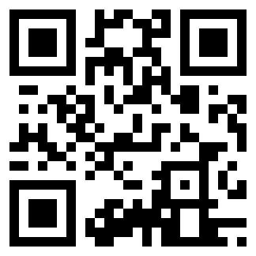
Interpreting Data-Making Sense of it!
What needs to happen for the symbols to be useful to you or me?
Notes:
For either of these to be useful, they must be interpreted by a reader and translated into something meaningful for the user. A QR code is only useful when a QR reader interprets the code. A barcode is only useful when the scanner interprets the code and translates it into a price.
The same is true of assessment data. Having a stanine score of x on any particular assessment is not useful information if one doesn’t translate that into something meaningful. Even a PSAT score or an SAT score alone isn’t meaningful unless there is some context.

Slide 41
Interpreting Data-Making Sense of it!
Think about how the data answers the questions you are trying to answer:
Strengths
Needs
Interests/Preferences
Look for similarities, differences, and patterns
How does the data you collected relate to the students long term goals?
Notes:
The process of interpreting data really means thinking about what it is that you want to know about the student. The assessments that you give, should be selected with

Slide 42
Interpreting Data-Making Sense of it!
No matter how assessment data is obtained…
Formal
Informal
Observational
Team-based
Interpret data in the present levels of the IEP
Make sure to include all baseline data.
Notes:
Parent and student information should be considered in the present levels of the IEP

Slide 43
Analysis -Things to consider!
Does the student possess the skills needed to pursue coursework, co-curricular, and extracurricular activities that match their interests and preferences?
Are there career-related experiences or activities, or instruction needed to help the student acquire the skills needed?
Does the goal need to be modified?
Notes:
This process of collecting and analyzing data continues over the course of the transition planning years until desirable, realistic visions for post-school lives are in harmony with students‘ interests, preferences, and strengths. Students’ visions for their lives can change with time and experience. IEP teams can strategically identify needs to be addressed as they create coordinated sets of transition activities that move students toward their goals. Needs identified in the PLoP drive the remaining components of the transition IEP: transition services, including courses of study and transition activities, annual goals, related services, and supplementary aids and services.

Slide 44
Step 2
Describe the student’s Present Levels of Academic Achievement / Functional Performance (PLAAFP)
(incorporating Assessment data)
Assess
Summarize
(PLAAFP)
Invite and Involve
Transition Plan
Measurable Annual Goals
Monitor Progress
Notes:
44

Slide 45
Present Levels
Academic skills
Functional skills
Skills related to post-secondary transition
Parent Input
How disability impacts involvement in general education curriculum
NEEDS
STRENGTHS
Notes:
By the time we get to STRENGTHS AND NEEDS, there should be no surprises! The information should be presented in the earlier sections and there should be NO NEW INFORMATION under strengths and needs.

Slide 46
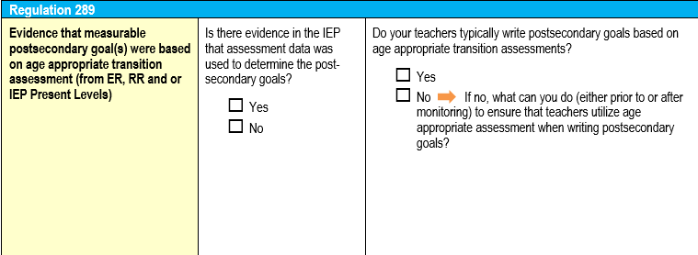
Let’s Reflect

Slide 47
Step 3
Student Invitation, Parental Consent and
Agency Involvement
Assess
Summarize
(PLAAFP)
Invite and Involve
Transition Plan
Measurable Annual Goals
Monitor Progress
Notes:
Step three in the transition planning process is to ensure that the student is invited to their IEP meeting, if they are or will be turning age 14 (or older)in the duration of the annual IEP.
Parents must consent to outside agencies attending the IEP meeting. By filling out the IEP, and checking the box that states “Transition Services” you are asking the parent if necessary, and with their consent, staff from other public agencies who may be providing or paying for transition services to be invited to IEP team meeting.
Then, in the graph below, representative(s) from the agency or agencies are listed. This is determined by the parent and LEA as needed for transition services and other community services.
47

Slide 48
Indicator 13 Checklist and CMCI Review Questions
File Review: Question #246
Indicator 13 Checklist: Question #2
Transition Planning and Services: If appropriate, evidence that a representative of any participating agency was invited to the IEP team meeting with the prior consent of the parent or student (if agency is not providing the services or paying for the services indicate N/A)
If appropriate, is there evidence that a representative of any participating agency was invited to the IEP Team meeting, with prior consent of the parent or student if age of majority reached?

Slide 49
Indicator 13 Checklist and CMCI Review Questions
File Review: Question #247
Indicator 13 Checklist: Question #1
Transition Planning and Services: Transition planning is checked (age 14 or younger if deemed appropriate), STUDENT IS LISTED ON INVITATION
Is there evidence that the student was invited to the IEP meeting?
File Review: Question #245
Transition Planning and Services: Invitation to parents is checked (age 14+ and younger if deemed appropriate)

Slide 50
Invitation to the IEP Meeting
The invitation must reflect that both the parent(s) and student are invited (for students of transition age)
Notes:
The invite will be included in the student’s file to indicate if the student was invited to the IEP meeting.

Slide 51
Invitation to the IEP Meeting
Notes:
A revision in May of 2015 removed the requirement to use two separate invitations to participate in the Individualized Education Program Team for transition planning/services. Beginning in June of 2015, LEA’s need to begin using this format.
You will see that there are boxes available to state the purpose of the IEP meeting you can check as many boxes that apply. If the student is 14 year or older, or the student is turning 14 with the duration of the IEP, you want to check the box that that states transition planning will be discussed. If you will be inviting outside agencies to the meeting, you will also want to check the box below it. And finally, you will need to include the student’s name listed under IEP team members invited to the meeting.
So again, there is now just one invitation letter to invite both the parents and the student to the meeting. However, the boxes that we just went over will need to be checked in order to be compliant.

Slide 52
Invitation t0 IEP meeting
How do I know when and whom to invite for a transition IEP?

Slide 53
When to Invite an Agency to an IEP Meeting
Invite agency:
If likely to provide or pay for transition services
Only with parent permission
Agency involvement is based on individual needs
Younger students’ involvement with outside agencies might be limited
Agency involvement may vary by region
Document agency involvement in present levels section of the IEP under secondary transition.
Putting “Agency Involvement” as a separate bullet in this section is helpful
Notes:
Permission for agencies who are likely to provide or pay for services
Inviting an agency for their expertise
One size does not fit all!!
OK to contact regional supervisor if agencies are not coming when they need to be present

Slide 54
Invitation to the IEP Meeting
Notes:
You will see that there are boxes available to state the purpose of the IEP meeting. And mind you, you can check as many boxes that apply. If the student is 14 year or older, or the student is turning 14 with the duration of the IEP, you want to check the box that that states transition planning will be discussed. If you will be inviting outside agencies to the meeting, you will also want to check the box below it. And finally, you will need to include the student’s name listed under IEP team members invited to the meeting.
So again, there is now just one invitation letter to invite both the parents and the student to the meeting. However, the boxes that we just went over will need to be checked in order to be compliant.

Slide 55
Best Practice/Evidence
Does the IEP (Present Levels) include information regarding agency involvement?
Representatives from agencies were invited with parent permission and it was documented in the IEP
OR
Parents refused consent to inviting outside agency personnel and it was documented in the IEP.
Parents were provided with information about agency involvement and it was documented in the IEP.

Slide 56
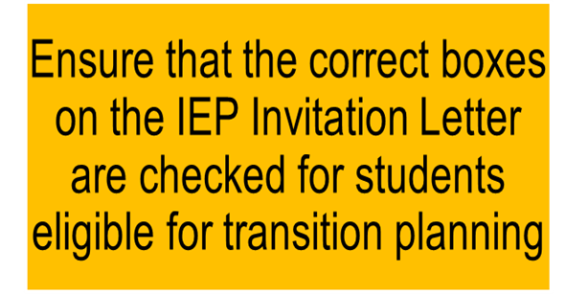
Invitation to the IEP Meeting
Notes:
The invite will be included in the student’s file to indicate if the student was invited to the IEP meeting.

Slide 57
Document agency involvement in present levels section of the IEP under secondary transition.
Putting “Agency Involvement” as a separate bullet in this section is helpful
Postsecondary Education and Training Goal:
Employment Goal:
Independent Living Goal, if appropriate:
Agency Involvement: (List any information regarding agency involvement, and the date and name of agency information given to the parent and guardian.
Notes:
It is recommended that agency involvement is listed in the transition section of the Present Education Levels, and is bulleted to draw attention to agency involvement as well as list the date and agency information that was gicven to the parent or guardians.

Slide 58
Documentation on IEP Team Participation by an Agency Representative
Attendance may include participation via telephone or videoconference. The IEP team may list the names of individuals who participate via telephone or videoconference (in the printed name column) and note how they participated
Written input from the agency team members should be included in the present education levels under secondary transition

Slide 59
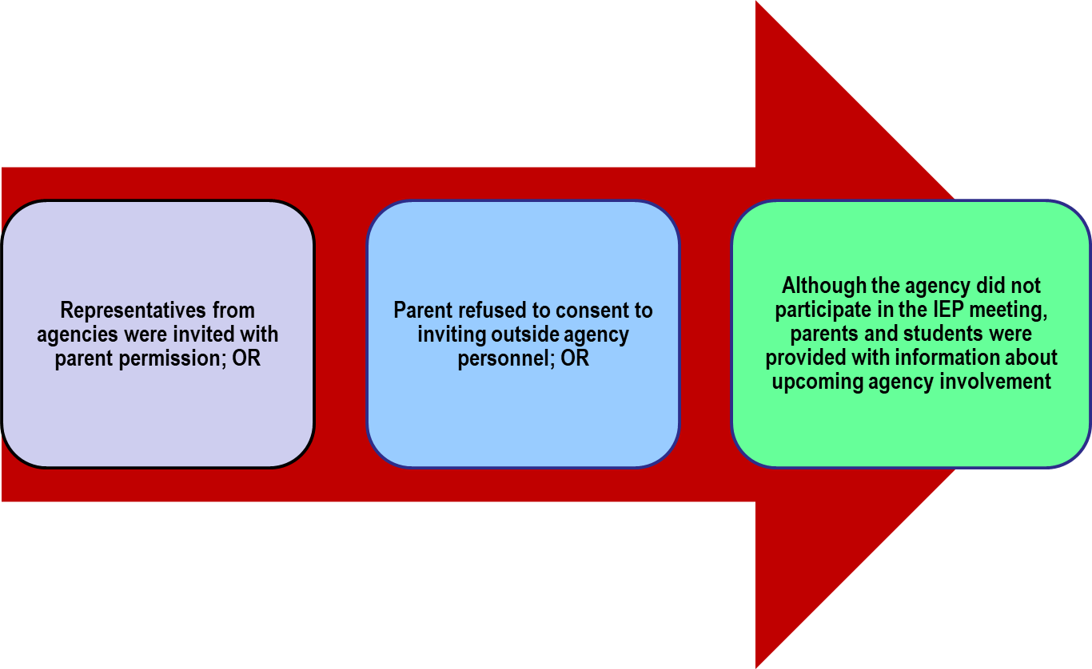
Sample IEP Statements
Notes:
Stress that there needs to always be a statement in present educational levels regarding agency involvement, even if the student is too young.

Slide 60
Sample Agency Statement
Bob and his family were provided with information regarding the supports provided through Allegheny River Intellectual Disability Services (ARID) and the Office of Vocational Rehabilitation (OVR). Bob met with a supports coordinator from ARID on May 3, 2017 and now has a current open case. Bob is scheduled for an intake with an OVR representative during the Fall of 2017. Both and OVR and ARID representatives were invited to his current IEP meeting.

Slide 61
Examples of Agencies
Office of Vocational Rehabilitation
County Mental Health
County Office of Developmental Programs /Intellectual Disabilities
Department of Human Services
Bureau of Autism Services
Blindness and Visual Services
Children and Youth Services
Juvenile Justice System
Social Security Administration
The ARC
Centers for Independent Living
Disability Specific Agencies
Notes:
The next two slides list examples of frequently referenced agencies that assist youth and their families with the secondary transition process.
There may be additional examples of agencies in your area.

Slide 62
IEP Team Participants for Transition Planning
Required Members
parents/guardians
local education agency representative (LEA)
general education teacher
special education teacher
career-technical education representative (if being considered)
Other Members
transition coordinator
school psychologist
guidance counselor
instructional support staff
job coach (if considered)
employer representative
community/agency representatives
relatives/friends/
advocate

Slide 63
Let’s Reflect

Slide 64
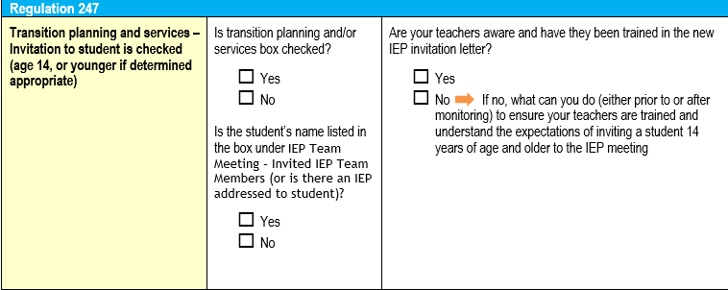
Let’s Reflect

Slide 65
Pause and Reflect: IEP Invitation
What system is in place to ensure that students 14 years and older are invited to the IEP?
How do you engage a student in his/her IEP meeting?
Notes:
Considerations Guide Sheet
What system is in place to ensure students age 14 and older are invited to the IEP?
If the team determines that an agency involvement is not necessary but it is not documented in the IEP, how might you address this issue during the meeting

Slide 66
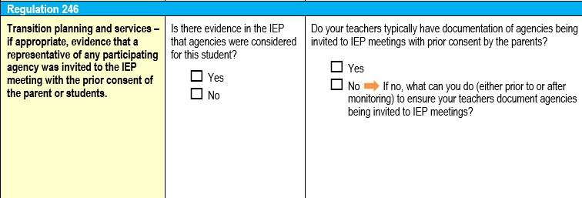
Let’s Reflect

Slide 67
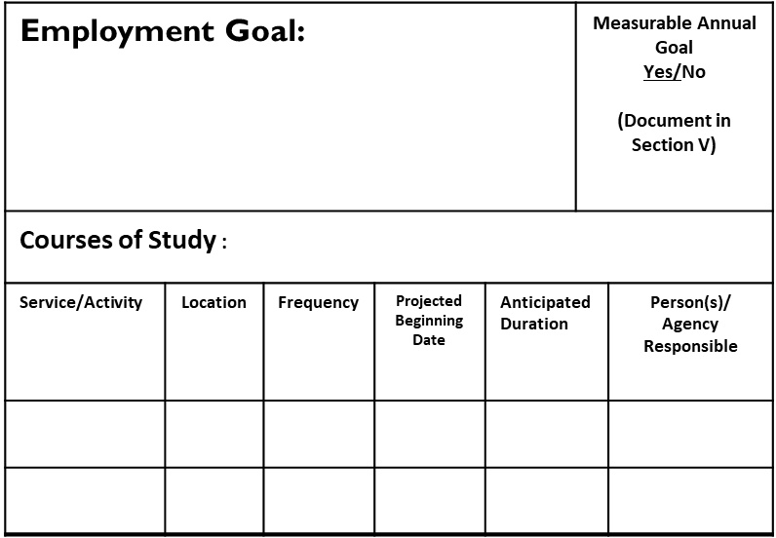
Step 4
Section III
of the IEP
“The Transition Grid”
Assess
Summarize
(PLAAFP)
Invite and Involve
Transition Plan
Measurable Annual Goals
Monitor Progress
Notes:
Design a Transition Plan that includes:
Courses of Study and
Services/Activities that help the student achieve his/her goals
67

Slide 68
Indicator 13 Checklist and CMCI Review Questions
File Review: Question #288
If the student’s IEP required participation in CTE program, was the CIP code completed?

Slide 70
Let’s Reflect

Slide 71
Indicator 13 Checklist and CMCI Review Questions
File Review: Question #290
Indicator 13 Checklist: Question #4
An appropriate measurable postsecondary goal or goals that cover education or training, employment, and AS NEEDED, independent living?
File Review: Question #291
Is there evidence that the postsecondary goal(s) that covers education and training, employment, and, as needed, independent living are updated annually?
Is there an appropriate measurable postsecondary goal or goals in this area?
Education and Training
Employment
Independent Living
Indicator 13 Checklist: Question #5
Are postsecondary goals updated annually?

Slide 72
Best Practice/Evidence
Do present education levels provide evidence that all 3 post-secondary goal areas have been considered?
Is there a post-secondary goal for Education/Training or a statement that the area was addressed by the IEP team?
Is there a post-secondary goal for Employment or a statement that the area was addressed by the IEP team?
Is there a post-secondary goal for Independent living or a statement that the area was addressed by the IEP team?
Notes:
(Independent Living is considered from all of the following lenses: residential, accessing community, and recreation/leisure activities.)

Slide 73
Best Practice/Evidence
Will the goal(s) occur after the student graduates from school?
Is there evidence that the postsecondary goal(s) are updated annually?
A summary of previous goals is referenced and:
Notation is made that based on updated assessments, goals remain same
OR
Notation that a goal has changed from one year to the next and WHY

Slide 74
So What Do I Put in the Grid?
Measurable Post-Secondary Goals for Education, Career, and Independent Living
Courses of Study
Services related to (MAG’s)
Activities
Notes:
Remember Measurable Post-Secondary goals are NOT the same as Measurable Annual Goals.

Slide 75
Measurable
Post Secondary
Goals

Slide 76
Review Assessment Data to create Post-Secondary Goals
Post Secondary Independent Living Goal
Notes:
Everything begins with assessment!

Slide 77
Writing Meaningful Post-Secondary Goals
The measurable goals are based on the transition assessment data, knowledge of postsecondary options and the input of the entire educational planning team, including the student
Training / Education
Employment
Independent living
Notes:
Post Secondary Goals are developed by using assessment result o determine what the student’s goals are in these 3 areas, AFTER they finish High School.
Beginning no later than with the IEP that is in effect when the student turns 14, or earlier if determined appropriated by the IEP Team, the IEP must include appropriate measurable postsecondary goals based upon age-appropriate transition assessment related to education/training, employment, and where appropriate independent living skills.

Slide 78
Writing Meaningful Post-Secondary Goals
Post-Secondary goals
Annual Goals
Notes:
Annual Goals are developed to set a target for ONE year’s progress, (Measurable Annual Goals) and are focused on what the student needs to be able to reach for his/her desired postsecondary outcomes.
Measurable Post-Secondary Goals are measurable, but are created for AFTER HIGH SCHOOL and it must be clear that these are goals that are intended to occur after high school, it is not necessarily limited to the first year after graduation. It is considered measurable if it can be counted. It is considered measurable if it can be counted, it isn’t the process for achieving the goal, it is the goal itself.
So to reiterate previous slides,

Slide 79
Sample Grid → Post-Secondary Goal
Post-Secondary Education Goal: |  |  |  |  | Measurable Annual Goal Yes/No (Document in Section V)
Courses of Study: List current courses by name here (including CTE Program of Study)
Service/Activity | Location | Frequency | Projected Beginning Date | Anticipated Duration |  | Person(s)/ Agency Responsible
Notes:
This is where on the transition grid post secondary goals are listed.

Slide 80
Using Transition Assessment to Develop Post-Secondary Goals
https://transitiontn.org
Notes:
Laying a foundation by using assessment and identifying the findings in ways that will help inform he transition plan.
https://transitiontn.org/age-appropriate-transition-assessment/?wppb_cpm_redirect=yes
You can go to this website to refer to videos to help you in these 4 areas.

Slide 81
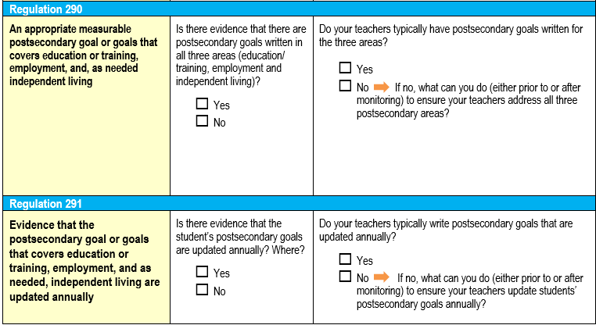
Let’s Reflect

Slide 82
Courses of Study

Slide 83
Indicator 13 Checklist and CMCI Review Questions
File Review: Question #292a
Indicator 13 Checklist: Question #7
Transition Services include courses of study that will reasonably enable the student to meet his or her postsecondary goal(s)
Do the transition services include courses of study that will reasonably enable the student to meet his or her post-secondary goal(s)?

Slide 84
What are Courses of Study?
Part of the “coordinated set of activities” that helps student move from high school to identified post-secondary goals
Support academic and functional achievement
Should promote graduation by meeting district
standards
Courses should be aligned with Post-secondary goals
Include “Programs of Study” at Career Tech Centers, whether Exploratory or Laboratory program
Courses should be listed by course name used in the LEA’s Program of Studies - not “functional curriculum”
or “college prep”
Course of Study must reflect current year’s courses.
Notes:
Decisions on appropriate Courses of Study are team decisions. Courses selected should support post-secondary goals. Inclusion in the general education curriculum is, of course, a consideration for the team.
A CTE program is considered a course of study. If CTE program is selected, be sure to list CIP code on the appropriate spot on the IEP form. AND be sure to invite the CTE representative to the meeting if CTE is being considered or if student plans to enroll.
List courses by name (i.e., as they would appear in course catalogue or with some specificity).
**NOTE: If Work Based Learning (including Community Based Vocational Training (CBVT) or Work Experience) OR Community Based Instruction is part of an actual course, list by exact name as it is listed in the list of school courses.
List of courses needs to reflect current year’s courses: If schedule or course selection changes during duration of IEP, revision is needed.

Slide 85
Listing Courses of Study
Post-Secondary Education Goal: |  |  |  |  | Measurable Annual Goal Yes/No (Document in Section V)
Courses of Study: List current courses by name here (including CTE Program of Study)
Service/Activity | Location | Frequency | Projected Beginning Date | Anticipated Duration |  | Person(s)/ Agency Responsible
Notes:
This is where on the transition grid course of study are listed.
NOTE: If a student attends a CTE make sure to include the CTE Code and invite a representative from CTE, as they become a mandatory team member

Slide 86
Sample Grid → Post-Secondary Education/Courses of Study:
Postsecondary Education and Training Goal: Following Graduation, Rayna has a goal of attending a college/university to pursue a career in the field of education. |  |  |  |  |  | Measurable Annual Goal Yes/No (Document in Section V)
Courses of Study: Biology, English 3, American History, Algebra I, Art and Design
Service and Activity | Location | Frequency | Projected Beginning Date | Anticipated Duration | Person(s)/ Agency Responsible
Notes:
Review this example. Discuss the Goal Area and indicated activities and services.
Briefly make reference to the location, frequency, projected beginning date, duration, agency responsible, and IEP goal.
Note: this may not be the entire grid…. Just a section to show as example.

Slide 87
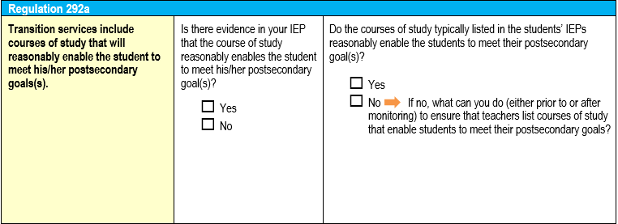
Let’s Reflect

Slide 88
Services and Activities
Notes:
Remember we learned about ESSA and Career Readiness so things are happening in the general ed curriculum that could be used as appropriate services and activities in the development of a student's transition plan. Link back to ESSA/Career Readiness Indicator and CEW

Slide 89
Indicator 13 Checklist and CMCI Review Questions
File Review: Question #292b
Indicator 13 Checklist: Question #6
Transition services in the IEP that will reasonably enable the student to meet his/her postsecondary goal(s).
File Review: Question #292
Location, Frequency, Projected Beginning Date, Anticipated Duration, and Person(s)/Agency Responsible for Activity/Service
Are there transition services in the IEP that will reasonably enable the student to meet his or her postsecondary goals?

Slide 90
Indicator 13 Checklist and CMCI Review Questions
File Review: Question #292c
Indicator 13 Checklist: Question #8
Annual goals are related to the student’s transition services
Is (are) there annual IEP goal(s) related to the student’s transition needs?

Slide 91
Sample Grid → Post-Secondary Education Service
Postsecondary Education and Training Goal: Following Graduation, Rayna has a goal of attending a college/university to pursue a career in the field of education. |  |  |  |  |  | Measurable Annual Goal Yes/No (Document in Section V)
Courses of Study: Biology, English 3, American History, Algebra I, Art and Design
Service and Activity | Location | Frequency | Projected Beginning Date | Anticipated Duration | Person(s)/ Agency Responsible
Service: *Improve skills in solving algebraic equations and inequalities | High School Academic Classes and Resource Room | During the school day | 10/4/17 | 10/3/2018 | LEA, General and Special Education Staff
Service: *Increase writing fluency and willingness to write. | High School Academic classes and Resource Room | During the school day | 10/4/17 | 10/3/2018 | LEA, General and Special Education Staff
Activity: Expand use of word processing and graphic organizer software to complete assignments | High School Academic classes and Resource Room | During the school day | 10/4/17 | 10/3/2018 | LEA, General and Special Education Staff
* Denotes measurable annual goal
Notes:
Review this example. Discuss the Goal Area and indicated activities and services.
Briefly make reference to the location, frequency, projected beginning date, duration, agency responsible, and IEP goal.
It is important to list all services/activities being provided to the student within the grid.
When listing instructional services (e.g., reading, math, behavior) in the grid, do not word as a measurable annual goal– but DO indicate what need is being addressed. For example, you do not want to write the entire 5 part measurable annual goal into the grid. Rather if it is a math goal based on improving computations, then it is fine to just write improve math computation skills in the grid.
You should always give credit for what’s done in general education. SO for example, if all students in the English 10 class are writing resumes, then list that as an activity in the grid. That is a fabulous activity to anyone transitioning into employment after high school but it is also great experience for those students going to college who will eventually need to write a resume in the future.
You do not need to list routine Specially Designed Instruction in the Grid
Nor do you need to list the same activity under more than one post-secondary goal area
Note: this may not be the entire grid…. Just a section to show as example.

Slide 92
Sample Grid → Post-Secondary Education Activity
Postsecondary Education and Training Goal: Following Graduation, Rayna has a goal of attending a college/university to pursue a career in the field of education. |  |  |  |  |  | Measurable Annual Goal Yes/No (Document in Section V)
Courses of Study: Biology, English 3, American History, Algebra I, Art and Design
Service and Activity | Location | Frequency | Projected Beginning Date | Anticipated Duration | Person(s)/ Agency Responsible
Service: *Improve skills in solving algebraic equations and inequalities | High School Academic Classes and Resource Room | During the school day | 10/4/17 | 10/3/2018 | LEA, General and Special Education Staff
Service: *Increase writing fluency and willingness to write. | High School Academic classes and Resource Room | During the school day | 10/4/17 | 10/3/2018 | LEA, General and Special Education Staff
Activity: Expand use of word processing and graphic organizer software to complete assignments | High School Academic classes and Resource Room | During the school day | 10/4/17 | 10/3/2018 | LEA, General and Special Education Staff
Notes:
Review this example. Discuss the Goal Area and indicated activities and services.
Briefly make reference to the location, frequency, projected beginning date, duration, agency responsible, and IEP goal.
Note: this may not be the entire grid…. Just a section to show as example.

Slide 93
What are Transition Services / Activities?
Action steps that support the student’s movement towards post-secondary goal areas
Slated to occur during current IEP
Each post-secondary goal area must have:
At least one SERVICE tied to a Measurable Annual Goal to address skill deficit (e.g., reading, writing, behavior, organization, etc.)
At least one ACTIVITY- other activities that help the student reach his/her goal (next slide)
Part of coordinated set of activities
Notes:
Definitions of transition activity/ service
Action steps – both activities and services
Include instructional services to address skill deficits, with Measurable Annual Goals. This is an important concept to emphasize.

Slide 94
Listing Services and Activities in the Grid
List all services/activities being provided to the student
When listing instructional services (e.g., reading, math, behavior) in the grid, do not word as a measurable annual goal– but DO indicate what need is being addressed
Give credit for what’s done in general education, e.g.,
Don’t need to list routine Specially Designed Instruction in the Grid
Don’t need to list the same activity under more than one post-secondary goal area
Notes:
It is important to list all services/activities being provided to the student within the grid.
When listing instructional services (e.g., reading, math, behavior) in the grid, do not word as a measurable annual goal– but DO indicate what need is being addressed. For example, you do not want to write the entire 5 part measurable annual goal into the grid. Rather if it is a math goal based on improving computations, then it is fine to just write improve math computation skills in the grid.
You should always give credit for what’s done in general education. SO for example, if all students in the English 10 class are writing resumes, then list that as an activity in the grid. That is a fabulous activity to anyone transitioning into employment after high school but it is also great experience for those students going to college who will eventually need to write a resume in the future.
You do not need to list routine Specially Designed Instruction in the Grid
Nor do you need to list the same activity under more than one post-secondary goal area

Slide 95
Example Services…
…ADDRESS SKILL DEFICITS & LEAD TO MEASURABLE ANNUAL GOAL & PROGRESS MONITORING
Build vocabulary skills
Writing conventions
Learn to board a bus
Comprehend figurative language
Initiate peer interaction
Improve skills with budgeting, time management, algebraic equations, etc.
Follow three-step directions
Self advocacy skills
Notes:
The important point here is that we don’t write measurable annual goals (MAGs) for activities such as those on the right.. But we MUST have at least one Measurable Annual Goal under each identified post-secondary goal. The MAG supports the student in achieving his/her post secondary goals by addressing skill deficits.
Note:
Not every service required for a student as part of their FAPE will have an IEP goal that corresponds, e.g., Counseling to address MH needs, assistive technology services. We are using the term SERVICE to make a distinction from typical transition activities.
Remember that MAGs are prioritized– we want to limit to a few areas that are important enough to measure.

Slide 96
Post-Secondary Education/ Training: Examples of Activities
Explore post-secondary programs
College fairs
“Virtual tours”
Guest speakers
College visits
Learn about accommodations
Contact Disability Services Office
Information on registration for PSAT, SAT
Time management
Practice disability disclosure
PYLN Toolkit materials
Develop list of questions for schools
Notes:
NOT AN EXHAUSTIVE LIST– JUST SOME EXAMPLES

Slide 97
Employment: Examples of Activities
Career exploration
Visit/tour CTC
Career portfolio
Job fairs
Guest speakers
Community visits/field trips
Research paper on career of interest
Review employment ads
Community service
Job shadowing
Resume writing
Graduation writing
Group meeting with OVR
Explore PaCareer Zone
Military visits/ Jr. ROTC
Work experience
Explore Job Accommodations Network
Notes:
NOT AN EXHAUSTIVE LIST– JUST SOME EXAMPLES

Slide 98
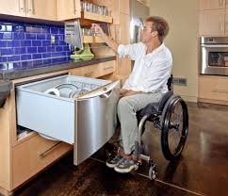
Independent Living: Examples of Activities
Clubs (socialization and participation)
Shopping
Family and Consumer Science activities
Budgeting skills
Food preparation
Checking listings for apartments
Visiting community recreation facilities
Open case with agency
Obtain bus pass
Learning about transportation options
Help with voter registration
Driver’s Education (if provided at school)
Notes:
NOT AN EXHAUSTIVE LIST– JUST SOME EXAMPLES

Slide 99
Services and Activities in the General Curriculum
Make use of transition activities that take place as part of:
Be sure to list in the transition grid, as appropriate
Many districts “map out” activities by grade (i.e. 339 plan, transition mapping guide and transition assessment plan)
General education courses (resume writing, food preparation, career research, career portfolios)
Guidance services
Other school activities
Notes:
May want to begin, or come back to, a discussion about mapping out things that are already happening in the general curriculum as well as within special education.
Consider using Mapping Assessments and Activities Examples form to capture what is already happening and to identify gaps.

Slide 100
Indicator 13 Checklist and CMCI Review Questions
File Review: Question #292
Location, Frequency, Projected Beginning Date, Anticipated Duration, and Person(s)/Agency Responsible for Activity/Service

Slide 101
Location, Frequency, Projected Beginning Date, Anticipated Duration, and Person(s)/Agency Responsible for Activity/Service
Postsecondary Education and Training Goal: Following Graduation, Rayna has a goal of attending a college/university to pursue a career in the field of education. |  |  |  |  |  | Measurable Annual Goal Yes/No (Document in Section V)
Courses of Study: Biology, English 3, American History, Algebra I, Art and Design
Service and Activity | Location | Frequency | Projected Beginning Date | Anticipated Duration | Person(s)/ Agency Responsible
Service: *Improve skills in solving algebraic equations and inequalities | High School Academic Classes and Resource Room | During the school day | 10/4/19 | 10/3/2020 | LEA, General and Special Education Staff
Service: *Increase writing fluency and willingness to write. | High School Academic classes and Resource Room | During the school day | 10/4/19 | 10/3/2020 | LEA, General and Special Education Staff
Activity: Expand use of word processing and graphic organizer software to complete assignments | High School Academic classes and Resource Room | During the school day | 10/4/19 | 10/3/2020 | LEA, General and Special Education Staff
Notes:
Although the indicator 13 checklist doesn’t include additional questions for Location, Frequency, Projected Beginning Date, Anticipated Duration, and Person(s)/Agency Responsible for Activity/Service
It is important to be sure to include the most accurate information, and note that the person responsible can’t be the parent or student ALONE, must be under the supervision of LEA personnel. i.e. “parent and special education teacher”

Slide 102
Step 5
Develop Measurable Annual Goals that address skills deficits and lead to post-secondary goals
Assess
Summarize
(PLAAFP)
Invite and Involve
Transition Plan
Measurable Annual Goals
Monitor Progress
Notes:
102

Slide 103
Measurable Annual Goals (MAG)
Build skills (identified in Needs)
Prioritized: 3-5 goals for most
Communicate expectations-projects student performance at the end of one year of instruction
Begin from baseline of skill (present levels)
Contains measurable, countable data.
Are written to include progress monitoring.
Notes:
The Performance Criteria, as indicated in the measurable annual goal, should easily enable progress monitoring to occur.
In writing the measurable annual goal it is important to accurately project what the student will be able to obtain within the IEP year.
For students with more complex needs they may have more than 3-5 MAGs – however, it is suggested that there is only one MAG for each support area.

Slide 104
Measurable Annual Goals and Objectives
What they are NOT
NOT curriculum
NOT for subject areas
NOT grade averages or passing a course
NOT only for students instructed in special education classes
NOT activities such as visiting a college fair or job shadowing
Notes:
Note the following for each area listed:
1. NOT curriculum- do not list all of the skills for 8th grade math i.e.
Student will be able to complete: fractions, decimals, percentages, algebraic expressions
2. NOT for subject areas- do not list- gain fluency in social studies and science class
3. NOT grade averages……- do not list- receive at least a D in all subjects
4.NOT only for students….do not list- student will achieve an 80% when answering questions in the resource room
5. NOT activities such as……- do not list activities that are not going to be monitored

Slide 105
Measurable Annual Goals Must Be Skill-Building
In order that the student is able to
Access, participate, and make progress in the general curriculum and the life of the school/community,
AND progress towards his/her post-secondary goals…
A measurable annual goal (and short term objectives) must build skills.
Goals must focus on an area of need that will
make the biggest difference to the student.
Notes:
What specific skill should we target for instruction and measurement?
PRIORITIZE: Select skills that will have
Endurance
Leverage
Necessity

Slide 106
SKILLS that might be needed for Secondary Students
Organizational skills
Social Skills
Time Management Skills
Dexterity Skills
Communication Skills
Self Help Skills
Travel Skills
Mobility Skills
Task-related skills
Self Determination and Self Advocacy Skills
Academic Skills
Notes:
ALWAYS KEEP IN MIND THE INDIVIDUALITY OF THE STUDENT.
A student in need of skill building related to communication looks very different, and will require different skill building goals, if his/her disability is in the Sensory/Hearing category, Autism spectrum, or is a Communications Impairment.

Slide 107
Writing the MAG - Questions
*Writing the MAG – Questions How will we assess the development of the target skill?
What do we want the student to actually DO to show that s/he is learning the skill? (may use or paraphrase language from Standard, Anchor, etc.) With what materials, or under what conditions? How will we measure the skill? How often will we measure it? | How well must s/he perform the skill? How consistently must the skill be performed to demonstrate mastery (endpoint)? What other assessments/ forms of data will also indicate if s/he is progressing towards the goal?
Notes:
Handout: Steps for Developing a Standards-Aligned Measurable Annual Goal (MAG)
It is often important to point out to teachers that the skill is something that can be used in the future to support the PSGs of the student. So it would NOT be ok to have a goal that says “ Name will raise his score from 70-80% or will score 7/10 on a reading comprehension probe” as the actual skill we want the student to master. That is really performance criteria not a skill. Read 7th grade level text with comprehension might be a skill or solving algebraic expressions

Slide 108
Let’s Review: Measurable Annual Goals
Four required parts:
Condition
Student’s Name
Clearly Defined Behavior
Performance Criteria
Adapted from Strategies for Writing Better Goals and Short Term Objectives or Benchmarks by Benjamin Lignugaris/Kraft Nancy Marchand-Martella and Ronald Martella Sept/Oct 2001 Teaching Exceptional Children
Notes:
It is suggested to distribute the Measurable Annual Goal Development Guide at this point in the training

Slide 109
Measurable Annual Goals 1. Condition
Describes the situation in which the student will perform the behavior (e.g., accommodations, assistance provided prior to or during assessment)
Describes material that will be used to evaluate the learning
May describe the setting for evaluation
Examples:
During lunch breaks on the job …
Given picture checklists to follow …..
Using graphic organizers for writing assignments…
Using grade level passages…
Given a two step direction…
Given a grocery list and $20…
Using the alarm feature on his cell phone…
Notes:
Information from the present educational levels are used to help describe conditions under which the behavior is to be performed.
When reviewing the condition section of the IEP check to see that the goal describes when or under what conditions the behavior will take place; what the student will use to perform the behavior; and where the behavior will be observed or assessed.

Slide 110
Measurable Annual Goals 2. Student Name
Should not be a problem!
Caution if using “copy/paste”
Names
Pronouns (she/he and him/her)

Slide 111
Measurable Annual Goals 3. Clearly Defined Behavior
Use PA Academic Standards/Anchors or Curriculum Framework as basis
Describe the behavior in measurable, observable terms
Ask yourself…what will the student actually DO?
Examples:
Say, print, write, read orally, point to, solve…
Non-examples:
Understand, know, recognize, behave, comprehend, improve…
Notes:
Make sure that you are not using “fuzzy words” in this section.
Is the behavior described an action?
Can it be described in terms of what the student will do?
Can you close your eyes and visualize what the student will be doing?
Can the behavior be observed?

Slide 112
Measurable Annual Goals 4. Performance Criteria
3 Parts of the Performance Criteria:
Criterion Level
How well- the level the student must demonstrate for mastery
Number of Times Needed to Demonstrate Mastery
How consistently the student needs to perform the skill(s) before it’s considered “mastered”
Evaluation Schedule
How frequently the teacher plans to assess the skill
HOW progress will be monitored (Note: On the IEP form, this is placed in the column to the right of the goal.)
Notes:
112
112
Performance Criteria – There are three major components of performance criteria: the criterion level, the number of times the student should demonstrate that level, and the evaluation schedule. The criterion level is the functional performance level the student must demonstrate for mastery (i.e. 125 words per minute with 97% accuracy). The number of times the student should demonstrate the criterion level is often forgotten when writing goals. It is important because it specifies what is required to reach mastery. The evaluation schedule addresses how frequently the teacher plans to assess student mastery on the objective and the method by which the teacher will evaluate progress and/or completion of the goal. Note that monitoring progress once per quarter is NOT enough to evaluate if the student is making progress towards goals!
Performance criteria should set up test situations for progress monitoring
Performance criteria should reflect the type of measurement that is meaningful for the skill

Slide 113
Example Language for Performance Criteria
“How Well?”
___% of time
___% accuracy
__ out of ___ times
with _# correct
with ___or fewer errors
with __ out of __ points on rubric or checklist
words/digits/ correct per minute
with no more than ___ occurrences of…
with an ___or better on skill specific rating scale
earning __% of possible points per day
with “x” movement on a prompting hierarchy
independently
Notes:
Rate
The frequency of a behavior and its relation to time expressed as a ratio
Appropriate behavior: vocational tasks completed per minute, social interactions per hour
Inappropriate behavior: call outs pre class period
Duration
The total amount of time in which a targeted behavior occurs in a specified observation
Appropriate behavior: attending to lesson, completion of hygiene routine
Inappropriate behavior: tantrums, stereotyped behavior
Task Analytic Measurement
A record of the performance of each step in a sequence of behaviors comprising a task
Appropriate behaviors: bed making, playing a CD, assembly tasks, preparing a snack
Interval Recording
A record of the occurrence of behavior within each segment of time (intervals) within a single observation
Appropriate and inappropriate behaviors: any of the behaviors listed for frequency or duration

Slide 114
Example Language for Performance Criteria
Times to mastery “How Consistently?” | Evaluation Schedule “How Frequently will we monitor progress?”
3 of 5 random trials 5 consecutive trials 4 out of 5 trials | Daily (seldom used for progress monitoring because instruction needs to occur between monitoring opportunities) 2 times per week Weekly Biweekly Tri-weekly Note: “Quarterly” is not often enough!
The Endpoint!
Notes:
Do not list end dates as part of “times to mastery”
How frequently will we monitor progress? Quarterly is not enough!

Slide 115
MAGs at a Glance – Resource
Measurable Annual Goals at a Glance
Condition | Name | Clearly Defined Behavior | Performance Criteria
Describe the situation in which the student will perform the behavior. Materials, settings, accommodations? Examples: Given visual cues… During lectures in math… Given active response checks… |  | Describe behavior in measurable, observable terms. Use action verbs. What will s/he actually DO? Examples: Locate Name Point Separate Rank Choose Remember--Academic Standards, Assessment Anchors, Big Ideas, Competencies from the Standards Aligned System (SAS) provide the content for goals. | The level the student must demonstrate for mastery: How well? Examples: % of the time #times/# times With the # or % accuracy “X” or better on a rubric or checklist. | Number of times needed to demonstrate mastery: How consistently? How consistently will the student need to perform the skill(s) before considered “mastered?” | Evaluation Schedule: How often? How often will the student be assessed? AND : What will be the method of evaluation?

Slide 116
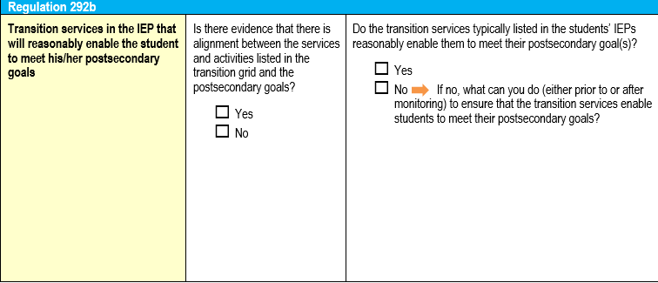
Let’s Reflect

Slide 117
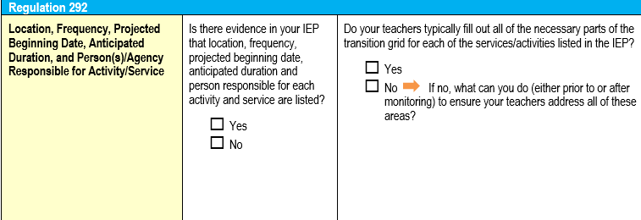
Let’s Reflect

Slide 118
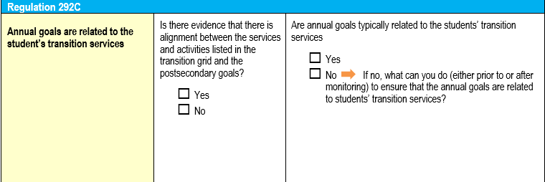
Let’s Reflect

Slide 119
Step 6
Progress Monitor Measurable Annual Goals and make adjustments as needed
Assess
Summarize
(PLAAFP)
Invite and Involve
Transition Plan
Measurable Annual Goals
Monitor Progress
Notes:
119

Slide 120
Progress Monitoring
It is impossible to progress monitor goals if they are not clear and measurable.
In order to write clear and measurable goals, one needs to have clear and measurable present levels.
Therefore: We must start with clear and measurable Present Levels of Academic Achievement and Functional Performance (PLAAFP)
Notes:
It is impossible to progress monitor goals if they are not clear and measurable.
The next set of slides gives more detail on General Outcomes measures and Specific Skills measures and uses examples from the trainings.

Slide 121
PLAAFP
Present Levels of Academic Achievement and Functional Performance : Baseline information that gives a starting point.
Needs
Needs: Areas of need that must be addressed in the IEP
Grid
Grid: Services or Activities listed in the Transition Grid that will help the student to achieve his/her post-secondary goals
MAGs
Measurable Annual Goals: Specific areas of skill deficits that will be targeted for instruction and monitoring
Progress Monitoring
Progress Monitoring: How, and how often, we will monitor the skill to ensure that student is on track to achieve the goal.
Notes:
The IEP should be aligned. It should tell the story of where the child is now, where they want to go, and what needs to be done to get them there, including goals and supports and services.
121

Slide 122
Transition Resources

Slide 123
Indicator 13: Compliance Module Series
Overview: The Overview module provides and introduction to the Indicator 13 Compliance Module Series and explains the format of each of the six modules in this series.
Module 1: This module provides a compliance and effective practices overview of outside agency and student involvement in the IEP meeting.
Module 2: This module provides a compliance and effective practices overview of interest/preference, academic, and functional assessment.
Module 3: This module provides a compliance and effective practices overview of Post-Secondary Goals related to education/training, employment, and independent living.
Notes:
The Indicator 13 Compliance Module Series is a training series developed by PaTTAN and Intermediate Unit Secondary Transition consultants in response to the accountability requirements under the Individuals with Disabilities Education Act (IDEA) of 2004, Part B State Performance Plans as it relates to secondary transition. The module series highlights effective practices in secondary transition. The series is designed to provide an overview of the seven areas required by Indicator 13 for compliant, secondary transition practices.
Each module contains a pretest, PowerPoint presentation, effective practices Q&A discussion and a posttest. Participants are encouraged to view the Overview Module prior to completing any of the individual content modules.
The modules can be found on the PaTTAN website.
123

Slide 124
Indicator 13: Compliance Module Series
Module 4: This module provides a compliance and effective practices overview of how to annually update the three Post-Secondary Goal areas.
Module 5: This module provides a compliance and effective practices overview of the “transition grid” section of the IEP. Included in this section is a discussion regarding Courses of Study, Activities and Services related to the Post-Secondary Goals.
Module 6: This module provides a compliance and effective practices overview of Measurable Annual Goals.
Notes:
http://www.pattan.net/category/Educational%20Initiatives/Secondary%20Transition/page/Indicator_13_Compliance_Module_Series.html
124

Slide 125
Notes:
You can access the secondary transition guide on the PaTTAN website. Here you can find contact information for your regional local Intermediate Unit Transition TAC and regional PaTTAN Transition Consultants. This is a screenshot of the cover of the previous year. The updated 2019-2020 Directory will be available on the PaTTAN website in the near future.

Slide 126
Resources for Transition Programming
PA Secondary Transition Guide
http://secondarytransition.org/
AHEAD Transition Resources A-Z
https://www.ahead.org/membership/students-families
Transition Toolkit
https://dredf.org/special_education/training_materials/Transition-Toolkit.pdf

Slide 127
Resources for Transition Programming continued
Transition Live Binder
http://www.livebinders.com/play/play/176690
OCR Transition Guide
https://www2.ed.gov/about/offices/list/ocr/transitionguide.html#reproduction
GWU0 Health Transition Guide
https://www.heath.gwu.edu/files/downloads/toolkit.pdf

Slide 128
Questions?

Slide 129
Hillary Mangis Pittsburgh hmangis@pattan.net Ryan Romanoski Harrisburg rromanoski@pattan.net Kim Cole East kcole@pattan.net
Commonwealth of Pennsylvania
Tom Wolf, Governor
Pennsylvania Department of Education
Pedro A. Rivera, Secretary
Matthew Stem, Deputy Secretary, Elementary and Secondary Education
Carole Clancy,
Director, Bureau of Special Education

