Slide 1
How to Be a Special Education PRO: Proactive, Responsive & Organized
Spring 2021 | Virtual Delivery

Slide 4
Icons Used in PRO
= Handout
= Search and Share
Notes:
Self-Explanatory – Discuss meaning of Icons throughout presentation

Slide 5
Participants will be……
Proactive:
Utilize tools, strategies and activities to proactively prepare for special education mandated data collection and reporting
Responsive:
Identify and respond to needed systemic changes related to special education mandated data collection and reporting
Organized:
Identify work habits to be intentionally organized to prepare for special education mandated data collection and reporting
Notes:
Proactive:
Utilize tools, strategies and activities to proactively prepare for special education mandated data collection and reporting
Responsive:
Identify and respond to needed systemic changes related to special education mandated data collection and reporting
Organized:
Identify work habits to be intentionally organized to prepare for special education mandated data collection and reporting

Slide 6
Proactive Responsive Organized Agenda
Special Education Reporting Requirements
PDE Website
Leader Services
Cyclical Monitoring
Components
Process
Policies/Procedures
Getting Ready for the Big Day
Notes:
Have participants rename their zoom box “NOVICE” - N or “Experienced” - E

Slide 7
Timelines & Reporting

Slide 8
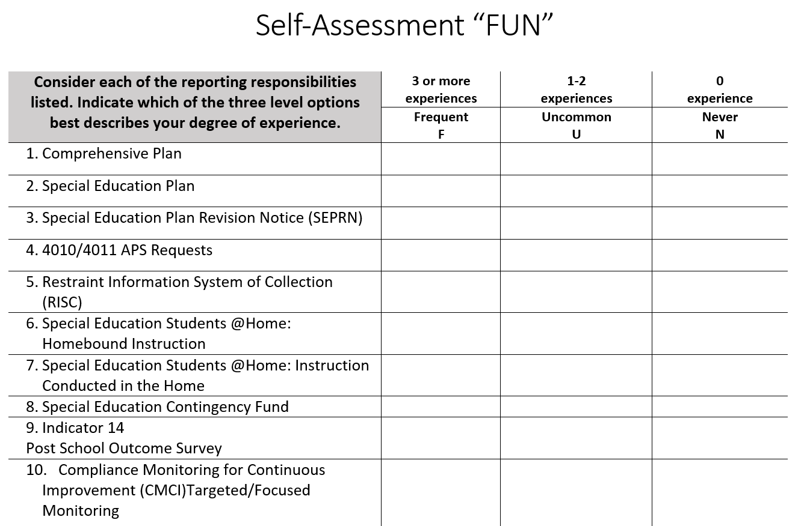
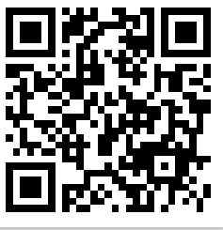
Self Assessment for FUN!
1. Rate your FUN experience for all 10 items on this handout.
2. Type in URL or Scan QR in and transfer your answers so we can formatively assess today’s learners.
https://tinyurl.com/selfassessmentfunpfp
Notes:
Self Assess FUN:
Have participants complete the hard copy self assessment and then to complete the digital copy in order to 1)self assessment, 2) anticipatory set of learning to come, and 3) provide collective formative feedback for facilitators https://goo.gl/forms/6uvNvVeVKWp78gKE3
In order to view results –
1. PFP 2018-19 https://docs.google.com/forms/d/1UKCyeiPQoX7Nlu4B08q48lqcd7ho_RwvaddhquNJqmw/edit#responses
2.Click on “RESPONSES” at the top
3. Project results and take note of which items have the most experience and which has little experience

Slide 9
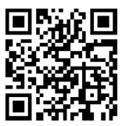
Self Assessment for FUN! (WEST)
1. Independently: Rate your FUN experience for all 10 items on this handout.
2. Collectively: Click or QR in and transfer your answers so we can formatively assess today’s learners.
http://tinyurl.com/selfassessmentfun
Notes:
Self Assess FUN:
Have participants complete the hard copy self assessment and then to complete the digital copy in order to 1)self assessment, 2) anticipatory set of learning to come, and 3) provide collective formative feedback for facilitators http://tinyurl.com/selfassessmentfun
In order to view results –
WEST
https://docs.google.com/forms/d/1McKLWa1OC9_fcIUURWelC_rCznHovNQm7VRpqYMffh8/edit?usp=sharing
Click on “RESPONSES” at the top
Project results and take note of which items have the most experience and which has little experience

Slide 10
Self Assessment for FUN! (CENTRAL)
1. Independently: Rate your FUN experience for all 10 items on this handout.
2. Collectively: Click or QR in and transfer your answers so we can formatively assess today’s learners.
http://tinyurl.com/selfassessmentfuncentral
Notes:
Self Assess FUN:
Have participants complete the hard copy self assessment and then to complete the digital copy in order to 1)self assessment, 2) anticipatory set of learning to come, and 3) provide collective formative feedback for facilitators http://tinyurl.com/selfassessmentfun
In order to view results –
CENTRAL
https://docs.google.com/forms/d/1la3X5CHJEGZ1mHsUE7hWM0W9dttWHlHnOGlhwKqmfK4/edit?usp=sharing
Click on “RESPONSES” at the top
Project results and take note of which items have the most experience and which has little experience

Slide 11
Self Assessment for FUN! (EAST)
1. Independently: Rate your FUN experience for all 10 items on this handout.
2. Collectively: Click or QR in and transfer your answers so we can formatively assess today’s learners.
http://tinyurl.com/selfassessmentfuneast
Notes:
Self Assess FUN:
Have participants complete the hard copy self assessment and then to complete the digital copy in order to 1)self assessment, 2) anticipatory set of learning to come, and 3) provide collective formative feedback for facilitators http://tinyurl.com/selfassessmentfuneast
To View and Display Results:
EAST
https://docs.google.com/forms/d/1ptT0TiK4rrcz1BNxUteOvAyKvrmLB-RVzdPJAxd0doo/edit
Click on “RESPONSES” at the top
Project results and take note of which items have the most experience and which has little experience

Slide 12
Purpose of Reporting
The Pennsylvania Department of Education (PDE) has the responsibility to ensure that all Local Education Agencies (LEA) providing services, whether directly, or by contractual arrangements, administer special education services and programs that are in compliance with applicable state and federal laws and regulations.
Notes:
According to Chapter 14.156 of the Pa School Code,
The Department will assure in accordance with section 302(b) of the act (11 P. S. § 875-302(b)) through its monitoring and technical assistance activities, a system of quality assurance, including evaluation of the developmental appropriateness, quality and effectiveness of programs; assurance of compliance with program standards; documented progress indicators; and provision of assistance to assure compliance. These requirements will apply to those programs operated by the early intervention agency directly or through providers contracted by the early intervention agency.

Slide 13
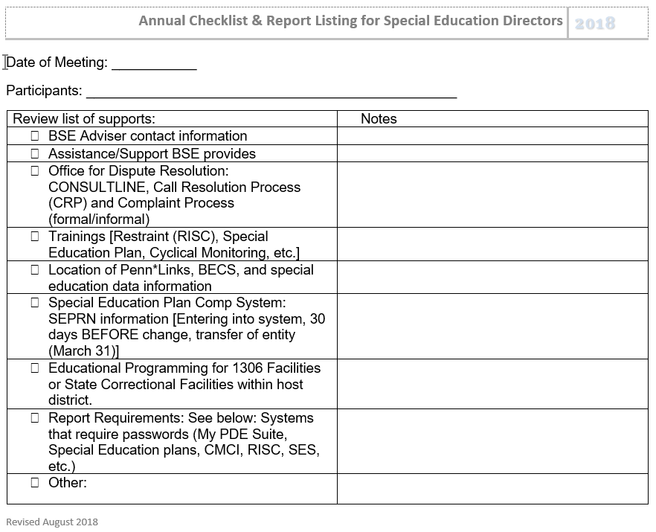
Annual Checklist & Reporting
Use this to guide your awareness
Collaborate with colleagues to map out responsibilities and be sure internal communication is happening
Notes:
Virtually: Checklists & Reporting - Participants can share out in the chat box which reports they have the least experience with and/or which reports they really want to know more about.
Handout: Annual Checklist & Report Listing for Special Education Directors (by month)
This handout features a comprehensive list of reporting responsibilities. Participants can use this to build their awareness and upon return to their homebase, they can (if they already don’t know) engage their business director and administrative support to see who may already be carrying these responsibilities.
Have participants circle/highlight one report that they have a lot of experience with and one that they do not have a lot of experience with. Turn and talk.

Slide 14
Typical Timeline of PDE Reporting
OCT
NOV
DEC
JAN
FEB
MAR
APR
MAY
JUNE
Child Count
PIMS SE Snapshot
ESY Determinations by 2.28 NOREPS issued by 3.31
PIMS Student Fact Template Annually
End of Year PIMS SE Exit window opens in June
Contingency Funds Window Opens
By 2.1 Preschool EI
Decisions:
Mtgs by 2.28
Special Education Plan due 5.1 Triennially
Notes:
This is an example of how to think or begin to map your annual reporting responsibilities. This example does not include everything on the list we just reviewed .
SEP omitted due to school beginning.
OCT – this is the entire student population of the LEA
NOV – CF window opens in Nov, usually closes in late Dec or early Jan. Trainings for applying for Contingency Funds usually occur at PaTTAN in Oct.
DEC – Child Count – this is where ALL SE funding is derived. Important to insure that all students with disabilities in the LEA have an IEP that includes DEC 1 of current year. This includes students in placements outside the LEA – hospitals, partials, AEDY, etc.
JAN – Preparation for EI transition – decisions regarding K or 1st grade.
FEB – All EI meetings must be convened by 2/28.
MAR – All EI NOREPS issued by 3/31.
APR – No reporting due in April; however statewide assessments usually occur during this month and into May.
MAY - Special Education Plan due May 1 every 3 years.
JUN - PIMS Special Education Exit window opens later in June.
Does anyone do anything like this? How do you stay organized in knowing when and how to complete reports?

Slide 15
Reporting by Location
PDE Website | Leader Services
Comprehensive Plan | Restraint Information System of Collection (RISC)
Special Education Plan | Special Education Students @ Home Homebound Instruction Instruction Conducted in the Home
Special Education Plan Revision Notice (SEPRN) | Act 16 Special Education Contingency Fund
4010/4011 APS Requests | Indicator 14 Post School Outcome Survey
 | Cyclical Monitoring for Continuous Improvement (CMCI) Targeted/Focused Monitoring
Notes:
These are the various reporting expectations that LEAs are responsible for. You will see that some reporting protocols are done through the PDE website and some are done through the Leader Services Website.
This is not an exhaustive list but these will be the ones that we are highlighting today.

Slide 16
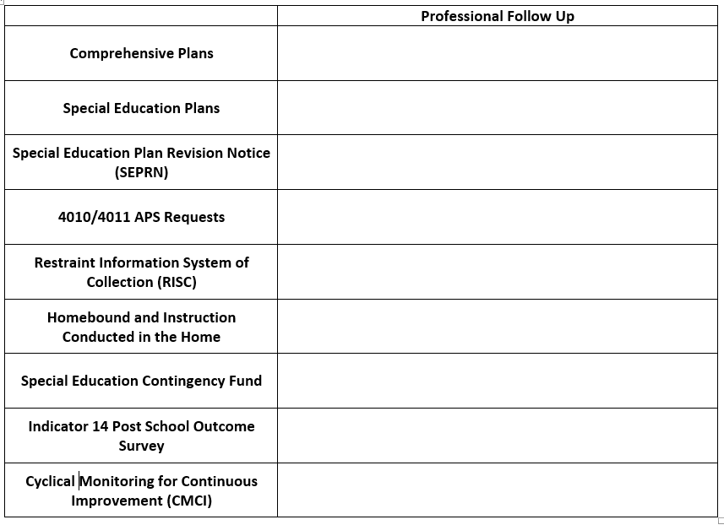
Professional Follow-Up
Notes:
Encourage participants to use their hard copies to make notations regarding information that is specific to the LEA.

Slide 17
Reporting by Location (PDE Website)
PDE Website | Leader Services
Comprehensive Plan | Restraint Information System of Collection (RISC)
Special Education Plan | Special Education Students @ Home Homebound Instruction Instruction Conducted in the Home
Special Education Plan Revision Notice (SEPRN) | Act 16 Special Education Contingency Fund
4010/4011 APS Requests | Indicator 14 Post School Outcome Survey
 | Cyclical Monitoring for Continuous Improvement (CMCI) Targeted/Focused Monitoring
Notes:
We are going to start with the ones that must be completed through PDE’s Website, which are highlighted in green.
The Comprehensive Plan is a requirement of Chapter 4 for school entities. A school entity is defined as a local education provider (e.g., public school district, charter school, cyber charter school, AVTS or Intermediate Unit). There are 6 planning requirements, but for our purposes, we are focusing on this requirement. Every 6 years, a school entity must develop and implement a comprehensive and integrated K-12 program of student services. This student services plan must be make available for public inspection and comment for 28 days, and then it can be approved by the school entity’s governing board.
The Special Education Plan is one of the 6 components of the Comprehensive Plan. Each school district shall develop a special education plan aligned with the strategic plan of the school district under § 4.13 (relating to strategic plans). The special education plan shall be developed every 3 years consistent with the 3-year review cycle of the strategic plan of the school district. The Secretary will prescribe the format, content and time for submission of the special education plan. (§14.104(a)) The special education plan must be made available for public
inspection and comment for 28 days, and then it can be approved by the school entity’s governing board and then submitted to PDE.
3. Special Education Plan Revision Notices (SEPRN’s) is an on-going update to the school entities’ special education plan. Any changes – new classrooms, closing classrooms, shifting of caseloads - must be submitted for approval 30 days prior to proposed changes. Transfer of entity after March 31 requires signatures from the IU Executive Director prior to BSE approval.
5. The electronic system to input 4010’s & 4011’s for students in Approved Private Schools (APS) or Chartered Schools for the Deaf and Blind began July 1, 2016. The new system is called APSEM and will be housed in PDE Suites. Each occurrence to create a 4010 request for funding & 4011 program change to an approved private school (APS) and Chartered Schools for Deaf/Blind (CSDB) must be entered into this system. A directory listing of schools was updated May 2016.

Slide 18
Comprehensive Plan
WHAT | A Comprehensive Plan is a comprehensive and integrated K-12 program of student services
WHO | LEA leadership to include superintendent, building principals, curriculum director, special education director, etc.
WHY | The Comprehensive Plan is a requirement of Chapter 4 for all school entities in PA.
WHEN | Every 3 or 6 years, depending on planning component
Notes:
http://www.education.pa.gov/Teachers - Administrators/Comprehensive Planning/Pages/default.aspx
The Comprehensive Plan is a requirement of Chapter 4 for school entities. A school entity is defined as a local education provider (e.g., public school district, charter school, cyber charter school, AVTS or Intermediate Unit). There are 6 planning requirements, but for our purposes, we are focusing on this requirement. Every 6 years, a school entity must develop and implement a comprehensive and integrated K-12 program of student services. This student services plan must be make available for public inspection and comment for 28 days, and then it can be approved by the school entity’s governing board.

Slide 19
Search and Share
Google: PDE and Comprehensive Plan
Chapter 4 Planning Requirements Overview
What are the other 5 report requirements nested in the Comprehensive Plan?
Which of the reports need to be submitted every 3 years/6 years?
Are you familiar with the New Comprehensive Planning website (former Wiki)?
https://sites.google.com/capitalareaiu.org/compplanning/home
Notes:
Virtually: Search & Share for Comprehensive Plan - Give participants time to do the search on their own. After some time, have them share their responses in the chat box.
http://www.education.pa.gov/Documents/Teachers-Administrators/Comprehensive%20Planning/Chapter%204%20Planning%20Requirements%20Overview.pdf
Special Education Plan – 3 years
Professional Education – 3 years
Pre K – Every 3 years or when plan is amended
Induction – 6 years
Student Services – 6 years
Gifted – 6 years
After the group has answered these questions, have the group explore the comprehensive planning wiki site.

Slide 20
Comprehensive Planning Components
Three (3) Years | Six (6) Years
Professional Education Plan | Induction Plan
Special Education Plan | Integrated K-12 Program of Student Services
Pre-Kindergarten Implementation Plan | Gifted Education Plan
Notes:
Planning Requirements Overview
The revised Chapter 4 specifies planning requirements for school entities. A school entity is defined as a local education provider (e.g., public school district, charter school, cyber charter school, AVTS or Intermediate Unit). These planning requirements are summarized:
Every 3 years, a school entity must submit to the Secretary for approval a professional education plan. The professional education plan must be made available for public inspection and comment for 28 days, and then it can be approved by the board and then submitted to PDE.
b. Every 6 years, a school entity must submit to the Department for approval an induction plan. The induction plan must be made available for public inspection and comment for 28 days, and then it can be approved by the school entity’s governing board and then submitted to PDE.
c. Every 6 years, a school entity must develop and implement a comprehensive and integrated K-12 program of student services. This student services plan must be make available for public inspection and comment for 28 days, and then it can be approved by the school entity’s governing board.
d. Every 3 years, each school district must develop and submit to the department a special education plan. The special education plan must be made available for public inspection and comment for 28 days, and then it can be approved by the school entity’s governing board and then submitted to PDE.
e. Every 6 years, each school district must develop and implement a gifted education plan. The gifted education plan must be made available for public inspection and comment for 28 days, and then it can be approved by the school entity’s governing board.
f. Every 3 years or when the plan is amended, a school district offering a prekindergarten program must submit an implementation plan. The implementation plan must be made available for public inspection and comment for 28 days, and then it can be approved by the school entity’s governing board and then submitted to PDE.
https://www.education.pa.gov/Teachers%20-%20Administrators/Comprehensive%20Planning/Pages/PlanningRequirements.aspx

Slide 21
Special Education Plan
WHAT | The Special Education Plan is one of the six report sections nested in the Comprehensive Plan and should be aligned with the strategic plan
WHO | Must be completed by all LEAs with the exception of Charter Schools which complete an Annual Report
WHY | Required by Chapter 4.13 relating to strategic plans
WHEN | Every 3 years
Notes:
http://www.education.pa.gov/K-12/Special Education/Pages/Special-Education-Plan-Information.aspx
The Special Education Plan is one of the 6 report sections nested within the Comprehensive Plan. Each school district shall develop a special education plan aligned with the strategic plan of the school district under § 4.13 (relating to strategic plans). The special education plan shall be developed every 3 years consistent with the 3-year review cycle of the strategic plan of the school district. The Secretary will prescribe the format, content and time for submission of the special education plan. (§14.104(a)) The special education plan must be made available for public inspection and comment for 28 days, and then it can be approved by the school entity’s governing board and then submitted to PDE.

Slide 22
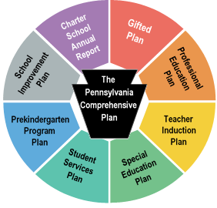

Slide 23
Special Education Plan Revision Notice
WHAT | When LEA proposes to make changes to their submitted Special Education Plan (new classroom, closing classroom, change to caseloads, etc.)
WHO | An LEA Representative (usually the director/supervisor of special education)
WHY | Reflection of on-going programs and services and incorporates anticipated changes in programming as a result of corrective action
WHEN | Ongoing when a change is made – must be submitted 30 days prior to implementing the proposed change
Notes:
Special Education Plan Revision Notices (SEPRN’s) is an on-going update to the school entities’ special education plan. Any changes – new classrooms, closing classrooms, shifting of caseloads - must be submitted for approval 30 days prior to proposed changes. Transfer of entity after March 31 requires signatures from the IU Executive Director prior to BSE approval.
SEPRN’s reflects on going programs and services and incorporates anticipated changes in programming as a result of corrective action generated by the cyclical monitoring and improvement planning and other factors. The special education plan is completed by school districts in conjunction with the school district's strategic plan structure. The school district's special education plan is on a three year cycle which corresponds to the school district's strategic plan cycle so that the information in the special education plan can be applied to the school district's strategic plan, especially the professional education and induction programs.
A SEPRN is submitted on the PDE website through the special education plan window. When submitted, the website notifies your SPoC to review. Your SPoC will contact you to set up a time to visit and discuss before formal approval. Once completed, the SEPRN will be submitted by your SPoC to division chief.
All SEPRNs must be completed 30 calendar days prior to the implementation of the change to the special education plan.
“Planning Leader” status has to be assigned in order to submit SEPRN. This is done in within the LEA.
What was the last SEPRN you did? Share out.

Slide 24
4010/4011 (Applications for Approved Private Schools)
WHAT | The electronic forms used when placing a student outside of the district of residence into an APS or when a student returns from an APS
WHO | School District of Residence
WHY | Because these placements are partially funded by the State, all must reported
WHEN | Every time a student is placed in an APS (4010) or returns from an APS (4011)
Notes:
http://www.education.pa.gov/K-12/Special Education/Pages/Approved-Private-Schools-and-Chartered-Schools-for-the-Deaf-and-the-Blind.aspx
The school district of residence or charter school will input all of the 4010’s and 4011’s. All current students have been transitioned to the new system. For technical assistance, please check the webinar on the PaTTAN-Harrisburg website or contact Stacey Mears at smears@pa.gov.
The school district or charter school will also input Preschool Early Intervention students into the system with information provided by the MAWA or the Preschool Early intervention program. Please have the school district/charter school staff contact their local Preschool Early Intervention program to identify who the contact person from the established Preschool Early Intervention program will be handling any procedural concerns related to students in the EI program who are enrolled in an APS and participating in the APS 4010 funding process. We appreciate your cooperation in this important enrollment process. The Approved Private Schools (APSs) are private schools, licensed by the State Board of Private Academic Schools. The Chartered Schools for the Deaf and the Blind, which are exempt from licensure. Both groups are approved by the Secretary of Education to provide a free appropriate special education for students with severe disabilities. The schools are eligible to receive funds from the school districts and/or the Commonwealth for the education of these students. Pennsylvania currently has four PA chartered and 31 non-charter APSs for which the Department approves funding. These schools provide a program of special education for over 4,000 day and residential students. A Directory of Approved Private and PA Chartered Schools for the Deaf and the Blind (pdf) is available by mail from the Bureau of Special Education or at this web site in PDF version.
Placement of students in a relatively restrictive environment such as an APS or PA Chartered School, must be based on the student's individual needs. Chapters 14,and 171 of the state's special education regulations and standards govern placements. These provisions require, among other things, that placement shall be based on the following:
The appropriate level of intervention,
The appropriate location of intervention, and
The appropriate grouping of students
Generally, the permissible justification for removing a child from the student's regular educational environment is only when the nature or intensity of the disability is such that education in regular classes with the use of supplementary aids and services cannot be achieved satisfactorily.
When a school district and the parent agree that the only source of an appropriate program of education for an eligible student is in an APS, in accordance with the stated admission policy of the particular APS, the recommendation and supporting documentation is forwarded to the Bureau of Special Education for final approval/disapproval of payment.
Costs for school age students placed in APSs are shared between the school district of residence and the Commonwealth.
APSs are an important and necessary part of Pennsylvania's special education delivery system. These schools provide some students with what may be the only appropriate education program currently available.
The electronic system to input 4010’s & 4011’s for students in Approved Private Schools (APS) or Chartered Schools for the Deaf and Blind began July 1, 2016. The new system is called APSEM and will be housed in PDE Suites. Each occurrence to create a 4010 request for funding & 4011 program change to an approved private school (APS) and Chartered Schools for Deaf/Blind (CSDB) must be entered into this system. A directory listing of schools was updated May 2016.
Sure. It is a topic that gets folks confused quite easily. 4010 refers to the processing of placement for a child to be enrolled in a state-subsidized school (APS or chartered school like WPSD). 4011 is the process for sending them back to their home district (completed by the district). The APSEM system, which was rolled out last summer, is an electronic version of this process. It helps us to track acceptance, enrollment.. etc much more efficiently that the paper process. In order for a child to be approved for a funded slot, there must be a PDE approval. Students can be enrolled, at a full tuition rate (paid by the district), if need is proven, but a funded slot is not available.

Slide 25
List of Approved Private Schools (APS)
Directory of Approved Private Schools
and
Chartered Schools for the Deaf and the Blind
May, 2020 Update
https://www.education.pa.gov/Documents/K-12/Special%20Education/APS%20Directory.pdf

Slide 26
PDE Website – www.education.pa.gov
Do you have your username and password for the PDE Portal?
If so, can you locate your Comprehensive Plan and Special Ed Plan?
Do you know how to complete a SEPRN?
If you answered NO to any of these questions, please contact your Bureau of Special Education Adviser (BSE)
http://www.education.pa.gov/k-12/special%20education/pages/default.aspx#tab-1
Notes:
Culminating slide for this section. Just remind participants that if they can’t answer any of these questions, they should contact their BSE adviser.
If you do not know who your BSE adviser is, you can find it on the PDE Website.

Slide 27
Reporting by Location (Leader Services)
PDE Website | Leader Services
Comprehensive Plan | Restraint Information System of Collection (RISC)
Special Education Plan | Special Education Students @ Home Homebound Instruction Instruction Conducted in the Home
Special Education Plan Revision Notice (SEPRN) | Act 16 Special Education Contingency Fund
4010/4011 APS Requests | Indicator 14 Post School Outcome Survey
 | Cyclical Monitoring for Continuous Improvement (CMCI) Targeted/Focused Monitoring
Notes:
These are the various reporting expectations that LEAs are responsible for. You will see that some reporting protocols are done through the PDE website and some are done through the Leader Services Website

Slide 28
Restraint Information System Collection (RISC) Reporting Windows
Reporting windows have been updated to allow districts to analyze their data and not only report their data.
Quarter | Begin Date | End Date | Last Day to Report
1 | 7/1/2020 | 9/30/2020 | 10/18/2020
2 | 10/1/2020 | 12/31/2020 | 1/15/2021
3 | 1/1/2021 | 3/31/2021 | 4/15/2021
4 | 4/1/2021 | 6/30/2021 | 7/15/2021
Press Here
https://apps.leaderservices.com/_risc/index.aspx
Notes:
https://apps.leaderservices.com/_risc/index.aspx
The reporting dates for 2019-2020 are indicated in this table.
***While the system has been enhanced with quarterly requirements and gives LEAs greater opportunity to provide both more detail about restraints and to analyze trends in reducing the use of physical restraints on students, the Bureau of Special Education encourages the LEAs to report the restraints in RISC in as timely a manner as possible and not wait until the end of each reporting quarter.***
Questions regarding RISC or the RISC Webinar should be directed to Keith Focht, Special Education Adviser, at 717.783.6921 or kfocht@pa.gov.

Slide 29
Documentation Needed for RISC
PA Secure ID
Grade
Age
Student’s Disability
Program Location
Antecedent
Behavior of Concern
De-escalation Techniques used prior to restraint
Date of Restraint
Physical Location
Type of Restraint Used
Minutes/Seconds of restraint
Number of Staff who conducted the restraint
Titles of those who conducted restraint and whether each staff member is “trained and certified in de-escalation techniques and safe physical restraints” (Y or N)
Did injury occur (student)?
Did injury occur (staff)?
If serious student/staff injury occurs, must report to BSE (date)
Notes:
For LEAS – This is the required information that needs to be documented in the RISC system every time a restraint is conducted.
Each LEA should have some type of internal form which aligns with these items to give to all schools that house your students (within district and out of district)

Slide 30
Additional Documentation Needed for RISC
Was the child restrained referred to law enforcement?
Date of Parent Notification
Was the Use of Restraints Listed in the IEP?
Date IEP Meeting Held (if not waived)
Was IEP Meeting held within 10 school days of the restraint?
Date Waiver Signed (not required if IEP meeting held
Results of IEP Meeting:
FBA Reevaluation
New Behavioral Support Plan
Revised Behavioral Support Plan
Change of Placement
Notes:
This includes additional information needed in the RISC system

Slide 31
For more RISC Information . . .
https://apps.leaderservices.com/_risc/index.aspx
Restraint Reporting Guidelines
PennLink
USDoE resource document of restraints and seclusion
Restraint Entry Form that can be sent out to gather restraint information
Contact:
Keith Focht
kfocht@pa.gov
717-783-6921
Notes:
All of these documents are located on the RISC site (Leader Services).

Slide 32
Restraint Conversation
Does your LEA use a common restraint document for all of your students both within your schools and out of the district? Is it aligned with the data points requested by the RISC system?
What procedures do you have in place to ensure that people involved in the restraint understand the required reporting protocol?
Notes:
Virtually: Restraints - Pose the questions on the slide; unmute volunteer participants in order to allow them to share out their LEAs procedures and documentation protocol.

Slide 33
Special Education Students @ Home
https://apps.leaderservices.com/seshomenet/index.aspx
Notes:
Homebound Instruction and Instruction Conducted in the Home have to be reported in Leader Services under Special Education @ Home.

Slide 34
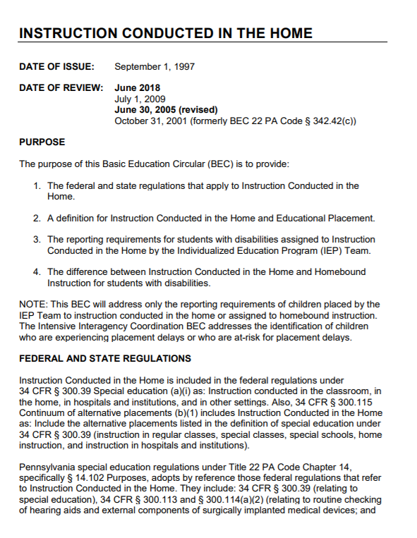
Homebound Instruction & Instruction Conducted in the Home
Notes:
Virtually: Reference hard copies of both documents.
BEC - https://www.education.pa.gov/Documents/Codes%20and%20Regulations/Basic%20Education%20Circulars/Federal%20Code/Instruction%20Conducted%20in%20the%20Home.pdf

Slide 35
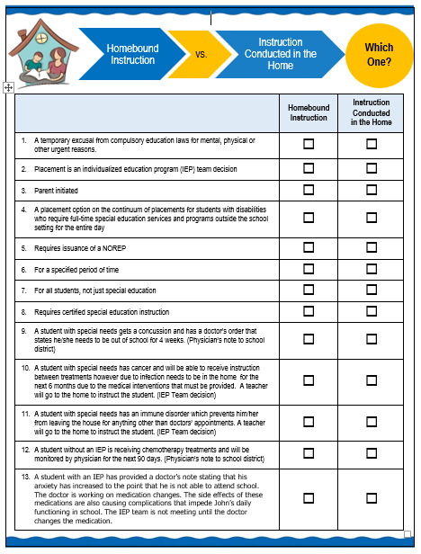
HBI or ICITH Activity
Notes:
Virtually: HBI or ICITH Activity - Give participants time to complete activity on their own; come back as a group for a “share out” of answers live.
Have the participants utilize the publication to answer the scenarios.

Slide 36
Procedures for Initial Placement
Reports must be made within five (5) days of the placement.
LEAs should use their Administrative Unit Number as the username to log into the website. The password is identical to the one used to log into the Compliance Monitoring System on Leaderservices.com.
Indicate, if after a reevaluation, it is expected that the student will be on Homebound Instruction or Instruction Conducted in the Home.
Include a brief description as to why the student is on Homebound Instruction or Instruction Conducted in the Home.

Slide 37
Procedures for Follow-Up Reporting
LEAs submitting follow-up reports for these records should do so via the website. If a student returns to school, the date of their return should be recorded in the “When did student return to school?” field, then click Save.
Indicate if it is expected that the student will be on Homebound Instruction or Instruction Conducted in the Home for longer than three months.
Report student to the Leader Services website if filing an extension using PDE 4675 Homebound Instruction form and PDE 4676 Request/Approval for Homebound Instruction form.
Report “Day Student Returned to School,” including last day of school if Homebound Instruction or Instruction Conducted in the Home lasted until the end of the school year.

Slide 38
Procedures for Extended Reporting
If the placement is being extended, provide a reason for the extension in the “Provide brief explanation why student is on Homebound or placed on Instruction Conducted in the Home” field and record the new anticipated return date in the “Extended Anticipated Length of Placement” field then click Save.
The “Extended Anticipated Length of Placement” field may be updated as many times as necessary; however, it is requested that extensions are reported.

Slide 39
Act 16 Expenditures Per Student Report
WHAT | Act 16 of 2000, in part, amends Section 1372 of the PS code and requires PDE to annually compile information listing the number of students with disabilities in one of three financial categories.
WHO | All 500 school districts and 177 charter schools. There is an expected 100 percent reporting rate for this data.
WHY | This data is an assessment of the individual cost of the delivery of special education services to each child in each of the three categories.
WHEN | This data collection occurs during Collection #1 in the Pennsylvania Information Management System reporting system during the month of October.
Notes:
Questions regarding Act 16 can be directed to Don Dolbin @ ddolbin@pa.gov. (2020)
https://www.education.pa.gov/K-12/Special%20Education/FundingGrants/Pages/Act16Guidelines.aspx
Information provide on PDE Handout “Act 16 Expenditures Per Student Guidance”
Reporting is required for special education students with Individualized Education Programs (IEP) only. When determining the cost of student’s program, it is important to consult with all local educational agencies, school district and charter school staff involved in the administration of a child’s IEP. (This also includes the sharing of information between the local educational agency/school district/charter school and intermediate unit, where applicable.
Responsibility
The responsibility of reporting the student with an IEP lies with the School district of residence, not the educating local educational agency, intermediate unit, approved private school (APS), county prison, career and technology center (CTC), or other entity.
Exceptions
1. Charter School – these students are reported by the charter school
2. 1305 (Nonresident children placed in foster care) – these students are reported by the school district in which the student resides with the foster parents.
3. Wards of State – Do not report Wards of State. If a student becomes a ward of state during the school year, only report those expenditures during the time the student was not a ward of state.
4. Gifted Students – these students are not included in the special education submissions.
Include the following when reporting the cost per student:
Instructional Cost per Student
1. Classroom teacher (prorated)
2. Classroom aids (prorated)
3. Para-profession/one-to-one aid assigned to specific student (total cost)
4. General education as it applies to special education services
Related Services Cost per Student
1. Specialized Transportation
a) Bus/van that is required in the IEP for more than one student (prorated)
b) Bus/van required for one specific student (total cost) August 2018 2
2. Speech group (prorated)
3. Individual services including speech, occupational therapy, physical therapy, vision services, hearing services, orientation and mobility (total cost)
4. One-to-one nurse (total cost)
5. Para-profession, one-to-one aid assigned to specific student (total cost) (if no accounted for elsewhere) Specialized Equipment Cost per Student
Specialized Equipment Cost per Student
1. Braille materials specific to student (total cost)
2. Assistive technology
3. Other equipment required per IEP
Do NOT include the following items in the reported cost per student:
1. Management fees
2. Non-specialized transportation
How/When Will Act 16 Be Reported This Year?
PIMS Collection 1 - October
PIMS Student Fact Template Specifications for use in submitting the Act 16 Report
Refer to Appendix AJ of Volume 2 of the PIMS User Manual for a complete list of valid values.
Appendix AJ – Categories to use in the student Fact Template for Special Education Act 16 Funds Code Description
1 $1 - $25,628.39 (Category 1 special education funding formula)
2 $25,628.40 - $51,256.79 (Category 2 special education funding formula)
3 $51,256.80 - $76,885.19 (Category 3 special education funding formula)
4 $76,885.20 and OVER (Category 4 special education funding formula)

Slide 40
Special Education Contingency Fund
WHAT | The Secretary of Education under P.S. §25-2509.8 was given the authority to establish guidelines for the application, approval, distribution and expenditure of funds for extraordinary special education program expenses
WHO | For students with significant disabilities whose expenses result from needs/circumstances which are not ordinarily present in a typical special education service and program delivery system and which costs exceed the state funding
WHY | To help LEAs offset costs of extraordinary educational needs of a child with significant disabilities who requires a highly specialized program or related services in order to receive an appropriate education, in the LRE
WHEN | Applications are usually accepted between November and January
Notes:
Questions regarding Contingency Funds: Janette Fulton
What: The Secretary of Education under P.S. §25-2509.8 was given the authority to establish guidelines for the application, approval, distribution and expenditure of funds for extraordinary special education program expenses, also known as Special Education Contingency Funds. The fund’s purpose is to provide additional state funding for the implementation of the Individualized Education Program (IEP) for a student with significant disabilities. A contingency fund application may be submitted by a school district or charter school to partially meet the extraordinary educational needs of an individual child with significant disabilities who requires a highly specialized program or related services in order to receive an appropriate education, in the least restrictive environment. The Department of Education (PDE) considers the following to constitute extraordinary expenses: Expenses that result from needs and circumstances of a student with significant disabilities, which are not ordinarily present in a typical special education service and program delivery system and which costs exceed the school district, or charter school funding. In order for a maximum number of LEAs to participate, a school district or charter school may receive contingency funds in an amount not to exceed $150,000. Funds will be disbursed in the May 2018 Unipay
Who: Applications will be accepted electronically starting on November 20, 2017 and will be accepted until January 5, 2018. Faxes will not be accepted. Applications received after January 5, 2018 will not be considered. Applicants must use the 2017-2017 web-based application form. The student’s IEP in place at the time services were provided must be submitted with an application. IEPs are submitted electronically or by fax to Leader Services. No information is to be transmitted directly to the Bureau of Special Education. Contracted services through Intermediate Units, private schools, consortia programs or other contractors no longer must be itemized by individual service. The Bureau of Special Education will accept a tuition statement for individual student services. The statement must clearly indicate that the services contracted for are educational only.
Note: Paper application forms will NOT be accepted. Applications that do not include requested IEPs, applications that do not include the 2016-2017 IEP, as well as, applications that do not include all the required information listed below, will be considered incomplete and will not be considered for funding. Each application must include the following information: • Student’s Disability • Student’s Educational Placement (includes Learning Support, Emotional Support, Multiple Disabilities Support, etc.); • Student’s IEP; • A specific explanation of the extraordinary circumstances; • A brief narrative background of each eligible student; • For students in programs operated by the requesting LEA, the LEA must itemize special education service and program costs for each student in the 2016-2017 year for whom an application is being submitted.
WHY: Applications with Total Eligible Costs of $75,000 or more will be reviewed on the basis of the unique needs of each child with priority given to those students with the most significant needs and greatest financial impact on the LEA. Only reviewing applications above a preselected threshold will ensure the approved applications will receive a higher prorated amount. Therefore, not all eligible applications will receive funding. Expenses will be approved based on the following criteria: • Expenses incurred for students with low-incidence disabilities, whose needs require interventions that are substantially different from those provided to students without disabilities in that the interventions require highly specialized personnel, special training, assistive technology, and equipment. For example, interventions under this definition include, but are not limited to: Assistive technology services, Braille services, oral/sign language, interpreting services, real-time captioning services, orientation and mobility services and consultation with experts in the student’s disability program area. • Expenses that result from the development of a broader range of services and programs for a student with disabilities that enable the school to deliver these services and programs as described in 22 PA Code §14.131(1). • Specific staffing expenses that result from the establishment of a fully integrated or inclusive service delivery setting for a student or students with disabilities. Upon review of a school district or charter school application, any ineligible cost that is included in the total cost will be subtracted. This net result is further reduced by state subsidy for school district and charter schools.
WHEN: Applications will be accepted electronically starting on November 23, 2015 and will be accepted until January 8, 2016. Faxes will not be accepted. Applications received after January 8, 2016 will not be considered. Applicants must use the 2015-2016 web-based application form. PDE will fund requests received by January 8, 2016 up to the total amount available.
http://www.education.pa.gov/Documents/K-12/Special%20Education/Funding%20Sources/Contingency%20Fund%20Guidelines%202017-18.pdf

Slide 41
Search and Share
Google: PA Special Education Contingency Fund
Contingency Fund Guidelines for Extraordinary Special Education Program Expenses 2019-2020
Applications with Total Eligible Costs of $_______ will be reviewed
Applications should be submitted by what date?
What are some expenses NOT eligible for reimbursement?
Notes:
Virtually: Search & Share - Contingency Funds - Give participants time to complete - share their answers in the chat box
Applications with Total Eligible Costs of $75,000 will be reviewed
Applications should be submitted by what date? January 3, 2020
What are some expenses NOT eligible for reimbursement?
Funds requested to augment typical special education services, such as non-specific curriculum materials and non-specific technology purchases such as classroom computers. • Costs attributable to services for which the school is already receiving state reimbursement. This includes students in Approved Private Schools (APS) or approved Out-of-State Placements. However, if a school district is paying 100% of an educational cost to an APS, this cost is eligible for contingency funds. • Administrative costs such as principal’s office costs, legal fees, secretarial support, rent, building costs, copying fees, etc. • Prorated costs of regular education teacher time during mainstreaming or inclusion. • Non-specific building aides, playground aides, bus aides • Non-extraordinary nursing or counseling services • English as a Second Language instruction • Extended School Year • Residential costs of private school placements • Costs of compensatory education

Slide 42
Contingency Fund Activity
Contingency Fund Guidelines August, 2020
How many students do you have who reach the $75,000 threshhold?
Where can you find this information?
Who can you contact or what other resources can you utilize in order to gather this information?
https://www.education.pa.gov/Documents/K-12/Special%20Education/Funding%20Sources/Contingency%20Fund%20Guidelines.pdf
Notes:
Virtually: Contingency Fund Activity - Can be completed individually or in small breakout rooms, then return to the whole group and share out.
Have participants take out the Contingency Fund Activity Worksheet
Have the participants see if they fill out this chart based on their “most expensive student.” If there are areas that they are struggling to fill out, ask questions:
How many students do you have that reach the $75,000 threshold?
Where can you find this information?
Who should you contact to gather this information?

Slide 43
PA Post School Outcomes (Indicator 14)
PA Post School Outcomes Survey (Indicator 14) reported every 5 years
https://apps.leaderservices.com/_outcomes/
Notes:
Indicator 14 Post School outcomes survey. This is a 2 year process. One year, LEAs collect information for the student leavers and the following year, they collect information on the students one year after leaving school.
https://apps.leaderservices.com/_outcomes/

Slide 44
Education/Training Questions
Since leaving high school have you enrolled in any type of education or training program?
If so, full time, part time, completed one full year?
What accommodations have you received in your education or training program?
If not, why?

Slide 45
Employment Questions
Since leaving high school have you been employed?
If so, what type (competitive, military, etc.)
Have you been employed for at least 90 days
How many hours per week do you average
Were you paid at least minimum wage?
What accommodations have you received at your place of employment
If not, why?

Slide 46
Independent Living Questions
How much help do you need with each of these activities:
Housework
Making appointments
Money management
Personal Hygiene
Meal planning and preparation
Decision making
Maintaining health and fitness
Arranging transportation
Participating in recreation/leisure activities
Involvement in community organizations
Voting

Slide 47
Indicator 14 (PaPOS) Data
Targets (in purple) Actual Data (in green)
 | 2015 | 2016 | 2017 | 2018 | 2015 PA Data
Enrolled in higher education within one year of leaving high school | 26.4% | 27.1% | 27.8% | 28.5% | 28.84%
Enrolled in higher education or competitively employed within one year of leaving high school | 60.8% | 61.0% | 62.0% | 65.0% | 67.32%
Enrolled in higher education or in some other postsecondary education or training program; or competitively employed or in some other employment within one year of leaving high school. | 68.8% | 69.9% | 70.9% | 72.0% | 73.34%

Slide 48
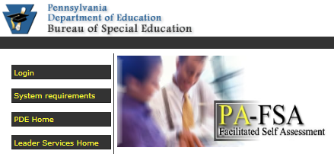
Cyclical Monitoring for Continuous Improvement (CMCI)
https://apps.leaderservices.com/_pde_comp_mon/
When was your LEA’s last monitoring?
Does your LEA have an outstanding Corrective Action Verification Plan (CAVP)?
When is your LEA’s next monitoring?
Notes:
https://apps.leaderservices.com/_pde_comp_mon/
Also, PaTTAN website under Legal, CMCI Process

Slide 49
Targeted/Focused Monitoring
Suspensions and Expulsions (Indicator 4)
Least Restrictive Environment (Indicator 5)
Or if particular compliance issues are noted requiring closer review
If your rates are significantly discrepant in either of these areas, you may be notified of your LEA being targeted for monitoring
https://apps.leaderservices.com/_pde_comp_mon/
Notes:
http://www.education.pa.gov/K-12/Special%20Education/Pages/Compliance.aspx#tab-1
Conducts Compliance Monitoring for Continuous Improvement (CMCI) of school districts, charter schools, and early intervention programs to ensure compliance with applicable regulations;
Cyclical Monitoring is conducted every six years among all public school districts and charter schools;
Focused Monitoring may be conducted annually among school districts and charter schools whose data does not meet established accountability benchmarks;
Targeted Monitoring may be conducted among school districts and charter schools where particular compliance issues are noted requiring closer review;
In accordance with the Gaskin Settlement Agreement Least Restrictive Environment (LRE) Monitoring will be conducted among school districts that are the lowest ranking in the state in including special education students in regular education classrooms for all or part of the school day;
Following monitoring visits, PDE sends reports to the school districts detailing results. The school district must correct any difficulties that are present. BSE staff verifies the school districts' corrective actions.
If a school district is 1.5 times greater than the state rate is a candidate for targeted monitoring

Slide 50
Leader Services: www.leaderservice.com
Do you have your username and password for Leader Services website?
If so, can you locate RISC, Special Education Students @Home, etc?
Do you know how to complete a restraint report?
If you answered NO to any of these questions, please contact your BSE Adviser!
Notes:
Culminating slide for this section. Just remind participants that if they can’t answer any of these questions, they should contact their BSE adviser.

Slide 51
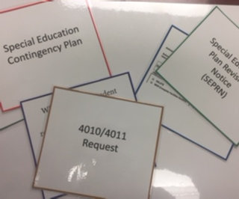
Reporting Matching Activity
game.educaplay.com
PIN – 838817
Breakout
&
Challenge
Notes:
Spring, 2021 Results - https://www.educaplay.com/user/4042264-sielke/challenges/
PIN - 838817
This virtual game originates from Educaplay –
West Region –https://www.educaplay.com/ | u/n scaparelli@pattan.net p/w Chopin88 |
Send participant into Zoom Breakouts in teams with this website and PIN –
Reporting Matching Activity Challenge participant website game.educaplay.com PIN– 425512

Slide 52
Reporting Matching Activity (HBG)
game.educaplay.com
PIN – xxxxxx
Breakout
&
Challenge
Notes:
This virtual game originates from Educaplay –
Send participant into Zoom Breakouts in teams with this website and PIN –
Reporting Matching Activity Challenge participant website game.educaplay.com PIN– xxxxxx

Slide 53
Reporting Matching Activity (East)
game.educaplay.com
PIN – xxxxxx
Breakout
&
Challenge
Notes:
This virtual game originates from Educaplay –
Send participant into Zoom Breakouts in teams with this website and PIN –
Reporting Matching Activity Challenge participant website game.educaplay.com PIN– xxxxxx

Slide 54
Components of Cyclical Monitoring for Continuous Improvement (CMCI)
Notes:
In many LEA’s, the SE Leader may have dual administrative responsibilities like, curriculum requirements, 504 requirements, Gifted, Alternative Education, Athletic Director, Pupil Services, Principal.

Slide 55
Cyclical Monitoring
“…PDE provides general supervision over all public schools, school districts, and other public education agencies within the state to ensure that each student with a disability receives a Free Appropriate Public Education (FAPE) and that each family has the benefits of a system of procedural safeguards.”
Notes:
http://www.education.pa.gov/K-12/Special%20Education/Pages/default.aspx#tab-1
In accordance with the Individuals with Disabilities Education Act (IDEA) and Chapters 14 and 15 of the State Board Regulations, PDE provides general supervision over all public schools, school districts, and other public education agencies within the state to ensure that each student with a disability receives a Free Appropriate Public Education (FAPE) and that each family has the benefits of a system of procedural safeguards.

Slide 56
CMCI
Cyclical Monitoring for Continuous Improvement (CMCI)
Don’t be afraid – this is formative.
Learn and apply.
Notes:
Stress to participants, that the process is formative in nature and will offer resources for areas that require improvement.

Slide 57
Embrace the Journey of CMCI
For those who have been through CMCI…
What advice do you have to offer?
For those who have NOT been through CMCI…
What questions do you still have?
Notes:
Set the tone for the poster activity here.

Slide 58
Major Document Components of CMCI
Facilitated Self Assessment (online)
Student, Parent and Teacher Surveys (online)
Administrative Interview (on site)
File Reviews (on site)
Classroom Observations (on site)
Parent and Teacher Interviews (on site)
Educational Benefit Review
Notes:
Virtually: Cyclical Monitoring Poster Activity - Create groups and a breakout room for each “poster”. Assign reporters/recorders. After breakout rooms occur, come back to large group and have share out by reporters as you go through slides . (Consultants will give information on each component slide; after each, then have reporter give their advice and questions from each breakout room.) There will still need to be consideration for assigning seasoned leaders with novice leaders to enhance discussion. Information on veterans/novice could be garnered at the beginning of the training and one consultant could then arrange for the groups to be ready when it is time for this activity.

Slide 59
1. Facilitated Self-Assessment (FSA)
Trained by BSE prior to start of the school year
All topics require documentation and explanations
Pre-populated data needs to be reviewed to include most recent data for accuracy and addressed in the narrative

Slide 60
Search and Share
PDE Website:
School District Facilitated Self Assessment
How many topics are there in the FSA?
What are some of these?
Notes:
Virtually: Search & Share FSA - Give participants time to complete; then share their responses in the chat box.
http://www.education.pa.gov/Documents/Teachers-Administrators/Comprehensive%20Planning/Chapter%204%20Planning%20Requirements%20Overview.pdf
Special Education Plan – 3 years
Professional Education – 3 years
Pre K – Every 3 years or when plan is amended
Induction – 6 years
Student Services – 6 years
Gifted – 6 years
After the group has answered these questions, have the group explore the comprehensive planning wiki site.

Slide 61
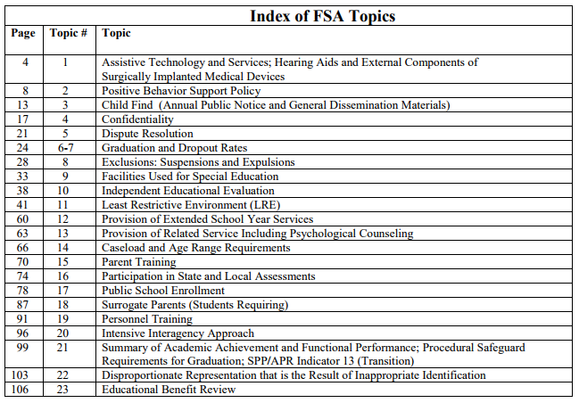
23 Topics for FSA
Notes:
Hide slide for handout

Slide 62
2. Student, Parent and Teacher Surveys
LEA is responsible for disseminating the surveys to all parties
Surveys are on-line
Hard copies are available in English and Spanish – must then be submitted into the database

Slide 63
3. Administrative Interview
LEA may provide interview questions prior to the interview so administrators can prepare
The more administrators that participate, the better
5 sections
Demographics
Administrative structure
Collaboration with families
Provision of Services in the LRE
Strengths and Needs

Slide 64
4. File Review (for students selected)
Most Recent Documents needed:
Permission to Evaluate/Reevaluate
* ER/RR document
Invitation
Consent to Excuse (if required)
IEP (including documentation related to FBA and Progress Monitoring)
NOREP/PWN
10 additional student files are reviewed for students of transition-age as well

Slide 65
5. Classroom Observations
Only applies to school districts/not cyber charter schools
Single Point of Contact (SPoC) will provide guidance on how many observations will be needed
Observations are completed for students who have been chosen for the file review

Slide 66
6. Parent and Teacher Interviews
LEA may provide interview questions prior to the interview
Interviews are completed for students who have been chosen for the file review
LEA should provide a quiet environment with a phone in order to contact parents for the interview
LEA is responsible for interview schedule

Slide 67
7. Educational Benefit Review (EBR)
Educational Benefit Review (EBR) and the Law
The basis for the EBR is found in §300.324 of the IDEA 2006 Regulations, which states that “each public agency must ensure that the IEP team:
Reviews the IEP periodically, but not less than annually to determine whether the annual goals for the child are being achieved;
Revises the IEP, as appropriate, to address any lack of expected progress toward the annual goals, and in the general education curriculum, if appropriate.”
Notes:
After completion of this slide:

Slide 68
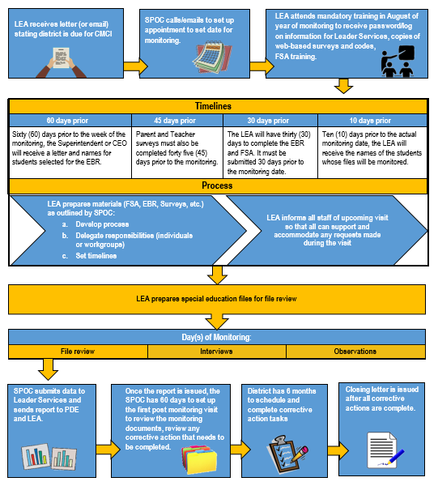
CMCI Process
Notes:
Pass out flowchart and walk through the process.

Slide 69
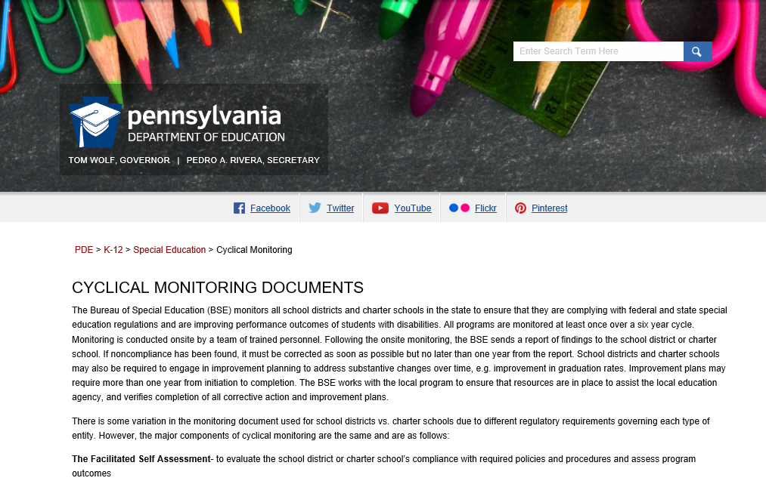
PDE Website
Simply Google:
PDE and CMCI
Notes:
Also, PaTTAN website under Legal, CMCI Process

Slide 70
What is a POLICY/PROCEDURE?
Policies are written documents that reflect local specifications as well as current state and federal laws and regulations.
States how an organization must operate in light of relevant governing bodies.
States where the organization stands
Generally written and approved by upper management and governing bodies
Procedures define implemented protocol that fulfill or endorse the policies it is supporting.
Step by step actions written by leaders at the operations level of the organization.

Slide 71
Policy Standard Sequence
000 – 99 = Local Board Procedures
100 – 199 = Programs
200 – 299 = Pupils
300 – 399 = Administrative Employees
400 – 499 = Professional Employees
500 – 599 = Classified Employees
600 – 699 = Finances
700 – 799 = Property
800 – 899 = Operations
900 – 999 = Community
Notes:
http://65.61.24.229/districts_policies/p/000/index.asp - Do you know where to go to review sample policies?
When making programming decisions, be sure you are aware of the many standing policies that contribute to your decisions.

Slide 72
Know Your District Policies and Practices !
Review
How are district policies cycled throughout regularly scheduled board meetings?
Who updates policies as federal and state laws evolve?
If you were to recommend an update, do you know who to talk to?
Where can you go to review sample policies?
Notes:
Virtually: District Policy Practices - Volunteer participants can share out in the chat box.
Policies should be reviewed on a regular basis – according to PSBA, the recommended cycle of review is every 3 years.
Many LEAs have an established committee for this work – is this another of your responsibilities?

Slide 73
Required Policies for CMCI
Required Policies | Legal
Positive Behavior Support | 22 Pa. Code 14.133 BEC
Confidentiality | 34 CFR 300.610 through 300.627 & 300.535(b)(1)(2) 444 of GEPA FERPA
Public School Enrollment | 22 Pa.Code 11.41 BEC Enrollment of Students Jan 22, 2009
School Visitor Policy | 34 CFR 300.34(c)(8)(i)(ii)(iii) (8)(i) Ensures reasonable classroom access for parents Under Topic 15 Parent Training in the FSA
Notes:
PBIS must include annually updated training records.
Confidentiality Policy must be incompliance with all federal and state regulations.
610 = personally identifiable information is protected
611-627 = how those records are collected, stored, maintained,
535 = transmittal of records, especially discipline records
General Education Provisions Act (GEPA) to ensure the confidentiality of any personally identifiable information.
FERPA – Family Educational Rights &Privacy Act federal privacy law that gives parents certain protections with regard to their children's education records, such as report cards, transcripts, disciplinary records, contact and family information, and class schedules.
Public School Enrollment policy considers the percentage of students in each disability category and how it compares to the State averages. LEAs must be prepared to explain any extraordinary rates. BSE personnel will also be examining enrollment date and provision of FAPE for students with disabilities into the LEA from in state and out of state. There must be a policy in place regarding how enrollment is managed for students with disabilities, and that students within each disability category have been identified, located and evaluated.
School Visitor Policy STANDARD – PARENT TRAINING Parent opportunities for training and information sharing address the special knowledge, skills and abilities needed to serve the unique needs of children with disabilities.
REGULATORY BASE - 34 CFR 300.34(c)(8)(i)(ii)(iii) (8)(i) Parent counseling and training means assisting parents in understanding the special needs of their child; (ii) Providing parents with information about child development; and (iii) Helping parents to acquire the necessary skills that will allow them to support the implementation of their child’s IEP or IFSP.

Slide 74
Positive Behavior Support Look Fors
Policy is current
Restraint
Use
Training of personnel
Reporting
SPoC will review LEA data in RISC system
Notes:
Positive Behavior Support – 22 Pa. Code 14.133 (f) School entities have the primary responsibility for ensuring that positive behavior support programs are in accordance with this chapter, including the training of personnel for the use of specific procedures, methods and techniques, and for having a written policy and procedures on the use of positive behavior management support techniques and obtaining parental consent prior to the use of restraints or intrusive procedures as provided in subsection (c). (h) Subsequent to a referral to law enforcement, for st
students with disabilities who have positive behavior support plans, an updated Functional Behavioral Assessment and positive behavior support plan shall be required.
Chairperson (SPoC) will review the LEA’s policy looking for:
1. Positive techniques for the development, change, and maintenance of behaviors shall be the least intrusive necessary.
2. Restraints to control acute or episodic aggressive or self-injurious behavior may be used only when the student is acting in a manner as to be a clear and present danger to himself, to other students, or to employees, and only when less restrictive measures and techniques have proven to be or are less effective.
3. The use of restraints to control the aggressive behavior of an individual student shall cause a meeting of the IEP team to review the current IEP for appropriateness and effectiveness.
4. The use of restraints may not be included in the IEP for the convenience of staff, as a substitute for an educational program, or employed as punishment.
5. Mechanical restraints, which are used to control involuntary movement or lack of muscular control of students when due to organic causes or conditions, may be employed only when specified by an IEP and as determined by a medical professional qualified to make the determination and as agreed to by the student’s parents. Mechanical restraints shall prevent a student from injuring himself or others or shall promote normative body positioning and physical functioning.
6. The following aversive techniques of handling behavior are considered inappropriate and may not be used by agencies in educational programs:
• Corporal punishment
• Punishment for a manifestation of a student’s disability
• Locked rooms, locked boxes, or other locked structures or spaces from which the student cannot readily exit
• Noxious substances
• Deprivation of basic human rights, such as withholding meals, water, or fresh air
• Suspension constituting a pattern under 22 Pa. Code 14.143(a)
• Treatment of a demeaning nature
• Electric shock
• Prone Restraints are never used
7. LEA has the responsibility for ensuring that Positive Behavior Support programs are in accordance with 22 Pa. Code Chapter 14, including the training of personnel for the use of specific procedures, methods, and techniques.
8. Policy requires that the LEA obtain parental consent prior to the use of restraints or intrusive procedures when included in a student’s IEP as reflected in 22 Pa. Code Chapter 14.133(f).

Slide 75
Confidentiality Look Fors
LEA’s Confidentiality Policy includes all required components
LEA personnel receive adequate training regarding confidentiality
Personnel are familiar with requirements for transfer of records to appropriate authorities for students with disabilities who commit a crime
Notes:
Confidentiality – 34 CFR 300.610 The Secretary takes appropriate action, in accordance with section 444 of GEPA, to ensure the protection of the confidentiality of any personally identifiable data, information, and records collected or maintained by the Secretary and by SEAs and LEAs pursuant to Part B of the Act, and consistent with §§ 300.611 through 300.627.
Referral to and action by law enforcement and judicial authorities - 34 CFR 300.535(b)(1)(2) (b) Transmittal of records. (1) An agency reporting a crime committed by a child with a disability must ensure that copies of the special education and disciplinary records of the child are transmitted for consideration by the appropriate authorities to whom the agency reports the crime. (2) An agency reporting a crime under this section may transmit copies of the child’s special education and disciplinary records only to the extent that the transmission is permitted by the Family Educational Rights and Privacy Act.

Slide 76
Public School Enrollment Look Fors
Staff responsible for enrollment are aware of the regulatory requirements
Written procedures exist to address these requirements
Timely provision of FAPE
Compare LEA enrollment of students with disabilities with those of the state
Review disability categories for proportionality
Notes:
1st STANDARD – PUBLIC SCHOOL ENROLLMENT The LEA’s percentage of children with disabilities served in special education is comparable to state data.
REGULATORY BASE Child Find - 34 CFR 300.111 Children with disabilities within each disability category have been identified, located, and evaluated.
2 nd STANDARD – TIMELY PROVISION OF FAPE
REGULATORY BASE Child Find - 34 CFR 300.111 Children with disabilities within each disability category have been identified, located, and evaluated.
When IEPs must be in effect- 34 CFR 300.323 (e) IEPs for children who transfer public agencies in the same State. If a child with a disability (who had an IEP that was in effect in a previous public agency in the same State) transfers to a new public agency in the same State, and enrolls in a new school within the same school year, the new public agency (in consultation with the parents) must provide FAPE to the child (including services comparable to those described in the child’s IEP from the previous public agency) until the new public agency either- (1) adopts the child’s IEP from the previous public agency; or (2) develops, adopts, and implements a new IEP that meets the applicable requirements in 300.321 through 300.324.
(f) IEPs for children who transfer from another State. If a child with a disability (who had an IEP that was in effect in a previous public agency in another State) transfers to a public agency in a new State, and enrolls in a new school within the same school year, the new public agency (in consultation with the parents) must provide the child with FAPE (including services comparable to those described in the child’s IEP from the previous public agency) until the new public agency (1) conducts an evaluation pursuant to 300.304 through 300.306 (if determined to be necessary by the new public agency); and (2) Develops, adopts, and implements a new IEP, if appropriate, that meets the applicable requirements in 300.320 through 300.324.

Slide 77
School Visitor Policy Look Fors
Topic 15 of the FSA
Review of parent survey
Plan to address concerns
Review trainings offered in the past 2 years
Ensures reasonable classroom access
Notes:
STANDARD – PARENT TRAINING Parent opportunities for training and information sharing address the special knowledge, skills and abilities needed to serve the unique needs of children with disabilities.
REGULATORY BASE - 34 CFR 300.34(c)(8)(i)(ii)(iii) (8)(i) Parent counseling and training means assisting parents in understanding the special needs of their child; (ii) Providing parents with information about child development; and (iii) Helping parents to acquire the necessary skills that will allow them to support the implementation of their child’s IEP or IFSP.

Slide 78
Required Procedures for CMCI
Required Procedures | Legal
Assistive Technology | 34 CFR 300.5, 300.6, 300.105, 300.113 & 300.324
Independent Education Evaluation | 34 CFR 300.502
Surrogate Parents | 34 CFR 300.519(a)(1)(2)(3)(4)(b)(1)(2)(h)
Notes:
Assistive Technology - Students in with disabilities who are in need of assistive technology receive that AT, and it is accurately reflected in their IEP’s. Also, that hearing aids for students with disabilities are properly maintained and functioning properly.
Independent Education Evaluation - Lea must provide to parents upon request, a list of where an independent educational evaluation may be obtained, and the agency criteria applicable. The LEA must show evidence of considering an IEE that was completed at public expense.
Surrogate parents - The LEA identifies those students in need of surrogate parents, and recruits, selects, trains and assigns in a timely manner.

Slide 79
Assistive Technology Procedure Look Fors
Topic 1 of FSA
LEA has procedure for addressing AT
Made available at no cost to parents
Must insure proper functioning and maintenance of hearing aids
Notes:
STANDARD – ASSISTIVE TECHNOLOGY The Local Education Agency (LEA) observed the requirement that the provision of assistive technology is reflected in the student’s IEP.
REGULATORY BASE Assistive technology - 34 CFR 300.5, 300.6, 300.105, and 300.324 (a) Each public agency must ensure that assistive technology devices or assistive technology services, or both, as those terms are defined in Sections. 300.5and 300.6, respectively are made available to a student with a disability if required as a part of the student's-- (1) Special education (2) Related services or (3) Supplementary aids and services.
STANDARD – HEARING AIDS Each public agency shall ensure that the hearing aids worn in school by children with hearing impairments, including deafness, are functioning properly. Each public agency must ensure that the external components of surgically implanted medical devices are functioning properly.
REGULATORY BASE Hearing Aids - 34 CFR 300.113 Proper functioning of hearing aids. Each public agency shall ensure that the hearing aids worn in school by children with hearing impairments, including deafness, are functioning properly. External components of surgically implanted medical devices - 34 CFR 300.113 Each public agency must ensure that the external components of surgically implanted medical devices are functioning properly

Slide 80
Independent Educational Evaluation (IEE) Look Fors
Topic 10 of FSA
Information how and where to obtain
NOREPs issued with LEA Decision
Evidence of consideration
Notes:
For IEE the LEA should have a description of the procedure used when a parent requests an IEE, and any files of students for whom an IEE was requested in the preceding year.
Provision of Related services means a description of how psychological services are provided, if needed, and a written assurance that if psychological counseling is required for a student with disabilities it is provided at no cost to parents.
Have you had to use your IEE policy with parents? How did it turn out?

Slide 81
Surrogate Parent Procedure Look Fors
Topic 18 of FSA
Show evidence of recruitment, selection, training and assignment of surrogate parents when needed
Notes:
STANDARD – SURROGATE PARENTS The LEA identifies eligible students in need of surrogate parents and recruits, selects, trains, and assigns in a timely manner.
REGULATORY BASE Surrogate parents - 34 CFR 300.519(a)(1)(2)(3)(4)(b)(1)(2)(h)
(a) General. Each public agency must ensure that the rights of a child are protected when—(1) No parent (as defined in § 300.30) can be identified; (2) The public agency, after reasonable efforts, cannot locate a parent; (3) The child is a ward of the State under the laws of that State; or (4) The child is an unaccompanied homeless youth as defined in section 725(6) of the McKinney-Vento Homeless Assistance Act (42 U.S.C. 11434a(6)). (b) Duties of public agency. The duties of a public agency under paragraph (a) of this section include the assignment of an individual to act as a surrogate for the parents. This must include a method—(1) For determining whether a child needs a surrogate parent; and (2) For assigning a surrogate parent to the child. (h) SEA responsibility. The SEA must make reasonable efforts to ensure the assignment of a surrogate parent not more than 30 days after a public agency determines that the child needs a surrogate parent.

Slide 82
Other Written Documents Needed for CMCI
Other Documents Needed | Legal
Child Find | Requires Annual Notice 34 CFR 300.111(a)(1) (i)(ii)(c)(1)(2) & Chapter 14.121(a)
Psychological Counseling as Related Services | Requires a Written Assurance (or other documentation) that if Psychological Counseling is required by the IEP Team, as a related service, it is provided at no charge 34 CFR 300.111(a)(1) (i)(ii)(c)(1)(2) & Chapter 14.121(a)
Notes:
Child Find - need to show proof that Annual notice was disseminated
Psychological Counseling as Related Services – this is a written statement from the Superintendent/CEO assuring that if a student with disabilities requires psychological counseling, the LEA will provide the counseling at no charge to the parents.

Slide 83
Child Find Procedure Look Fors
Topic 3 of FSA
Annual Notice and General Dissemination Materials
Print media
On-line resources
Other electronic media
Public Outreach Awareness
Inform parents
Describe contact procedures
Notes:
STANDARD – CHILD FIND LEA demonstrates compliance with annual public notice requirements.
REGULATORY BASE Child find - 34 CFR 300.111(a)(1) (i)(ii)(c)(1)(2) (a) General. (1) The State must have in effect policies and procedures to ensure that—(ii) A practical method is developed and implemented to determine which children are currently receiving needed special education and related services. (c) Other children in child find. Child find also must include—(1) Children who are suspected of being a child with a disability under § 300.8 and in need of special education, even though they are advancing from grade to grade; and (2) Highly mobile children, including migrant children, wards of the state and parentally placed private students as appropriate.
Child Find – Chapter 14.121(a) In addition to the requirements incorporated by reference in 34 CFR 300.111 (relating to child find), each school district shall adopt and use a public outreach awareness system to locate and identify children thought to be eligible for special education within the school district’s jurisdiction

Slide 84
Psychological Counseling Look Fors
Topic 13 of FSA
Written assurance that if student with a disability is in need of Psychological Counseling, it is provided to the student with no cost to parents
Notes:
STANDARD – PROVISION OF RELATED SERVICE INCLUDING PSYCHOLOGICAL COUNSELING
REGULATORY BASE Related Services – 34 CFR 300.34(10)(i)(ii)(iii)(iv)(v)(vi) (10) Psychological services includes—(i) Administering psychological and educational tests, and other assessment procedures; (ii) Interpreting assessment results; (iii) Obtaining, integrating, and interpreting information about child behavior and conditions relating to learning; (iv) Consulting with other staff members in planning school programs to meet the special educational needs of children as indicated by psychological tests, interviews, direct observation, and behavioral evaluations; (v) Planning and managing a program of psychological services, including psychological counseling for children and parents; and (vi) Assisting in developing positive behavioral intervention strategies.
LEA will describe the provision of psychological counseling services to students within the LEA, specifically how it plans and manages a program of psychological services, including psychological counseling for those students whose IEPs require this service as a provision of FAPE. LEA will provide, in this FSA, a brief listing of what services are available both within the school setting and for school-funded services obtained from outside agencies. During the onsite review, the LEA must provide to the Chairperson specific written assurance or other documentation that parents are not charged for psychological counseling services that students require if the service is a necessary related service.

Slide 85
Don’t Fear CMCI

Slide 86
Getting Ready for the BIG DAY!
Who is in charge of organizing your folders for the CMCI file review?
Do you have a checklist for organizing the files?
How do you measure quality of record management and record content?
What is your internal communication to prepare
your principals?
your teachers?
your parents?
Notes:
What kind of filing system does the LEA have? Do you understand it? Has it been purged recently? What would you change about it if you could wave a magic wand?
The handout is something you can use to check Special Ed files as the files come to the office – all original Special Education documentation needs to be stored in a central place, in a secure location. In a former life, this form was used to organize files as they came to the office. Every single piece of paper that came to the office had this as a cover sheet – making it very easy to see if something was missing.

Slide 87
What Happens Before?
4 Important Items to support your incoming Monitoring Team:
Directions to buildings
Take out menus of local places, or places nearby
Student & Teacher Schedules
Parent Contact Information
Notes:
Depending on the size of the LEA, directions, and possibly maps, may make it easier for the monitors to move around the LEA more easily.
Most of the monitoring teams prefer to keep working, either have lunch brought in, or sometimes, depending on the LEAs location, they will bring their snacks and lunches. LEAs are not to offer food (without payment), drinks (including coffee & water). Sometimes, again depending on the location of the LEA, monitors will eat at the school in the cafeteria. They will need receipts to turn in for reimbursement.
Every selected student requires and observation, an interview of the Special Education teacher, the General Education teacher, and the parent.

Slide 88
What Happens After?
Exit Interview (on the last day of the onsite visit)
Monitoring Data (submitted to Leader Services through SPoC)
Monitoring Report issued (by Leader Services)
Corrective Action Verification Plan (CAVP) Meeting (within 60 days of the report being issued)
Corrective Action proceeds
Notes:
Most SPoC’s will provide a rough idea of problem areas the monitoring team have found. There may be some that require immediate corrective action (within 30 days) and some that may require an Improvement Plan, and some that may require training. Most often, there are no true surprises, after monitoring the LEA team will understand where weaknesses are in their program, and will begin planning for the future.
The actual, official monitoring report is not issued for 60 days after the data is compiled. The SPoC will arrange a meeting to discuss corrective action if needed.
Most often, the LEA has a year to complete Corrective Action. Improvement plans may be for longer periods of time, but most do not exceed 3 years.

Slide 89
Recommendations for Improvement Plans
Address all targeted area(s) for improvement
Work with your IU TaC and PaTTAN staff on developing the improvement plan
Forecast and document timelines
Schedule appropriate personnel to provide training and technical assistance
Follow up with BSE Adviser as needed
Notes:
There is no standard format for the improvement. Work with your BSE advisers if you need additional assistance.

Slide 90
When will your district be monitored?
If you are unaware of where your district is in the cycle, contact your BSE Adviser.
Notes:
This web address page has not yet been updated for 2020-2021 compliance monitoring, but the schedule has been sent to LEAs..

Slide 91
Remember: Formative, not Summative
Success is not final, failure is not fatal: it is the courage to continue that counts.
~Winston Churchill
Notes:
Success is not final, failure is not fatal: it is the courage to continue that counts.
Stress the use of monitoring outcomes as an opportunity to action plan and engage in action to effective correct

Slide 92
Resources
PaTTAN – all offices
Local IU
Bureau of Special Education Adviser
Notes:
PaTTAN offices are an incredible resource for mostly free professional development. Many professional development programs are geared towards compliance issues common in LEA’s as a result of monitoring. All personnel are assigned an IU, so PaTTAN personnel are available to assist in planning corrective action if there is corrective action resulting from monitoring.
The Intermediate Unit in which the LEA is located have many programs available - perhaps the most important is Special Education Leaders meetings monthly. This is a wonderful opportunity for networking, advice seeking, problem comparison and resolution. It is important to take advantage of these meetings, as they are designed for Special Education Leaders.
The Bureau of Special Education assigns each LEA a Single Point of Contact – SPoC - these people are wonderful resources, especially if in need of an immediate answer to a compliance/procedure situation.

Slide 93
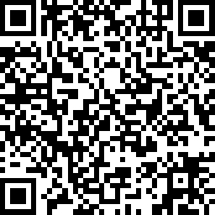
Act 48 Survey
Participants must complete the survey by 3/31/21 at the following QR code or link in order to obtain Act 48 credit:
https://www.surveymonkey.com/r/PROSpring2021
Notes:
Please Note: This survey MUST be completed by 3/31/21 in order for the participant to get Act 48 credit. Please be sure to share this date with participants!

Slide 94
Jeffery Coover, Educational Consultant PaTTAN Pittsburgh jcoover@pattan.net Kim Jenkins, Educational Consultant PaTTAN East kjenkins@pattan.net Nichole Kopco, Educational Consultant PaTTAN Harrisburg nkopco@pattan.net

