Slide 1
2020-2021 Competitive Integrated Employment Grants An Overview
Jeffery Coover, M. Ed. & Kaylee Wynkoop, Ph. D.
Educational Consultants
PaTTAN Pittsburgh

Slide 2
2020-2021 Competitive Integrated Employment Grants An Overview
WELCOME!
For attendees other than PaTTAN employees, please enter your name with your LEA name in the chat box. We will utilize this information to track attendance from across the state.
Thank you!

Slide 5
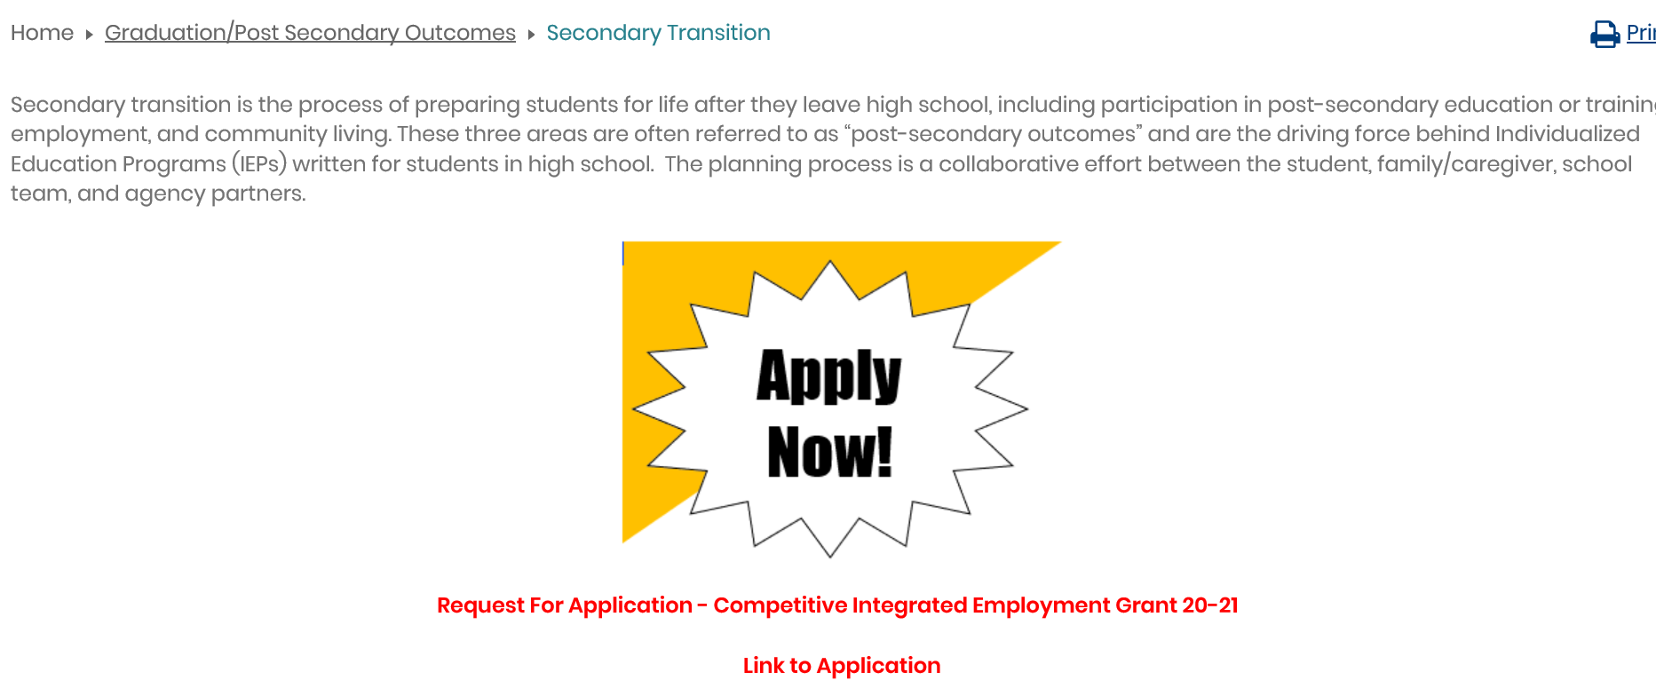
Recorded Session
This recorded session will be posted on the Transition page of the PaTTAN website.
https://www.pattan.net/Graduation-Post-Secondary-Outcomes/Educational-Initiatives

Slide 6
Agenda
Welcome
Request for Application (RFA)
Electronic Application
Questions/Comments/Concerns

Slide 7
Request for Application (RFA)
Purpose of grants
Application criteria and grant priorities
Budget
Application submission

Slide 8
I. Purpose of Grants
The purpose of the CIE grant is to provide youth with disabilities community-based paid work experiences during the 2020-2021 school year.
An emphasis on virtual employment/pre-employment experiences should be a priority due to the LEA’s ability to implement traditional site-based transition programming during the COVID-19 pandemic.
Notes:
Add discussion regarding the flexibility of the 2019-2020 grantees and how they successfully implemented virtual components. Refer to recordings of poster presentations.

Slide 9
I. Purpose of Grants (cont’d)
PURPOSE:
1) improve competitive integrated employment outcomes for youth with disabilities;
2) provide virtual and in-person work experiences, including but not limited to job shadowing, internship/practicum (paid/unpaid), cooperative education programs, apprenticeship, community-based work programs, and service learning (unpaid), with job coaching as appropriate, for youth with disabilities with preference for students at-risk of dropping out and/or youth who have difficulty obtaining employment, independently;
3) establish sites that can serve as models for community-based competitive employment for youth with disabilities; and
4) actively involve The Office of Vocational Rehabilitation (OVR), County/Community-Based Behavioral Health, The Office of Intellectual Disabilities, Centers for Independent Living and other disability-specific support organizations during the development and implementation of the grant-related activities.

Slide 10
II. Application Criteria & Grant Priorities
A. ELIGIBILITY
Local Education Agencies, including school districts, intermediate units, approved private schools and charter schools and chartered schools for the Deaf and Blind are eligible to apply. Grant monies will be awarded to applicants that:
1) have the ability to partner with local business(es);
2) collaborate with one or more of the following: The Office of Vocational Rehabilitation, County/Community-Based Behavioral Health, The Office of Intellectual Disabilities, Centers for Independent Living and other disability-specific support organizations; and
3) are establishing or have an established school-based career readiness program.

Slide 11
II. Application Criteria & Grant Priorities (cont’d)
The funding available for each successful grant applicant will be available from the date of the award through August 15, 2021.
2019-2020 Competitive Integrated Employment grantees are eligible for up to $15,000 to extend current programming.
All other applicants are eligible for funding up to $30,000.

Slide 12
II. Application Criteria & Grant Priorities (cont’d)
B. ASSURANCES
The grantee must agree to the following assurances:
1) Assurance that all activities and expenditures of funds conducted in association with the program are in direct compliance with the provisions of the funding authorities.
2) Assurance that reporting requirements will be submitted in a timely manner. Such reporting includes but is not limited to:
a. Efficacy and outcome data as directed by the funder and
b. Mid-year and summative report on specified activities and budget expenditures in a format to be provided by the grantor.
3) Assurance that program staff will participate in all required PaTTAN/PDE training and technical assistance activities.

Slide 13
II. Application Criteria & Grant Priorities (cont’d)
4) Assurance to disseminate materials and effective programs/practices as requested by PDE including presenting project outcomes and lessons learned at the 2021 PDE Conference (March 3–5, 2021) and the 2021 Pennsylvania Community on Transition Conference (August 11-12, 2021).
5) Assurance that collaboration with appropriate partners to strengthen and extend impact will be a priority of the project and will include direct engagement of agency partners as part of grant planning and implementation.
6) Assurance that the Fair Labor Standards Act will be adhered to within the course of implementing the grant priorities.

Slide 14
II. Application Criteria & Grant Priorities (cont’d)
C. GRANT PRIORITIES
The following essential program priorities must be addressed in the grant application.
1) Identify students who will be targeted for this grant: Targeted students need to be identified as youth with disabilities who have a primary post-secondary goal of competitive employment upon exiting high school, with preference for:
i. youth who are at risk of dropping out of school as determined by indicators of an early warning system
ii. youth who have difficulty obtaining employment, independently

Slide 15
II. Application Criteria & Grant Priorities (cont’d)
2) Implement an effective school-based career development program: The grantee must codify that either:
i. a school-based career development program is currently in place and is being utilized to support transition planning for youth with disabilities
ii. a school-based career development program will be developed and utilized to support transition planning for youth with disabilities
(Please be aware of the components of a school-based career development program as listed in this section of the RFA)

Slide 16
II. Application Criteria & Grant Priorities (cont’d)
3) Collect student data: The grantee must support each targeted youth’s development of a career portfolio representing the youth’s experience(s) and evidence of data collected during the grant period (consider linkages to career education and work standards).
4) Virtual Implementation: The grantee must describe how a virtual component will be incorporated into all grant priorities to ensure successful implementation given the impact of the COVID-19 pandemic.
5) Sustainability: The grantee must describe the vision for sustaining and/or continued expansion of the project at the end of the grant period.
6) Engage family/caregivers as partners in transition planning: The grantee must engage family/caregivers as participants in the transition process using a variety of activities and resources designed to provide an overview of the grant, strengthen the understanding of secondary transition, and provide an outline of the requirements for competitive, community-integrated employment.

Slide 17
II. Application Criteria & Grant Priorities (cont’d)
7) Engage relevant LEA personnel: The grantee must engage the following school-based personnel, as appropriate:
i. general and special education administrators
ii. career and technology education personnel
iii. secondary transition coordinator
iv. school counselor
v. general and special educators
8) Engage agency and community partners in transition planning: Based upon the needs of the targeted students, the grantee must engage local agency staff such as The Office of Vocational Rehabilitation, County/Community-Based Office of Behavioral Health, County-Based Office of Intellectual Disabilities, and/or the local Center for Independent Living in the development and implementation of the grant project. The grantee must submit one or more letter(s) of support from the local agencies in its grant application.

Slide 18
II. Application Criteria & Grant Priorities (cont’d)
9) Engage business in transition planning and implementation: The grantee must engage community businesses with the intent to support unpaid and/or paid work experiences that will lead to competitive integrated employment for youth upon completion of high school, with preference given to the following:
i. Community-based experiences for youth supported by the project that result in businesses providing youth with paid work experiences while the youth are still in school.

Slide 19
II. Application Criteria & Grant Priorities (cont’d)
D. ADDITIONAL GRANT REQUIREMENTS
Beyond the priorities delineated in section II.C, Grant Priorities, funded projects must also demonstrate a commitment to the following activities associated with each of the two (2) work-phases of the Competitive Integrated Employment Grant.
1) Phase 1 – Planning for Implementation (Timeline: From date of award through February 26, 2021)
a. Identify by name those students who will be supported through the grant-funded project.
b. Conduct a community-based assessment, using county-based job market data from the PA Department of Labor https://www.workstats.dli.pa.gov/Pages/default.aspx regarding integrated, high-priority jobs with family sustaining wages that are within reasonable proximity of the grantee.
c. Based on the results of the community-based assessment, identify and provide letters of support from employers who are willing to provide integrated, community-based, unpaid and/or paid work experience for students who will be supported through t he grant-funded project.
d. Match students, based on the learners’ interests, aptitudes, and abilities, with employers who are willing to provide integrated, community-based, unpaid and/or paid work experiences.

Slide 20
II. Application Criteria & Grant Priorities (cont’d)
e. Establish Letters of Agreement (LOA) with local employers to provide the work experiences for students who will be supported through the grant-funded project. The LOA must identify how the participating students will be paid as a result of the work experience, if applicable. Note: Grant funds cannot be used to pay student wages.
f. Establish methods by which to monitor the performance of students in the integrated, community-based work experience.
g. Participate in supported and/or customized employment training based upon targeted students as needed.
2) Phase 2 - Implementation (Timeline: From completion of Phase 1 through August 15, 2021)
a. Assign students to their integrated, community-based employment settings.
b. Monitor the performance of students in the integrated, community-based employment settings.

Slide 21
II. Application Criteria & Grant Priorities (cont’d)
E. TRAINING AND TECHNICAL ASSISTANCE
Grant awardees will receive support as follows:
1) Technical assistance provided by PaTTAN and Intermediate Unit Training and Consultation (TaC) System personnel.
2) Technical assistance and networking opportunities supporting the following:
i. Initial grant application training on required grant elements
ii. PaTTAN and PDE trainings and/or meetings designed to provide support for funded project priorities
iii. No less than two (2) onsite visits with PaTTAN and Intermediate Unit TaC System staff
iv. Other assistance, as determined by the need of the grantee

Slide 22
III. Budget
The funding available to each successful grant application is as follows:
2019-2020 Competitive Integrated Employment grantees are eligible for up to $15,000 to extend current programming.
All other applicants are eligible for funding up to $30,000.

Slide 23
III. Budget
The following terms will apply:
During Phase 1 (Timeline: From date of award through February 26, 2021) the grantee is eligible to request reimbursements of expenditures attributed to Phase 1 activities for up to half of the overall grantee’s award contingent upon submission of baseline data and participation in onsite visit(s) with PaTTAN consultants.
During Phase 2 (Timeline: From completion of Phase 1 through August 15, 2021), the grantee is eligible to request reimbursement of expenditures attributed to the whole of the project contingent upon submission of mid-year and end of year data, and participation in the PDE and Transition Conferences.
Equipment costs, clothing (except work uniforms – not streetwear), gift cards, food and entertainment, and student salaries are not allowable expenses.
General supplies must be purchased prior to May 31, 2021.

Slide 24
IV. Application Submission
The application can be accessed from the Secondary Transition webpage of the PaTTAN Website (https://www.pattan.net/Graduation-Post-Secondary-Outcomes/Educational-Initiatives) or using the following link:
https://fs25.formsite.com/3fHiZQ/CIE20-21/form_login.html
Applications must be submitted by 3:00 p.m. on Friday, August 28, 2020.
Note: Use of the Google Chrome browser will allow for easiest navigation. Applicants have the ability to save and return to the application as needed. The online application platform will enable applicants to upload letters of support and provide electronic signatures.

Slide 25
Electronic Application
New this year!
All application materials will be submitted via Formsite, a web-based, online form builder.
Grant applicants will be required to create an account with a username & password
Letters of Support & Assurance statements signed by Superintendents/CEO are required for the application to be considered complete.
The grant coordinator will need to share the Formsite username/password with the superintendent/CEO for Assurance signatures.
Technical issues with Formsite should be directed to Kaylee Wynkoop at kwynkoop@pattanpgh.net

Slide 26
Electronic Application (cont’d)
Components of the Application
Type & Title
LEA Information
Personnel Information
Grant Priorities
Students
Implementation
Engaging Stakeholders
Budget
Letters of Support/Assurance Statements

Slide 27
Electronic Application (cont’d)
Applicants will receive a confirmation email once their completed applications have been submitted successfully.

Slide 28
Past Grantee Poster Sessions
To view past grantees discussing their experiences throughout the grant process, cut and paste the following link into your web browser:
https://www.youtube.com/playlist?list=PLCkBP2csbOssts6H77A-_SlViOjeZ4ybp

Slide 29
Questions? Comments? Concerns?

Slide 30
For more information or questions on Competitive Employment (CIE) Grants please contact: Jeffery Coover, M. Ed., Educational Consultant jcoover@pattan.net Kaylee Wynkoop, Ph. D., Educational Consultant kwynkoop@pattan.net
Commonwealth of Pennsylvania
Tom Wolf, Governor

