Slide 1

Enhancing Family Engagement Module 6
Collaborating with the Community
Notes:
Welcome to the PaTTAN Family Engagement Module Series! The audience for these modules is educational professionals, families, and community members, including advocates and agency personnel. They may be implemented as professional development, self-advancement, school team activities, or as part of a school improvement plan. Presentation slides, activities, and handouts may be viewed, downloaded, printed and shared.
This Module, Collaborating with the Community, is the last of our six modules designed to inform, inspire, and provide strategies to enhance family-school partnerships. Strong, collaborative relationships among school, home, and community produce increased student success. This has been proven by over 50 years of research. Module 6 examines the relationships between school and the communities they serve and explores how these entities positively interact to the advantage of students and families.

Slide 2
PaTTAN’s
Mission
The mission of the Pennsylvania Training and Technical Assistance Network (PaTTAN) is to support the efforts and initiatives of the Bureau of Special Education, and to build the capacity of local educational agencies to serve students who receive special education services.
Notes:
This slide shows PaTTAN’s mission to support the efforts and initiatives of the Bureau of Special Education. We strive to build the capacity of those who serve students who receive special education services.
Authentic family engagement is a cornerstone of successful school-home partnerships. PaTTAN assists in the efforts of educational professionals and families of children with diverse needs to build strong relationships that lead to student achievement

Slide 3
PDE’s Commitment to Least Restrictive Environment (LRE)
Our goal for each child is to ensure Individualized Education Program (IEP) teams begin with the general education setting with the use of Supplementary Aids and Services before considering a more restrictive environment.
Notes:
The PA Department of Education and PaTTAN system is committed to ensuring all stakeholders fully understand the importance of IEP teams’ decisions about how and where the IEP will be implemented. The first consideration should always be the general education classroom.
The IEP team should determine how the student’s IEP could be implemented within the general education setting, with or without the support of supplementary aids and services, before considering more restrictive environments. Remember, the general education setting includes extracurricular activities and programs to which all students have access.

Slide 4
Family
Engagement
Family Engagement promotes equitable partnerships among schools, families and communities to actively advance student achievement through shared commitment, decision-making and responsibility.
#PAFamilyEngagement
Notes:
This is the definition of Family Engagement that we at PaTTAN use.
Also note that we have a Twitter hashtag, #PAFamilyEngagement. Please ‘like’ us!
The PaTTAN Family Engagement Initiative believes in:
Families and schools working together, because our students are worth it.
And we are: Bringing families, schools, and communities together.

Slide 5
Regulations and Implications for Practice
IDEA
ESSA
PA State Performance Plan (SPP)
Indicator 8
Danielson Framework
Component 4C - Communicating with Families
PA System for Principal Effectiveness
Component 4A – Maximizes Parent and Community Involvement and Outreach
Notes:
Here is an example of the necessity of family engagement within the law and standards for education.
The Individuals with Disabilities Education Act (IDEA) of 2004, PL 108-446, requires improving results for students with disabilities. IDEA also requires all states to develop a State Performance Plan, which includes 20 indicators that describes how the state will implement the Federal requirements and improve results for students with disabilities. Indicator 8 measures the percentage of parents, with a child receiving special education services, who report that schools facilitated parent involvement as a means of improving services and results for children with disabilities.
The Every Student Succeeds Act (ESSA) is a US law that governs K-12 public education policy. Pennsylvania designed its plan for Annual Meaningful Differentiation through a nationally-recognized stakeholder engagement effort that included educators, parents and families, and policy and community leaders. Pennsylvania’s accountability systems and school progress reporting will provide educators, parents and families, and other stakeholders with clear and meaningful reporting on both school and student group performance, as well as the ability to identify and act on opportunity gaps.
The Danielson Framework (Domain 4 – Professional Responsibilities, Component 4C) focuses on communication with families. In order for teachers to demonstrate competence in this area, proactive, frequent, appropriate, and two-way communication with families is paramount. Additionally, sharing information about instructional programs and student progress, so that the families can engage in their children’s learning processes, is vital.
Act 82 Principals/Assistant Principals (Domain 4 – Professional and Community Leadership, Component 4A) focuses on maximizing parent and community involvement and outreach. The school leader designs structures and processes, which result in parent and community engagement, support, and ownership for the school.

Slide 6

ESSA Parent Guide
Share with Your School Community!
Notes:
This guide, from the US Department of Education helps parents understand the Every Student Succeeds Act (ESSA), which amended the Elementary and Secondary Education Act, a landmark Federal education law. Click on the image on the slide to access the guide.
This free resource can also be found at https://tinyurl.com/essaparentguide.

Slide 7
Core Beliefs of Family Engagement
All families have dreams for their children and want what is best for them.
All families have the capacity to support their children’s learning.
Families and school staff are equal partners
The responsibility for cultivating and sustaining partnerships among school, home and community rests primarily with school staff, especially school leaders.
Mapp, Carver & Lander, 2017
Notes:
Schools should be exemplars of a safe, welcoming environment. In order to create a welcoming school community, administrators and educators must embrace several core beliefs of family engagement. First, they must recognize that all families have dreams for their children and want the best for them, even if those dreams may not be what the educators themselves might identify as important. They must also presume competence in each family’s ability to support learning in the home with the right scaffolding. Administrators and educators must also think of families as stakeholders and equal collaborative partners who vitally contribute to their children’s education.
Additionally, school staff must be willing to take on the onus of cultivating and sustaining relationships between home, school, and community. Administrators play a vital role in establishing a culture of welcoming and mutual respect.

Slide 8
Module 6 Goals
Define ways to promote partnerships among families, school, and the community​ and their impact
Describe practices that promote trust and respect between community and school ​
Discuss the importance of community engagement in secondary transition planning
Safely promote online community partnering
Notes:
This module examines the many connections between schools and the communities they serve. Our modules parallel the National Standards for Family-School Partnerships, produced by the National PTA. PTA describes the work in its Standard 6 “Families and school staff collaborate with community members to connect students, families, and staff to expanded learning opportunities, community services, and civic participation.”
The goals of this module are as follows:
Define ways to promote partnerships among families, school, and the community​ and their impact
Describe practices that promote trust and respect between community and school ​
Discuss the importance of community engagement in secondary transition planning
Safely promote online community partnering

Slide 9
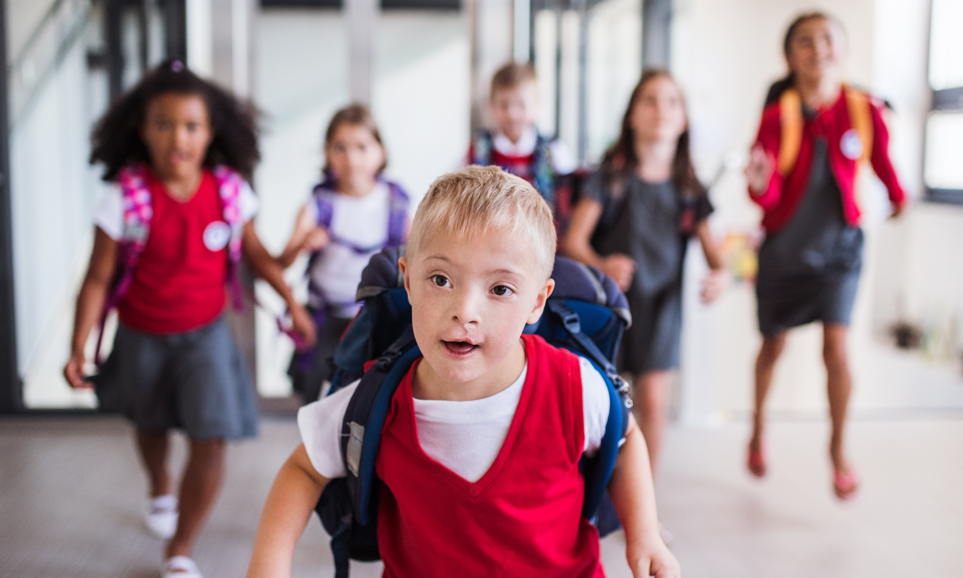
Community Engagement
Notes:
The Iowa and Nebraska Departments of Education joined forces to create The Primary Program: Growing and Learning in the Heartland curriculum to provide educators with a coherent framework to guide local planning for reform of educational programs for children at the kindergarten and primary level. In The Program’s work, the authors state that community success and school success are linked. Schools reflect their communities and vice versa. Principals can take the lead in connecting education with the community’s economic and social development.
In this regard, schools and their staffs have much to offer to the community: access to physical facilities, such as computer labs, gyms, meeting rooms, and playgrounds; access to the expertise, talents, and skills of teachers and administrators; students who serve the community through service projects; and training in computer and Internet use for community members.
Schools also are employers, who can hire local residents; purchasers, who can buy from local merchants; and neighbors who can join neighborhood projects such as crime watches, cleanup campaigns, neighborhood gardens, food banks, and cooperative purchasing. Partnerships work best when the relationship represents an exchange of benefits between schools and community organizations. They also need to be grounded in trust and mutual respect.

Slide 10
Who Are Our Partners in the Community ?
Childcare Centers
Libraries
Churches
Parks and Recreation
Sports Organizations
Community Centers
Cultural Centers
Local Businesses
Barker & Robinson, 2011
Notes:
The list of community agencies with which schools can and should partner is inexhaustible. Communities vary in the types of business and recreation opportunities available within their locale, but they all have community-based entities whether they be business-related, recreationally-based, or beyond. Barker (2011) notes that because children learn in a variety of environments, the local school represents just one of the many “educative actors” in the community. Therefore, developing partnerships between the school and community organizations increases student learning and creates valuable educational experiences.

Slide 11
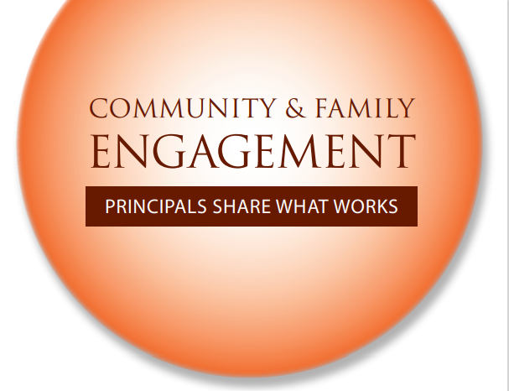
What Is Community Engagement?
“…a tool that promotes civic well-being and that strengthens the capacity of schools, families, and communities to sup- port young peoples’ full development. Community engagement is the hallmark of a community school..”
Berg, Melaville, & Blank, 2006
Notes:
In order to best serve our students, we must also recognize the strengths and contributions of their families and communities and develop partnerships among the three entities.
Berg, Melaville, and Blank describe community engagement as “a two-way street where the school, families, and the community actively work together, creating networks of shared responsibility for student success…It is a tool that promotes civic well-being and that strengthens the capacity of schools, families, and communities to support young peoples’ full development,” indicating the importance of the interlocking roles of school, family, and community.

Slide 12
Why Do Students Need
Community Engagement?
“As children interact with the people, places and things in their immediate community and beyond, they extend their horizons and develop the attitudes, dispositions, skills, and knowledge they need to become effective citizens.”
Iowa & Nebraska Departments of Education, et al
Notes:
In a document from The Primary Program: Growing and Learning in the Heartland, the authors begin by quoting Dan Davies: “Creating effective partnerships between schools, parents, and communities isn’t just a nice idea. It’s a necessity.” The guide goes onto say that “In order to provide the best possible education, schools must partner with families and communities. True partnerships are based on mutual respect…and that “Every adult has a stake in the education and welfare of children. It is essential for adults to build bridges in order to work together so children are healthy and safe.”
Community members contribute much to a child’s development. Think about your school community. Would students say they feel safe? engaged? supported? given opportunities to grow, discover, and contribute? Are the adults in the community good examples for the youth? What can their schools do to create a community environment that would provide conditions for health, safety, and learning?

Slide 13

Multiple Dimensions of Students’ Lives
Schools and communities must pay attention to the multiple dimensions of young people’s lives:
Academics
Physical
Social and emotional health
A motivating, engaging, and safe environment; and
Family and community support.
Berg, Melaville, & Blank, 2006
Notes:
As educators, we have a commitment to serve our students, recognize their strengths, and promote their achievement. However, students do not exist in a vacuum. They are who they are because of many factors, both biological and environmental. These include the many contexts in which they grow up, including school, home, and community.
Just as you have many dimensions to your life—your work, home, social, health/exercise, community memberships, volunteerism, and other facets all contribute to your makeup. Students and families are also multi-dimensional, especially if there is one or more children with a disability. Consider how your school and the surrounding community can be a positive influence and support them in all that it takes to navigate a complicated family life, such as theirs. The positive influences of a child’s family, school, and community life help develop their personality, values, interests, career choices, moral compass, and much more.

Slide 14
Valuing All Children
Increases student achievement
Promotes students social and emotional learning
Builds social capital
Facilitates school-life transitions
Provides additional resources and opportunities
Benefits of Community Engagement
Redding, Murphy, & Sheley, 2011
Notes:
Schools who seek to build relationships with their communities reap a variety of benefits for their students. Studies have shown that students who attend schools that are engaged with the community demonstrate increased academic achievement and are able to apply skills necessary to understand and manage emotions and relationships. Schools and communities benefit from the building of social capital. Not only does community engagement enable the development of networks of relationships among people who live and work in that community, it also promotes the creation of civic-minded individuals.
Additionally, school-life transitions are facilitated as students and families learn more about their communities and attain better understanding of the post-secondary opportunities that are available where they live. Students and families become more aware of the availability of necessary resources, while schools and communities gain a more complete understanding of the needs of the families that they serve.
Partnerships in education build bridges the connect schools, families, community and the world outside that community.

Slide 15
Elements of Successful School-Community Relationships
Strong school leadership
Inviting school culture
Educator commitment to student success
Recognition that school-community relationships are mutually beneficial
Ability to collaborate and communicate with community partners
Gross et al, 2015
Notes:
The building of successful school-community relationships can occur only under the guidance of strong school leadership. Educational administrators must not only believe in the efficacy of community engagement, but they must also actively embrace, promote, and demonstrate tenets of community engagement daily.
For successful school leaders, the building of community relationships is proactive, purposeful, and systemic, as they recognize the importance of school-community partnerships and actively seek them out. Such leaders exhibit a marked reverence for these relationships and portray that attitude to their staff members. These leaders also invoke practices that promote a welcoming and inviting school culture, indicating that all members of the community are active participants in the education of the children of that community. They require their educators within the school to commit to the success of their students, as well as recognize the importance of school-community partnerships.
Both leaders and educators at successful schools demonstrate a willingness and an ability to collaborate and communicate with community partners, trying to hone their skills to better network with the communities in which their students live.

Slide 16
Strategies for Effective Community Engagement
Leadership preparation programs must provide more instruction and field experience in community engagement
School and community should build a systemic framework for community engagement
School districts should find ways to support community engagement and provide principals the flexibility needed for doing this work most effectively
Berg, Melaville, & Blank, 2006
Notes:
In their research on community and family engagement, in 2006 Berg, Melaville, and Blank spoke with principals of community and other schools and shared their insights about why they engage their communities, why doing it is so hard, and what strategies and approaches they find most effective.
The findings from these interviews are captured in a body of work called, ‘Community & Family Engagement: Principals Share What Works.’ In the postscript of this document, Berg, et al, captures three clarifying strategies that school leaders feel are critical, shown on this slide.
Leadership preparation and training must include instruction and field experience in engaging communities.
School districts (and all LEAs) need to support community engagement and provide school leaders the flexibility to do this important work effectively.
Schools and their communities should build a systemic framework for community engagement.

Slide 17

Equitable
Practices for Developing Relationships
Use of culturally-sensitive communication
Inclusion of family and community wisdom
Increased connections
Recognition and use of local resources
Engagement with community issues and concerns
Teaching Tolerance, 2021
Notes:
We have learned that the development of connections with the community is vital to maximizing school success; however, how do we equitably build these relationships between the school and the community? Like all relationships, positive interactions between school and community rest on a foundation of mutual respect and successful communication. Communication between home, school, and community should be characterized by positive and inclusive language. All communication should be checked for assumptions about local resources, family traditions, cultural practices, political affiliations or other life circumstances. Additionally, communication from families and communities should be welcomed and assumed to be well-intentioned. Linguistic, cultural, and differences in family and community structures should be respected and viewed as strengths. Communication should also be provided in multiple modalities and methods that are attainable by family and community members. For example, in a community with sparse Internet access, it is not appropriate to use email as the primary means of communication. Rather, communication should be well-suited to families within the community and respectful of their communication preferences.
Effective communication is a two-way street. In addition to providing information to members of the community, leaders of equitable schools also welcome the contributions and wisdom that their families and communities can provide. Incorporating family and community knowledge into the regular life of the school enhances student learning, as families, neighbors, and community members have unique knowledge and perspectives that can inform, inspire, and place a familiar face on unfamiliar topics. When planned mindfully and thoughtfully, assignments involving family and community knowledge and interactions can make learning “real” for students. Family interviews, community research projects, and guest speakers are just a few ways to incorporate community wisdom into student learning.
Effective schools do not only establish their own connections with the community; they also facilitate connections between the families within the school, as well the communities that they serve. In order to build successful networks, schools recognize the unique strengths, needs, and preferences of their communities, and bring individuals together in a variety of ways – virtual and live events, recreation-based and educational activities. Social capital is built through the development of trusting and cooperative interpersonal relationships, as well as knowledge of and access to tangible resources.
Truly equitable relationships are also characterized by joint problem-solving and the promotion of a united and inclusive identity. School can facilitate these discussions by creating action projects that address real needs, reflecting upon community challenges and recognizing genuine student connections to the issues involved. In this way, students become civic-minded individuals who can recognize that they have a place in the community and that they can contribute to the well-being of their communities.

Slide 18

Practical Strategies to Get to Know Your Community
Community Walks
Community Mapping
Real-World Curriculum Connections
Community Expo
Community/ Business School Partnerships
Notes:
The literature identifies numerous practical strategies that can be employed to increase the development of school-community partnerships. Community walks (or community drives, in more remote areas) can be included as part of scheduled professional development sessions. These walks allow educators to explore the communities in which they work, speaking to community members, seeing local sites, and familiarizing themselves with local resources – in essence, seeing the community the way their students see it. Students and families can be employed to walk with the educators and introduce them to the community that they call home.
Schools may also choose to go a step further and perform community mapping. Community mapping engages educators – and, ideally, students and families – in identifying the assets of their neighborhood, looking at opportunities and creating a picture of what it is like to live there. The “map” may highlight people and resources within the community, as well as physical structures and organizations. Like community walks, this activity builds the educators knowledge of the community and assists them in creating experiences that can connect to the “real-world” of their students.
One way to showcase a neighborhood or municipality is to hold a community expo. A community expo is a planned event in which various local individuals, businesses, and organizations come together to highlight resources and services available within the community, as well as ways in which families and students can participate or give back to the community. This is good way to introduce students and families to local first responders, volunteer organizations, local colleges and universities, as well as civic organizations.
Partnerships between schools and local business and community organizations occur everyday, in communities of every size and description. Whether these relationships involve providing services – such as a local salon that offers free hair-styling for picture day; sharing space – like allowing the local soccer association to practice in school facilities; or expanding horizons by placing high school students at local businesses as interns, these symbiotic relationships are beneficial to all involved parties.

Slide 19
How We Partner with the Community
Space-sharing
Resource provision and exchange
Employment opportunities
Educational partnerships
Recreational opportunities
Provision of services
Information exchange and dissemination
Transition opportunities
Data-sharing
Problem-solving
Fundraising
Notes:
The ways in which schools partner with their communities are widely varied. Whether these relationships are characterized by the sharing of space, resources, information, or opportunities (or something completely different!, they require creativity, tenacity, and collaboration to initiate and maintain. Take a moment to consider the organizations and people inherent to your school community.
What kinds of partnerships have you created?
What kind of partnerships would you like to create?
Who is the first person you would reach out to to begin building relationships?

Slide 20
Roles of the Family in the Community
Consumers
Communi-cators
Business Reps
Employers
Employees
Cultural Experts
Volunteers
Facilitators
Advisors
Problem Solvers
Leaders
Voters
Notes:
Family members play a variety of roles within the community and, as such, can often make connections between schools and the outside world. Family members are the consumers within their neighborhoods. They work in the community, own businesses, attend religious and cultural centers, and volunteer. Family members are excellent choices to communicate and facilitate conversations between schools and communities, providing vital information and establishing contacts between schools and community entities. Families, schools, and communities are advocates for one another.
Living and working within communities gives family members insight into the strengths and resources within their neighborhoods. Families also serve as decision-makers within a community, as they are the individuals that vote, problem-solve, and lead community change. Never underestimate family members as valuable community resources!

Slide 21

Community Engagement in Secondary Transition Planning
Notes:
Children have hopes and dreams of how they want to live their lives when they get out of school. There needs to be at least some planning for how to make these dreams a reality. For students with disabilities, this preparation is known as Secondary Transition Planning.
Students in Pennsylvania who are 14 years or older, are turning 14 in the upcoming IEP year, or younger than 14, as appropriate, have Secondary Transition Planning incorporated into their Individual Education Program (IEP).
It is never too early to begin discussing the hopes and dreams of the student, family involvement in creating the reality of these dreams, and the supports and guidance by the school and community entities. After all, our students are the future educators, medical professionals, entrepreneurs and businesspersons, civic leaders, service providers, and financiers, to name a few, and need this support, experience, and modeling from the adults in their lives.

Slide 22



PA Secondary Transition and the Community
https://www.pasecondarytransition.com/
Notes:
The PA Secondary Transition is a collaboration between the Pennsylvania Department of Education, Bureau of Special Education and the Office of Vocational Rehabilitation. Its website, www.pasecondarytransition.com
has pages of resources to assist in secondary transition planning for students. Peruse the site and all its resources and share them, accordingly, with your families.
Another resource is the Pennsylvania Community on Transition, a group of various stakeholders who work collaboratively to ensure appropriate transition outcomes for Pennsylvania youth and young adults. The Pennsylvania Community on Transition is a state leadership team consisting of representative from: the State Departments of Education, Health, Labor and Industry, and Human Services; Various Serving Agencies, Young Adults, Parent Organizations, Advocates, Higher Education, and Employers.

Slide 23


Secondary Transition
Resources: Community Support
https://transitiondiscoveries.org
Notes:
Here you see a resource that is helpful to educators, students, and families called Transition Discoveries. This website supports students with disabilities and their families in connecting them with information and resources that build communities and improve secondary transition into life after high school.
To learn more about Transition Discoveries, explore the site, watch the short video called, ‘About the Transition Discoveries Initiative,’ check out the Infographic Guide (shown on the slide), and learn about the Framework, known as ‘Your Guide for Change.’

Slide 24
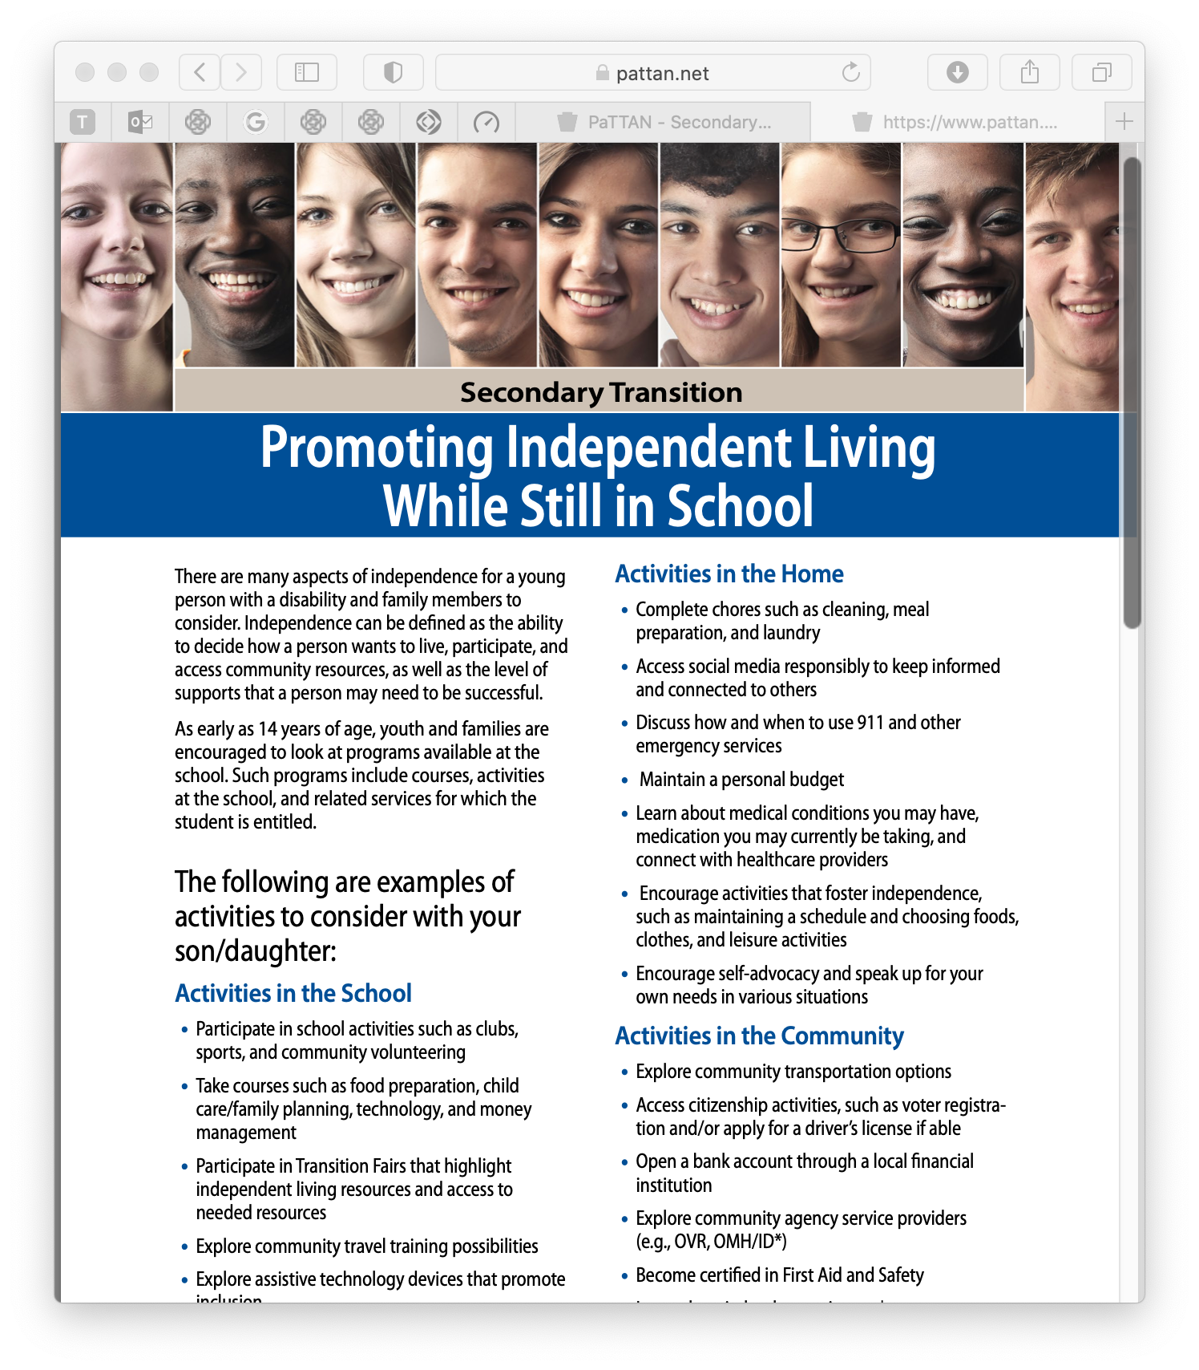


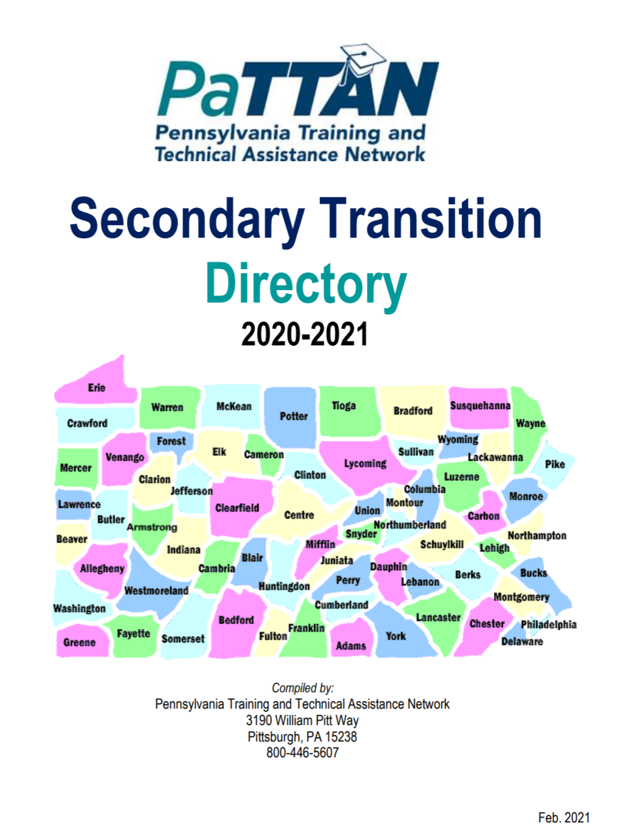
Secondary Transition
Resources: Community Support
(cont’d)
Notes:
On this slide, you will see a sampling of an extensive series of publications on secondary transition. These are available on the PaTTAN website, www.pattan.net, and are published in English and Spanish. There are many documented ways to engage your local community in secondary transition planning.
The Secondary Transition Directory shown provides contact information for PaTTAN, IU, and Transition State Leadership organizations.

Slide 25




More Secondary Transition
Resources: Community Support
Employment First for
Individuals with Disabilities
Notes:
Many community organizations provide job training and services for individuals with disabilities (while in school and post-secondary.) Some work collaboratively with the Office of Vocational Rehabilitation Services (OVR). Some are specific to a geographic territory in PA; others are statewide. Most of the community-based service groups provide services at no charge, while others may have a fee.
Make sure to share information like these resources with your families, especially those whose children are in middle or high school.

Slide 26
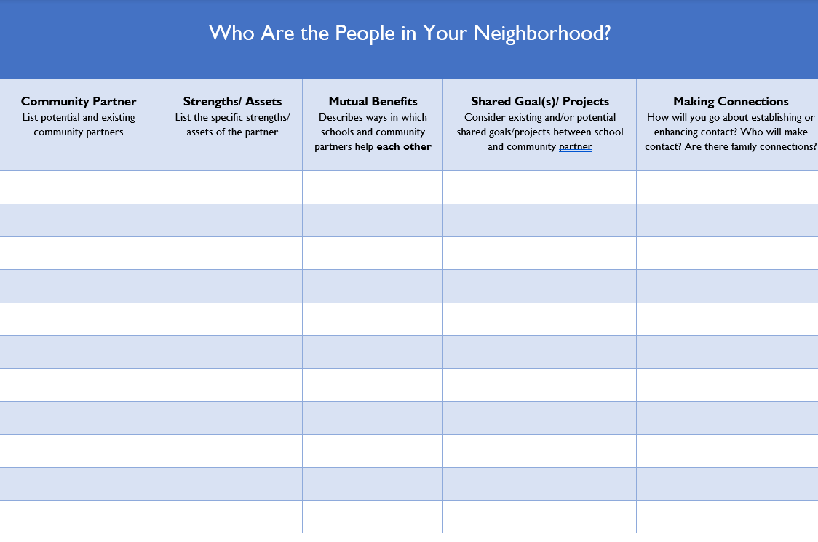
Who Are the People in Your Neighborhood?
Activity 6.1
Notes:
Take a few moments to consider what we’ve learned about the benefits of partnering with the community. Also consider the many, many community partners whom you could engage to work with you to the benefit of your students. Think about those partnerships you’ve already built and those you would like to develop. What shared goals and projects would unify your partnerships? How might you help each other?
Activity 6.1
The purpose of the activity is to consider how you might build partnerships between your school and at community at large. By completing the “Who Are the People in Your Neighborhood?” worksheet, you will identify current and potential partnerships, the strengths of the partners, the mutual benefits derived from the partnership, shared goals and projects, and how connections between these partnerships might be developed.
Complete the worksheet in a group or as an individual. If in a small group, prioritize one partnership identified by the group and debrief to the rest of the room.

Slide 27

Engagement in Online Communities
Notes:
We have seen the critical role that partnerships among schools, families, and the community play in the success of student achievement. Supporting students and families takes teamwork and many resources, including academic, financial, social/emotional, behavioral, extracurricular, spiritual, and problem-solving supports.
Connecting your school to its local community produces the proverbial ‘village’ that it takes to raise children. It provides students with real-life experiences; gives them an appreciation for the supports and services available to them; introduces them to those to whom they can turn for guidance, services, employment, finance, and support; induces a sense of civic responsibility and belonging; and creates an avenue for children and young adults to share their talents and skills.
But students are not the only benefactors of community resources. School staff and students’ family members can be introduced to a plethora of activities, services, supports, funding sources, and relationships they may not have known existed. As wonderful as all of this sounds, some challenges to participating in community resources are the constraints of time, availability, money, language barriers, and perhaps trust.
Luckily, in the digital world in which our communities exist, almost everything can be at your fingertips. Communities can connect via online communication and learning. Let’s discuss some of these options.

Slide 28
Connecting Communities
Information Sharing
Successes
School Links to (vetted) Community Sites
Virtual After-School Programs
Videos
Virtual Events
Online Forums
Family Feedback
Surveys/Polls
Photos
Community Mentor Program
Digital Marketing
Family
Community
School
Notes:
How do you connect school, families, and your community? There are a variety of ways, some listed here.

Slide 29
School
Connections to Families and Community
Social media
Digital newsletters
School TV/radio station
School website
Notes:
Many stakeholders have an interest in the success and happenings in their schools. Although students, their families, and educators access a school or district’s information most often, retail owners and operators, non-profit organizations, service providers, alumni, and other taxpayers will visit the various electronic communiques. It is very important that information is frequently updated and communicated in the most family-friendly, engaging, concise, and ADA accessible format.
If you want to engage students, families, and community members, using video is a practice that promises to be successful. In an article entitled, 6 Ways To Use Video For Online Community Engagement, published in 2015 and modified in 2019, the author states that, ‘Digital video is one of the leading ways to drive online engagement. The statistics don’t lie with website pages containing video attracting more traffic, users spending more time on pages with video content and people more likely to click on an email link containing a video.’ It is projected that by 2022, online videos will make up more than 82% of all internet traffic.

Slide 30




Social Media
Twitter
YouTube
Instagram
Facebook
announcements, updates, visual content
short messages (alerts, threads, redirects)
video content – live or recorded
photo/video stories
Notes:
Social media is the way many families, community members, and probably most students (the ‘digital natives’) share and receive information. Even if you think you are not tech savvy, find out what your community uses most frequently and think outside the box—instead of having a Back-to-School Night presentation with only a PowerPoint slideshow, also use Facebook Live and stream it.
If you are not a user of social media, you can always get technical assistance from your IT department, but why not ask a student to show you? Don’t you feel proud when someone asks for your help and you provide them with what they need? We all need to feel needed at times, and this is especially true for students with disabilities. More often than not, people will not seek their help but automatically assume they need help from others. They know more about using technology than you think!

Slide 31
Connections to School and Families
Organizations’ websites
Social media
Digital newsletters
Advertisements
Local TV/Radio station sponsorships
Community
Notes:
How do you receive information about your community? Think about it for a minute.
What if you want to know what is on sale at a particular store? the showing times of a new movie? A company’s last quarter profits? Local entertainment, articles of interest, current events? Your community members reach out by making connections using these and many other platforms.
Likewise, how do local entities reach out to your school community, including your students, families? How can you assist in facilitating these connections? If you hear an ad for an event you think your families would enjoy, do you share that information?

Slide 32
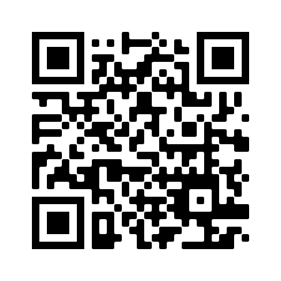

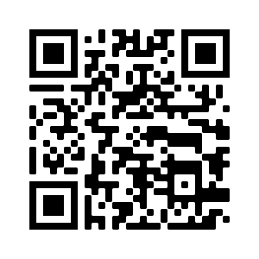
Helpful Websites
Pennsylvania Family Support Programs
PA Families, Inc. Resources
Notes:
Here are two links to sites that will provide community resources for you and to share with your families and other community members.

Slide 33
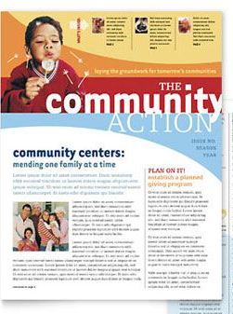

Newsletters
Notes:
Email newsletters or those posted on an organization’s website are a valuable and relevant source of community sharing. According to Janine Perri in her 2020 article, Is the Email Newsletter Still Relevant? The Answer is Yes, Here’s Why,’ they are one of the best channels for developing stronger relationships. In order to be valuable to your target audience, Perri says, newsletters should be entertaining, educating, and engaging. Opt-in and opt-out requirements are noted.
SMORE
Peach Jar
Microsoft Publisher

Slide 34
Tips for Making an Online Community Engaging
Be a leader
Make it easy to participate
Welcome and encourage newbies
Interact with your community
Post inspiring content
Ask questions that matter to the community
Post images showing the organization in action
Reward contributors
Use the ‘marketplace’ for promotion
Create RSS feeds applicable to your community
Solicit anecdotes about connections and collaborations
introNetworks, 2013
Notes:
In an article by introNetworks Smart Connections, 20 Tips To Make Your Online Community More Engaging, published in 2013, Mark Sylvester provides helpful tips on using online community sharing to enhance engagement. He suggests picking two or three to start and experiment with them, then add a few more. Here you see some of the 20 tips highlighted.
Some of the suggestions blend well with school-family-community engagement. For instance:
Easy to participate – online information that is easy to find and user (and family-) friendly will increase the likelihood of visitation.
Interact with the community – add items of interest to your targeted audience. Schools should include events and opportunities for community members and organizations to sponsor, volunteer, display, or fund. Community entities should entice families and school communities to support, patronize, volunteer, and join their businesses and organizations.
Post inspiring content – this holds true for all three partners—schools

Slide 35

Online Safety
Practices to maintain safety in online communities:
Explicitly teach students internet safety
Share online safety tips with families
Ensure communities outside of your LEA have safe, secure internet presence
Image courtesy of imagebin.com
Notes:
Many children, from a young age, are taught about ‘stranger danger.’ This is a vital lesson in keeping students safe, but transferring that knowledge from in-person to online safety is equally important. The Internet is a fabulous tool for educational and social skill development, but with the countless hours children and young adults spend online, they are vulnerable to hazardous or compromising situations they may not recognize or be able to manage. And parents and teachers are having a hard time keeping up with all that children have access to.
Not all online communications are harmful; educators and families need to teach children how to identify those that are. Lesson plans that address potentially menacing online communications at school and at home will help protect them. This includes things like sharing private information with others online like home address, phone number, or credit card information (theirs or their parents’.) Based on appropriateness by age, you may wish to present students with sample scenarios to determine their awareness of safe or unsafe interactions. Teach them about harmful communications like malware, Phish attacks,
Another area of concern is content. We are all aware of the dangerous images, videos, and written content that can be found on some online sites, including emails. Your administration and IT department, no doubt, has restrictions on access to websites which are threatening to our youth. But sometimes an unknowing click can send children (and adults) down the proverbial rabbit hole into a site that may seem innocent but is anything but.
We hope that families are protecting their children from online mischief but, as we stated, it is difficult to keep up with technology and stay on top of their children’s every digital move. For many parents, their tech savvy is far inferior to their children’s, and sometimes young people can sense and take advantage of that. This could be especially true for families whose child speaks English, though their primary language is not English, or perhaps parents or caregivers whose intellectual capacity is compromised, or their reading level is below that of their children’s.
According to a report by Tech Jury, over 204 billion applications were downloaded in 2019, with each smart phone user having an average of 40 apps on their phone. The statistics are staggering and will only increase as these ‘digital natives’ age and new ones are born, learning technology at a younger and younger age. With so much to access, your LEA needs to make sure that the communities to which you connect have safe sites for your school community.

Slide 36

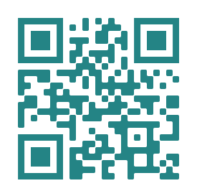
Website Scavenger Hunt (Part 1)
Activity 6.2
https://roundrockisd.org
Notes:
Let’s have fun with a scavenger hunt! There are two school websites we found to be very user friendly.
Take out your cell phone (ios or Android.) Open your camera and hold it up to the teal-colored QR code in the left corner. Then click on ‘open the link for Round Rock Independent School District.’ You may also use the link under to the QR code and access the site.
In the Search (icon of magnifying glass, upper right corner) type the words ‘Community Education classes’ – scroll past the links with ads and see Community Education | After-school activities and ... - Round Rock; explore the resources on this page.
Next, go back up to the Search (magnifying glass icon) and type ‘Summer Resources.’ Once again, scroll down past the ads and see ‘Summer Resources roundrockisd.org › summer-resources.

Slide 37

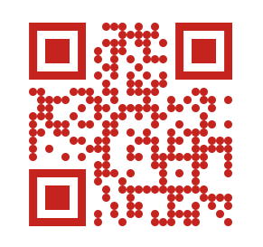
Website Scavenger Hunt (Part 2)
Activity 6.2
https://gwacademy.org
Notes:
For the second school, George Washington Academy, scan the QR code, following the steps you did earlier or use the link to get to the website. Click on the box at the top right that says, ‘Select language.’ Easily noticeable on the front page of the site; select any language and see what happens.

Slide 38
Scavenger Hunt Activity
Activity 6.2
ITEM | # CLICKS FROM HOME PAGE | Does Not Exist
View website in Portugese
Answer to 'Do I need to complete annual forms for a returning student if nothing has changed?'
Create an account to enroll a new student
Procedural Safeguards Notice
School's Strategic Plan
Professional Development for Teachers
Bus Routes
Phone number of the middle school nurse
Community event calendar
LEA's Twitter handle
How emergency school closing decisions are made
Dates school is closed for winter break
How do I apply for a free or reduced lunch for my children?
Notes:
Now, let’s see how community-friendly your LEA’s website is. Take our your handout (shown on this slide) and do the activity.
Starting at the home page, for each item count how many clicks it takes you to find it and record the number. If you cannot find it at all, check the ‘Does Not Exist’ box.

Slide 39

In Conclusion
School – Community – Family Partnerships
Enrich the lives of all members
Enhance the education of students
Influence the learning and development of children
Help produce resilient citizens that help build their communities

Slide 40
References
Pg. 1
Barker, D., & Robinson, A. (2011). Civic capacity and the role of community in education. Connections. Retrieved from https://www.kettering.org/content/civic-capacity-and-community-role-education
Berg, A. C., Melaville, A., & Blank, M. J. (2006). Community & family engagement: Principals share what works. Retrieved 7-8-21 from https://www.americaspromise.org/sites/default/files/d8/CommunityAndFamilyEngagement.pdf
Berg, A. C., Melaville, A., & Blank, M. J. (2006). Community-Based Learning: Engaging Students for Success and Citizenship. Retrieved 7-8-21 from ERIC https://files.eric.ed.gov/fulltext/ED490980.pdf
Butteriss, Dr. Crispin, (2015). 6 Ways To Use Video For Online Community Engagement. Retrieved 7-7-21 fromhttps://www.bangthetable.com/blog/6-ways-use-video-for-online-community-engagement/; bangthetable.com is now part of Grancicus

Slide 41
References
Pg. 2
G., Nick (2020). 55+ Jaw Dropping App Usage Statistics in 2021. Retrieved 7-721 from https://techjury.net/blog/app-usage-statistics/
Gross, J. M. S., Haines, S. J., Hill, C., Francis, G. L., Blue-Banning, M., & Turnbull, A. P. (2015). Strong school–community partnerships in inclusive schools are “part of the fabric of the school.…we count on them.” School Community Journal, 25(2). Retrieved from http://www.adi.org/journal/2015fw/GrossEtAlFall2015.pdf
Iowa and Nebraska Departments of Education, et al (2001). The Primary Program: Growing and Learning in the Heartland. 2nd Edition. Retrieved 7-8-21 from Kelly, M., ERIC: https://eric.ed.gov/?id=ED449922
Nebraska Department of Education. (2017). Partnerships with Families and Communities. [Online]. Available: https://www.education.ne.gov/wp-content/uploads/2017/07/Partnerships.pdf

Slide 42
References
Pg. 3
Perri, J. (2020). Is the Email Newsletter Still Relevant? The Answer is Yes, Here’s Why. Hearst Bay Area. Retrieved from https://marketing.sfgate.com/blog/is-the-email-newsletter-still-relevant, February 3, 2021.
Redding, S., Murphy, & P. Sheley (2011). Handbook on family and community engagement. Charlotte, NC: Information Age. Retrieved from http://www.schoolcommunitynetwork.org/downloads/FACEHandbook.pdf
Teaching Tolerance. (2021) Family and community engagement. Retrieved from https://www.tolerance.org/magazine/publications/critical-practices-for-antibias-education/family-and-community-engagement

