Slide 1

Enhancing Family Engagement Module 3
Supporting Student Success
Notes:
Welcome to the PaTTAN Family Engagement Module Series! The audience for these modules is educational professionals, families, and community members, including advocates and agency personnel. They may be implemented as professional development, self-advancement, school team activities, or as part of a school improvement plan. Presentation slides, activities, and handouts may be viewed, downloaded, printed, and shared.
Module 3, Supporting Student Success, is the third of our six modules designed to inform, inspire, and provide strategies to enhance family-school partnerships. Strong, collaborative relationships among school, home, and community produce increased student success. This has been proven by over 40 years of research. Module 3 discusses the importance of these partnerships and their direct correlation to improving students’ achievement in academics, social/emotional, and behavioral endeavors.

Slide 2
PaTTAN’s
Mission
The mission of the Pennsylvania Training and Technical Assistance Network (PaTTAN) is to support the efforts and initiatives of the Bureau of Special Education, and to build the capacity of local educational agencies to serve students who receive special education services.
Notes:
This slide shows PaTTAN’s mission to support the efforts and initiatives of the Bureau of Special Education. We strive to build the capacity of those who serve students who receive special education services.
Authentic family engagement is a cornerstone of successful school-home partnerships. PaTTAN assists in the efforts of educational professionals and families of children with diverse needs to build strong relationships that lead to student achievement.

Slide 3
PDE’s Commitment to Least Restrictive Environment (LRE)
Our goal for each child is to ensure Individualized Education Program (IEP) teams begin with the general education setting with the use of Supplementary Aids and Services before considering a more restrictive environment.
Notes:
The PA Bureau of Special Education (BSE) supports the Pennsylvania Department of Education (PDE’s) commitment to ensuring the Least Restrictive Environment (LRE) for all students. Families are an integral part of the Individualized Education Program (IEP) team.

Slide 4
Module 3 Goals
Discuss research on family-school relationships and students’ success
Examine key elements of engaging families
Explore strategies at various levels to enhance family engagement and increase student achievement
Notes:
In this module, we hope to achieve these goals.

Slide 5
Family
Engagement
Family Engagement promotes equitable partnerships among schools, families and communities to actively promote student achievement through shared commitment, decision-making and responsibility.
#PAFamilyEngagement
Notes:
This is the definition of Family Engagement that we, at PaTTAN, use.
Also note that we have a Twitter hashtag, #PAFamilyEngagement. Please ‘like’ us!
The PaTTAN Family Engagement Initiative believes in:
Families and schools working together, because our students are worth it.
And we are
Bringing families, schools, and communities together.

Slide 6
Regulations and Implications for Practice
IDEA
ESSA
PA State Performance Plan (SPP)
Indicator 8
Danielson Framework
Component 4C - Communicating with Families
PA System for Principal Effectiveness
Component 4A – Maximizes Parent and Community Involvement and Outreach
Notes:
Here is an example of the necessity of family engagement within the law and standards for education.
The Individuals with Disabilities Education Act (IDEA) of 2004, PL 108-446, requires improving results for students with disabilities. IDEA also requires all states to develop a State Performance Plan, which includes 20 indicators that describe how the state will implement the Federal requirements and improve results for students with disabilities. Indicator 8 measures the percentage of parents, who have a child receiving special education services, who ‘report that schools facilitated parent involvement as a means of improving services and results for children with disabilities.’
The Every Student Succeeds Act (ESSA) is a US law that governs K-12 public education policy. Pennsylvania designed its plan for Annual Meaningful Differentiation through a nationally-recognized stakeholder engagement effort that included educators, parents and families, and policy and community leaders. Pennsylvania’s accountability systems and school progress reporting will provide educators, parents and families, and other stakeholders with clear and meaningful reporting on both school and student group performance, as well as the ability to identify and act on opportunity gaps.
The Danielson Framework (Domain 4 – Professional Responsibilities, Component 4C) focuses on communication with families. For teachers to demonstrate competence in this area, proactive, frequent, appropriate, and two-way communication with families is paramount. Additionally, sharing information about instructional programs and student progress so that the families can engage in their children’s learning processes is vital.
Act 82 Principals/Assistant Principals (Domain 4 – Professional and Community Leadership, Component 4A) focuses on maximizing parent and community involvement and outreach. The school leader designs structures and processes, which result in parent and community engagement, support, and ownership for the school.

Slide 7

ESSA Parent Guide
Share with Your School Community!
Notes:
This guide, from the US Department of Education helps parents understand the Every Student Succeeds Act (ESSA), which amended the Elementary and Secondary Education Act, a landmark Federal education law.
This free resource can be found when you click on the picture, or at https://tinyurl.com/essaparentguide

Slide 8
Core Beliefs of Family Engagement
All families have dreams for their children and want the best for them.
All families have the capacity to support their children’s learning.
Families and school staff are equal partners.
The responsibility for cultivating and sustaining partnerships among school, home, and community rests primarily with school staff, especially school leaders.
Mapp, Carver & Lander, 2017
Notes:
Here are some research findings by Mapp, Carver & Lander. What they found is that in order to collaboratively support student success, administrators and educators within the school community must embrace several core beliefs of family engagement. First, they must recognize that all families have dreams for their children and want the best for them, even if those dreams may not be what the educators themselves might identify as important. They must also presume competence in each family’s ability to support learning in the home with the right scaffolding. Administrators and educators must also think of families as stakeholders and equal collaborative partners who vitally contribute to their children’s education.
Additionally, school staff must be willing to take on the onus of cultivating and sustaining relationships between home, school, and community. These partnerships support and fuel student achievement and long-term success.

Slide 9

FAMILY ENGAGEMENT AND STUDENT ACHIEVEMENT
SECTION 1
Notes:
The first section of our module will explain the relationship between family engagement and increased student achievement.

Slide 10
Student Benefits of Family Engagement
Elevated test scores in reading and math
More positive attitudes towards academics
Better school attendance
Increased graduation rates
Improved study skills and attention
Easier transitions between grade levels
Notes:
Many years of research on family engagement have shown links between family engagement and academic success for students. According to Bryk and colleagues, positive ties with families and communities significantly influenced achievement in reading and writing when they occurred in tandem with best teaching practices, instructional guidance and a student-centered learning climate (2007).
Family engagement has also been associated with more positive attitudes towards school (Huerta, 2009), improved study skills and attention (Cox, 2005), better school attendance (Cox, 2005), easier transitions between grade levels (Mac Iver et al, 2018), and increased graduation rates (Robertson, Smith, & Rinka, 2016).

Slide 11
Influences on Family Engagement
Their own educational experiences
Their own parents’ involvement in their school experience
Beliefs shaped by culture and values
Family responsibilities and time commitments
Families’ involvement in their children’s education is impacted by:
Mapp, 2002
Notes:
One of the core beliefs of family engagement, as introduced in an earlier slide, is that all families have the capacity to support their children’s learning. However, family engagement in education may be shaped by a variety of factors, including the family members’ own educational experiences, their own parents’ involvement in their school experience, beliefs shaped by culture and values, and family responsibilities and time commitments.
Every school and family is different. As schools build collaborative relationships with families, they will better understand their families’ needs and more successfully support their engagement in education.
11

Slide 12
Activities Supporting Academic Success
Communicate expectations for achievement
Discuss learning strategies
Prepare and plan for the future
Foster educational and vocational aspirations
Hill & Tyson, 2009
Notes:
There are many activities in which families can engage to positively impact their children’s academic success. These include communicating expectations for achievement, discussing learning strategies, preparing and planning for the future, and fostering educational and vocational aspirations (Hill & Tyson, 2009).

Slide 13
Activities Supporting Academic Success (cont’d)
Engage in homework completion
Set subject-specific educational goals
Attend academic meetings
Van Voorhis, 2001; Sheldon & Epstein, 2005; Baker, 2018
Notes:
Additionally, families support the academic success of their children by engaging in homework completion (Van Voorhis, 2011) and setting subject-specific educational goals (Sheldon & Epstein, 2005).
Family attendance at academic meetings, such as parent-teacher conferences or IEP meetings, also supports student success (Baker, 2018), whether it is done in-person or virtually (Winkler, 2016).

Slide 14
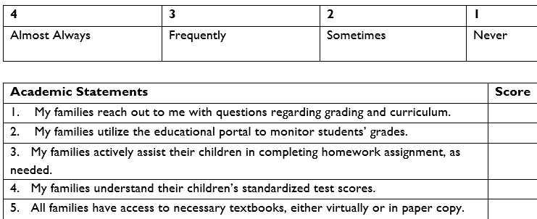

.Activity 3.1 Closer Look
Activity 3.1
Closer Look
Take a Closer Look
Notes:
Here is an activity that can be done individually or in a group. The results of your self-reflection will direct you to determining a focus area for improvement.
Materials Needed: “Closer Look” Chart
Roles:
Facilitator: Explain the activity and lead the follow-up discussion
Participants: Work individually or in small groups to determine the degree of engagement of your families in academic activities
Directions: Complete the “Take a Closer Look” chart regarding family engagement in academics. Then, identify a low-scoring area and create an action step to enhance engagement and partnerships.
Possible reflection questions:
Which avenue for information did you find was used the most in your school/district?
What did you notice about the scores?
What did you find were your areas of need?
How can this information be used to enhance communications with family members?
14

Slide 15
LEA-Level Strategies for Enhancing Student Achievement by Engaging Families
SECTION 2
Notes:
As we discussed previously, collaborative partnerships are achieved most successfully when school administration takes steps to ensure that families are able to engage in their children’s education. This section of our module will discuss steps that LEAs can take to ensure that their families are actively involved in academic planning and activities.

Slide 16
Prioritizing Partnerships
Best Practices
Family members on academic committees and councils
Academic information in all languages of your LEA
Families are shown how to access academic information
Family trainings on participation in academic activities
Notes:
The first step in engaging families in their children’s education is to make sure that family engagement and collaborative partnerships are a priority for the school districts, charter schools, and centers of technical education, at large. Local educational agencies (LEAs) can demonstrate this priority by including family members on academic committees and councils. Research has shown that by asking families for their input and involving them in district-level planning, LEAs can produce more effective solutions to previously identified barriers to engagement (Baker, Wise, Kelly, & Skiba, 2016).
LEAs should also seek to engage all their families by ensuring that they have equal access to academic information. If families do not have the necessary resources to access information, they cannot fully support their children. Be the conduit to help them acquire skills, materials, and access. This may be done by
providing academic information in a variety of ways:
paper communications
digitally, through educational portals, learning platforms, online videos and virtual trainings that parents can access at any time, social media sites, or even emails
in all languages of the school, including supports like educational interpreters for deaf students or parents; Braille; accessibility supports such as closed captioning on videos, accessible materials that can be read by screen readers for individuals with blindness or low vision.
access to technology
implementation of a family resource center with free and convenient access
lend or gift devices to families who do not have financial resources to acquire their own
training on the use of educational portals or learning platforms--easy-to-access, concise, family-friendly, training tutorials on the usage of these resources
providing a family liaison to support families
tech tips
implementing family mentor programs
These strategies may be helpful in allowing families to receive the resources and training they need to actively participate in their children’s academic lives.

Slide 17
Establishing Expectations for Staff Members
A shared commitment to collaborative family-school partnerships
Positive language is used with and about families
Attendance at trainings on effective family engagement
Family engagement in academics is an everyday activity
Notes:
Family members interact with a variety of staff members in the school environment. Therefore, LEAs should expect all staff members to recognize families as collaborative partners. This can be done in a variety of ways.
First, the LEA should express the educational entity’s commitment to family engagement, incorporate this commitment within policies and procedures, and make family engagement an everyday experience, rather than a luxury. Staff members should be expected to speak positively about families and interact with families with the utmost respect and professionalism.
‘Most teacher training programs mention the importance of family engagement at some point in time, but few teachers graduate feeling confident about how they can best engage family members’ (Bartels & Eskow, 2010). Research shows that ‘trainings can increase effective engagement skills, particularly when that training is matched to the needs of the school community’ (Bartels & Eskow, 2010). PaTTAN has resources on our webpage (https://www.pattan.net/Supports/Family-Engagement) and can provide other training on topics around family engagement, in addition to the six modules in this series. Trainings are available to individual groups, school teams, and large, statewide professional development sessions.
LEAs should, on a basic level, make family engagement activities an everyday expectation, not an infrequent activity. Encouraging teachers to communicate with their students’ families about academics on a frequent basis may create a culture of sharing throughout the school community. Such communication can be achieved by using such platforms as Class Dojo or Remind.

Slide 18
Family Engagement in Missions, Visions, and Goals
Best Practices
Family engagement is written into LEA’s mission and vision statements
LEA’s mission, vision, goals, and progress are shared with families often
Families contribute towards LEA-wide academic goals
Family engagement activities are connected to LEA’s academic goals
Notes:
Mission and vision statements are common bedrocks for LEA’s educational programs. These statements help define the purpose of schools and set the direction of the LEA.
Reflect on your own LEA’s mission and vision or belief statements. Is there reference to families? Do the statements convey that partnerships with families are needed and valued? Rather than creating a separate vision for family engagement, consider how families can be included in the LEA’s existing mission, vision, or belief statements, and how these statements reflect the LEA’s commitment to collaborative partnerships.
To that end, consider how family members can be active participants in the writing of these statements to increase the empowerment of families (their role and their voice) in the academic life of an LEA.
It’s not enough to just craft these statements, LEAs need to be strategic in how they inform families of the mission, vision, and belief statements and goals, and share the progress that is being made towards those goals. Referencing these elements often in communications increases family awareness, and connecting family engagement activities to school goals allows families to be active partners in school progress.
Belief statements and goals that reflect the values of the schools’ families and community convey relationships between school, home, and community in a natural, yet purposeful, way.

Slide 19
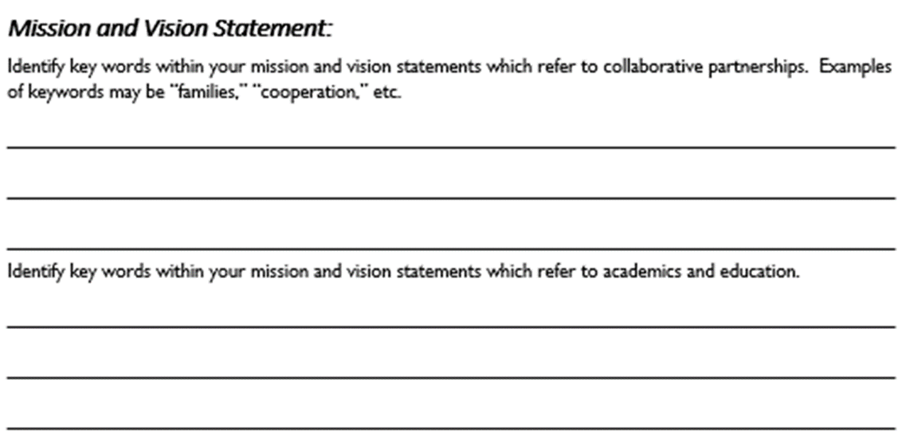

Envisioning Family Engagement
Activity 3.2
Envisioning Family Engagement
Notes:
Your school’s vision or mission statement is a reflection of who you are as an educational community. In this activity, you will take a closer look at your LEA’s vision and mission statements and goals and identify how families are included in the ideas expressed within the statements. If they are not included, you will brainstorm ways in which families could be invited to participate in developing mission and vision statements. You will also develop some ideas about connecting families to learning activities based on academic goals.
Refer to Activity 3.2. The purpose of this activity is to develop a vision statement that reflects the importance of families supporting student success and that solicits and welcomes family participation in all aspects of a child’s educational experience.
Debrief Activity 3.2. How can your school’s current data practices be enhanced or improved? Is there available data that might be more valuable to your families? How can your school obtain feedback on families’ data needs and preferences?

Slide 20
BUILDING/SCHOOL LEVEL STRATEGIES FOR ENHANCING STUDENT ACHIEVEMENT
SECTION 3
Notes:
You’ve seen how LEA-level strategies can globally help families and students. It is important for families to be informed and participate in events, improvement efforts, and the culture of the overarching educational entity.
Although families may understand the mission, culture and rules of their LEA, they often have children in different buildings within that entity (e.g., school district.) Each school is under the same LEA umbrella but has a unique culture, rules, academic levels and, perhaps, curricula provider. Likewise, IUs, charter, cyber charter, and approved private schools may have numerous locations in which they operate. Family engagement in one site can look differently in another.
Families take interest in the success of their child’s school, especially if more than one of their children attend; if they, themselves, attended that school; and if their child(ren) will be attending for several years. Work as a partner with families to advocate for the very best for the students, teachers, administrators and staff, and for the school community. Don’t ask families to help you; collaborate on ways to ensure success of your school building as a team.
Let’s take a look at the individual building, or school-level, approach to family engagement and student success.

Slide 21


Are They the Same?
Family Involvement
Family Engagement
Families Participate in School Events & Activities
School Leads with its Mouth*
Schools respond to families’ concerns with a narrow focus
Families Help Create and Oversee School Events & Activities
School Leads with its Ears*
Schools respond to families’ concerns by encouraging connections to move toward broader action.
Waterford.org, 2018
*Larry Ferlazzo, 2011
Notes:
Is family engagement the same as family involvement in a school? Not really. Although the terms seem interchangeable, they are not. As is noted in an article by Waterford.org in 2018, “it helps to think of parent involvement as the first step to parent engagement.” Here you see a sampling of ways that the two differ.
According to research by Larry Ferlazzo, when families are involved in their children’s school, they participate as a guest. They attend functions to which the school invites them; they are the recipients of information provided by their children’s teachers and administrators. When families are engaged, become partners. Thus, involvement implies doing to; in contrast, engagement implies doing with.
How does your school interact with families? How do you, individually? Do you lead with your mouth or your ears? Do your students’ families give as much input as you provide, or is it one-sided? The next time you interact with a family member, take note of the percentage of talking versus listening you do.
Effective family engagement requires the school to develop a relationship-building process focused on listening.

Slide 22
Children with Engaged Parents are…
More likely to:
Earn higher grades or test scores
Graduate from high school and attend post-secondary education
Develop self-confidence and motivation in the classroom
Have better social skills and classroom behavior
Less likely to:
Have low self-esteem
Need redirection in the classroom
Develop behavioral issues
Waterford.org, 2018
Notes:
Here is research from various studies on the positive effects of family engagement on students’ success. As is shown, students have much to gain by having family members what are active participants in their education. They have more confidence and self-esteem, have better social skills and behaviors, and are more likely to graduate and further their education after high school.
If you are interested in reading more, here are the links to the studies provided in this article by Waterford.org:
American Psychological Association. Parent Engagement in Schools. Retrieved from apa.org: https://www.apa.org/pi/lgbt/programs/safe-supportive/parental-engagement/default.aspx
Grand Rapids Public School District. What Is Parental Engagement? Retrieved from grps.org: https://www.grps.org/parents/parental-engagement.
Wairimu, M.J., Macharia, S.M., Muiru, A. (2016, November 27). Analysis of Parental Involvement and Self-Esteem on Secondary School Students in Kieni West Sub-County, Nyeri County, Kenya. Journal of Education and Practice, Vol 7. (82-98)
Sheldon, S. B., & Jung, S. B. (2015). Parent Involvement and Children’s Academic and Social Development in Elementary School. Johns Hopkins University, School of Education.

Slide 23
Versions of Family-School Partnerships
Fortress School
Come-if-We-Call School
Open-Door School
Partnership School
Henderson, Mapp, Johnson and Davies, 2007
Notes:
In the book, Beyond the Bake Sale, the authors describe four levels of achievement regarding family engagement at the school level. The description of each version of a family-school partnership, from the least to the most desirable, is as follows:
A Fortress School is one that does not maximize parent energy as a strategy for improving student achievement. It is closed off from the community. Families are not welcome in these schools but are quick to be blamed if there is a problem.
A Come-if-We-Call School may value the idea of tapping parent energy for the purpose of improving student achievement but hasn’t implemented the idea into actions. It may offer workshops on parenting, but otherwise provides little opportunity for partnership or communication. In this model, it is believed that families can only contribute so much.
An Open-Door School is focused on tapping parent energy for improving student achievement. It tries to increase community ties, celebrates cultural differences, and sends home regular progress reports, but partnership may be limited and not necessarily equal.
A Partnership School is the ideal, as it consciously and conscientiously taps parent energy for improving student achievement. Families are included in every way possible and are celebrated for what they have to offer.
Handouts accompanying this module include a self-assessment of your building, plus a document containing examples of each school type, both derived from this body of research by Henderson and Mapp, et al. Read through both resources and ponder these questions:
Where does your school fall along this continuum?
What are you currently doing to improve?
How can you sustain this improvement?
What level of trust exists between school personnel and family members?
How can you capitalize on that trust, or what can you do to earn it?

Slide 24

Linking to Learning in a Partnership School
Connect all family-based activities to what the students are learning
Encourage families and teachers to look at student work and test results together
Send home student work every week with a scoring guide
Invite community groups to provide tutoring and homework programs at the school
Henderson, Mapp, Johnson and Davies, 2007
Notes:
Research shows that family-school partnerships more successfully impact student achievement when family engagement activities link to learning. There are many strategies that can be utilized to link family engagement to learning activities. An example of this would be hosting a literacy night. Family members attend and have fun with their children, while simultaneously learning about the English Language Arts expectations within the school curriculum and ways to use literacy strategies at home.
Additional ways of linking to learning include:
Teachers' reviewing student work with families and sending student work home every week with a scoring guide.
Inviting local community groups to provide tutoring and homework programs at the school, thus creating a home-school-community partnership to increase student achievement.

Slide 25
Strategies to Promote Student Success
Create a school climate and structures that support student success
Create a family resource center
Designate a Parent Representative (family) and a Family Liaison (staff)
Set up a homework helpline
Utilize the Academic Parent-Teacher Teams (APTT) model
Notes:
The strategies listed are just some that allow families to keep informed of the school curriculum and be active proponents of their children’s learning. All school staff, beginning at the top of the organizational chart, must create an environment that promotes and supports active engagement from all members of the school community; families being the primary goal.
A family resource center can build the capacity of family members to assist students in educational achievement. It could also serve as a safe space for families to meet and offer Internet connection to those families who cannot afford or even get it in their area.
Workshops are another great way to the build capacity of families to be actively engaged and instrumental in students’ academic achievement. While the interaction and rapport-building is more effective in person, consider recorded webinars, videotaped demonstrations, and interactive online learning for family members who simply cannot attend an event at the school building. Suggested topics are academic content, study skills, supporting your child at home, tasks and time frames for students to successfully transition to post-secondary adult life.
Academic Parent-Teacher Teams (APTT), a project of WestEd, is a family engagement model, designed by Dr. Maria Paredes, that strengthens teacher-family relationships by focusing on student academic growth and achievement. The format creates a systematic pathway for teachers to share grade-level information, tools, and strategies that families can apply at home and in the community to accelerate student learning. You can learn more about this model at www.wested.org.

Slide 26
More Building-Level Strategies
Provide Access to Families
Home Visits
Comprehensive Services and Centers
Two-Generation Strategies
Oversight and Accountability
NCLS 2018

Slide 27
Building-Level Strategies (cont’d)
Communicate with families often and with a professional approach
Offer family workshops and trainings
Family report card
Create opportunities for families, teachers, students, and community members to share ideas on:
  improving student success
  addressing barriers to family engagement
  school improvement
Notes:
Advocate with families for school and student achievement

Slide 28

The
Perfect Fit
Activity 3.3
Connecting with Families
Notes:
Children’s success is like a puzzle. Families posses some pieces—knowledge of personal attributes, background, home culture, and many others; educators possess different pieces--learning in the school environment, interaction with faculty and classmates, and levels of participation. Take a few moments to reflect upon the ways that educators and family members can engage in completing the puzzle together. Are there ways in which families are already supporting students’ academic success? Are there structures that need to be in place before authentic engagement can occur?
To reflect further on this topic, please access Activity 3.3 Connecting with Families within the “Activities” folder of this module.
Refer to Activity 3.3. The purpose of this activity is to investigate how connecting with families can support student success, both at home and in the school community.
Debrief Activity 3.3. What are ways in which families are meaningfully involved in your school community? What are ways in which their engagement could be improved? What structures are necessary to increase this engagement?

Slide 29
Engaging Families in Data Discussions
To better serve families, educators need to share data about students’ attendance, behavior, and academic progress at the individual and school levels.
What data is most meaningful for families?
What data indicates why we need to partner?
What data conveys student progress?
What data provides a snapshot of learning?
REL Pacific, 2005
Notes:
As we have been discussing throughout this module, families, regardless of background or circumstances, are interested in knowing how their children are doing and want them to do well in school. Some parents may not fully understand assessment, curriculum, instruction, or grading conventions, and they may not know what questions to ask (you don’t know what you don’t know.) This is where educators’ expertise comes in.
Data is powerful. It summarizes assessments and student learning levels, informs educators if what they are teaching is effective or if adjustments need to be made, and formulates a good basis for development and tracking of students’ goals. When presented in a clear, easy-to-comprehend manner, data provides families insight into their children’s educational success and helps them visualize their future trajectories. Using graphs, charts, comparisons to peers’ data, PA Core Standards, and children’s own historical data are strategies that will be appreciated by families and pave the way toward collaborative partnerships, which can have a positive impact on student learning.
Consider the four questions posted on this slide. What data do the families at your school find most compelling? What data can be used to “diagnose” areas of need that could be addressed through family and community engagement? What kinds of data describe students’ progress and learning?

Slide 30
CLASSROOM-LEVEL STRATEGIES FOR ENHANCING STUDENT ACHIEVEMENT
SECTION 4
Notes:
Teacher-family partnerships are a key variable to enhancing student achievement. A child’s teacher is the closest point of contact for families. Questions, concerns, sharing of information, and brainstorming should begin at this level—between a family and its child’s teacher.

Slide 31
Classroom Strategies to Promote Student Success
Invite families to present talks/ demonstrations in their own skill areas
Initiate a classroom volunteer program
Invite families to share hopes and concerns regarding student goals
Provide families with a list of grade-level mastery skills in all subjects
Maintain regular communication through:
weekly work folders
monthly calendars
class newsletters
weekly activities to do with families
Compile a wish list of goods and services that families can provide
Create a classroom website and include a family page
Starr, 2011
Notes:
There are many strategies that can be used to link family engagement to learning activities. These strategies allow families to keep informed of the school curriculum and be active proponents of their children’s learning.
Take some time to read through each of these strategies as they appear individually (animated slide.) Think about how these strategies could be employed within your school.
To view each strategy: in ‘Slide Show’ mode, click the spacebar or hit ‘Enter’.

Slide 32
More Classroom Strategies
Share students’ non-academic accomplishments with families
Consult with families on:
  gaps in students’ background knowledge
  cultural norms and practices
  how students learn best
  students’ histories (e.g., traumas, athletics)
  family culture
Notes:
How do you feel when someone takes a genuine interest in you, your work, or your family? Getting to know your students and their families is not just a matter of social etiquette, it is paramount to your students’ success.
Parents know their children best. They should be your ‘go to’ for information on your students. Meeting family members at typical events like open houses or even parent-teacher conferences does not afford you the opportunity to really get to know them or gain insight about your students that only their families possess. Family members can help you put ‘pieces of the puzzle’ together that depict the whole child—his likes, dislikes; familial history and customs; past educational successes and challenges that cannot be gleaned from reports or student files; and those little gems like what makes the student light up, what makes him frightened, retreat, or what topics can he speak to forever (a movie series? sports? a past vacation? a friend or family member?) Family perspective is particularly critical if your student can’t communicate in traditional ways.
Share happy news with families. It doesn’t always have to be about academics. Let them know a positive behavior your student exhibited, a new friendship that was formed, a success in physical education class that was a proud moment for the child.

Slide 33
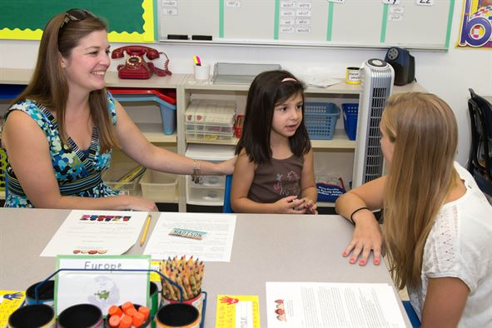
Helping Families Understand Homework
.
Teach families skills to help their children at home
Discuss how to improve student progress with families
Encourage families to promote high standards for student work
Ensure that families understand what their children are learning and doing in class
Henderson, Mapp, Johnson and Davies, 2007
Notes:
Conversations regarding homework may be the first step towards increasing families’ understanding of how they can take an active role in supporting their children’s success. To further maximize achievement, consider the following questions:
Are families informed of their children’s progress on a regular basis or simply presented with a grade at the end of the semester?
Do they understand the skills that are requisite for academic success? Are families educated to increase their understanding of standardized tests?
Do they have appropriate expectations for their children and understand the necessary process for pursuing post-high school education, whether it be college, trade school, apprenticeship?
Are families encouraged to ask questions and contribute to the academic discussion?
Have they been taught strategies for teaching and learning?
If so, families are truly active participants in the educational process. If not, what can be done to improve this relationship?
One way to improve the relationship and families’ support of successful learning is to share resources. Parents are experts on their children, but most are not trained educators. Sharing strategies on how to help their children achieve will benefit the student, the family, and educators, as well as strengthen your collaborative relationship. Understood.org’s ‘Homework and Study Skills’ provides strategies and best practices to use and share. You can find this under the ‘Resources’ section of the module page, along with other articles and strategies for families and educators to support student’s organizational and academic skills.

Slide 34
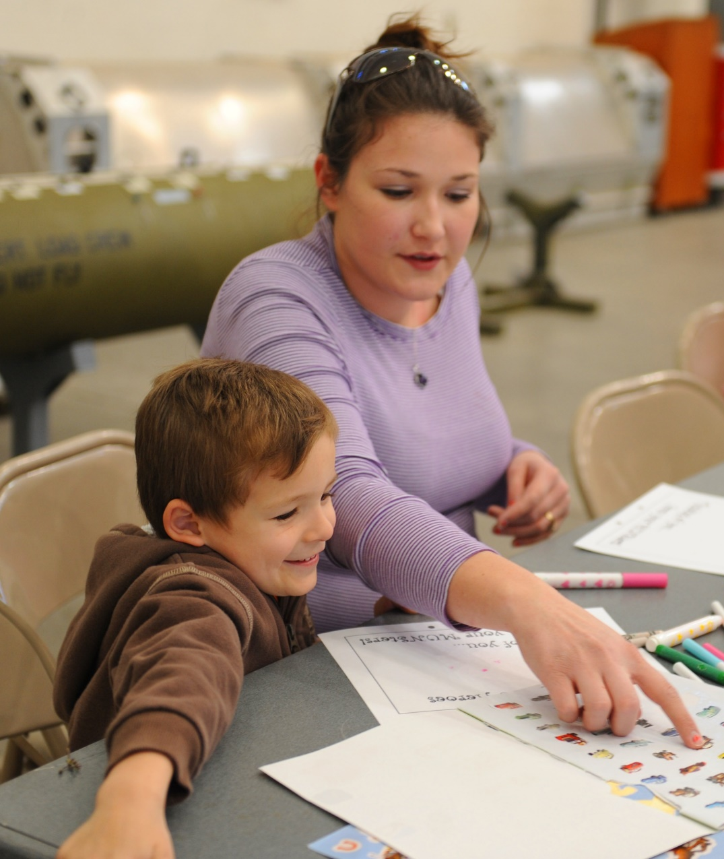
Interactive Homework Assignments
Provide parents with:
  Information on assignments
    increases time students spend on homework
    increases level of student achievement
  Specialized training
    elicits even greater levels of achievement
Bailey, 2006
Notes:
Homework, itself, may serve as a means of increasing family engagement, particularly by utilizing “interactive homework assignments,” in which families and students work together to complete work. According to research, families who were provided with information on homework assignments, such as the skills necessary to complete the assignment, the purpose of the assignment, etc., tended to spend more time working with their children on assignments and increased their children’s achievement level. Families who were provided with training on how to complete assignments – in this case, several sessions over a four-week time span – were able to help their children reach even greater levels of achievement, even for academically at-risk students.
Take a moment to consider the question: What kind of resources are available to our families to inform or instruct them on the “how” and “why” of homework?

Slide 35
Building Capacity for Academic Collaboration
Best Practices
Meet with families more than annually
Become a partner with families
Share data on aggregate classroom performance & individual students’
Set educational goals together with families
Model strategies to support learning at home
Notes:
In order to collaborate effectively with families and optimize students’ academic success, teachers must ensure that families have ample opportunities to be involved in their children’s learning. Many schools provide opportunities for teachers to hold discussions with family members at Open Houses or Parent-Teacher Conferences. But to increase student success, classroom teachers would benefit from meeting more regularly with their families--as a group, at least three times per year; with individual families, a minimum of once per year for at least 30 minutes, depending on the needs of the students and families. And they do NOT need to occur at the school or even in person. Providing families flexible platforms, times, and modes in which they can participate can increase family participation in these events. Some discussions, such as those surrounding core content, class-wide academic goals, and learning strategies may be more appropriate for groups, while student-based strengths and needs are best discussed with individual families.
Maintaining communication about academics is vital, especially between regularly-scheduled meetings.
In a collaborative model, teachers are partners with families, not advisors. They don’t merely pass along students’ grades and behavioral performances. Teachers should regularly update families on class-wide, aggregate data and individual student data. Some data, such as student grades, can be shared via remote means, such as academic portals. However, simply sharing data is not enough; it must also be explained. Most families, unless they are educators, are not necessarily familiar with how to interpret data in regard to class, grade-level, and PA core standards. Teachers must be prepared to provide their families with information that will help them make sense of the data that is provided.
When families understand academic data, they are better able to participate in activities such as goal setting. Families who collaborate in establishing goals for their children or the entire classroom are more invested in goal attainment and have a heightened awareness of academic expectations that helps them better support their children’s learning.
Families are also better able to support their children when they learn strategies to supporting their children’s learning at home. Classroom teachers should model strategies so families can duplicate and practice them at home. There are many ways that teachers can facilitate this learning, including digital means. Platforms like SeeSaw, Explain Everything, Loom and Screencastify allow teachers to produce video that families can view in order to learn academic strategies. Teachers should, of course, provide alternate ways for families to learn strategies in the event that they do not have Internet access. Formulas for math or sample essays for ELA may be helpful tools for families as they assist their children in learning at home.

Slide 36
References (1)
American Psychological Association. Parent Engagement in Schools. Retrieved from apa.org: https://www.apa.org/pi/lgbt/programs/safe-supportive/parental-engagement/default.aspx
Bailey, Lora B,. (2006). Interactive Homework: A Tool for Fostering Parent-Child Interactions and Improving Learning Outcomes for At-risk Young Children. Early Childhood Education Journal, 34(2), 155-167. 10.10007/s10643-006-0114-y.
Barnyak, N. C., & McNelly, T.A., (2009). An urban school district’s parent involvement: A study of teachers’ and administrators’ beliefs and practices. The School Community Journal, 19(1), 33-58.
Bryk, A., Sebring, P., Allensworth, E., Luppescu, S., & Easton, J. (2010). Organizing Schools for Improvement: Lessons from Chicago. University of Chicago Press. Cox, D. D. (2005). Evidence-based interventions using home–school collaboration. School Psychology Quarterly, 20(4), 473–497.
Epstein, J.L., Coates, L., Salinas, K.C., Sanders, M.G., & Simon, B.S. (2008). School, Family, and Community Partnerships: Your Handbook for Action. (3rd ed.) Thousand Oaks, CA: Corwin Press.
Ferlazzo, L. (2011, May). Involvement or Engagement? Retrieved July 02, 2020, from http://www.ascd.org/publications/educational-leadership/may11/vol68/num08/Involvement-or-Engagement%C2%A2.aspx, pp 10-14

Slide 37
Resources
Grand Rapids Public School District. What Is Parental Engagement? Retrieved from grps.org: https://www.grps.org/parents/parental-engagement.
Henderson, A. T., & Mapp, K. L., (2002). A new wave of evidence: The impact of school, family, and community connections on student achievement. Austin, TX: National Center for Family and Community Schools, Southwest Educational Development Laboratory.
Hill, N., & Tyson, D. (2009). Parental Involvement in Middle School: A Meta-Analytic Assessment of the Strategies That Promote Achievement. Developmental Psychology, 45(3), 740-763.
Hoover-Dempsey, K., Walker, J., Sandler, H., Whetsel, D., Green, C., Wilkins, A., & Closson, K. (2005). Why do parents become involved? Research findings and implications. The Elementary School Journal, 106(2), 105–130.
How Parent Involvement Leads to Student Success. (2018, November 1). Retrieved July 02, 2020, from https://www.waterford.org/education/how-parent-involvment-leads-to-student-success/
References (2)

Slide 38
References (3)
Kaufman, T. Family Engagement and Student Success: What the Research Says. Retrieved July 02, 2020, from https://www.understood.org/en/school-learning/for-educators/partnering-with-families/family-engagement-and-student-success?_ul=1*1mv0hdh*domain_userid*YW1wLU9qT3FFYmFXeU85WkU5TEdRaDV6bUE.
Mapp, K. L., Carver, I., & Lander, J. (2017). Powerful partnerships: a teachers guide to engaging families for student success. New York, NY: Scholastic.
Mapp, K. L., (2002). Having their say: Parents describe how and why they are involved in their children’s education. Paper presented at the Annual Meeting of the American Educational Research Association, New Orleans, LA.
McDonald, C. (2016, June 3, personal communication); Dawson, K., & Berry, M. (2002). Engaging families in child welfare services: An evidence-based approach to best practice. Child Welfare, 81, 293-317.
Parallelus. (n.d.). National Network of Partnership Schools: Johns Hopkins University School of Education. Retrieved from https://www.partnershipschools.org
Notes:
38

Slide 39
References (4)
Pena, D. C., (2000). Parent Involvement: Influencing factors and implications. The Journal of Educational Research. 94(1), 42-54.
REL PACIFIC, (2015). Toolkit of Resources for Engaging Parents and Community as Partners in Education Part 4: Engaging All in Data Conversations. Retrieved October 16, 2015, from http://relpacific.mcrel.org/resources/~/media/RELPacific/Files/Part4_Mar2015.ashx
Sheldon, S. B., & Jung, S. B. (2015). Parent Involvement and Children’s Academic and Social Development in Elementary School. Johns Hopkins University, School of Education.
Sheldon, Steven B., and J. L. Epstein. “Involvement Counts: Family and Community Partnerships and Mathematics Achievement.” The Journal of Longitudinal Research. 98(4), 196-206
Starr, L. (2011, January 1). A Dozen Activities to Promote Parent Involvement. Retrieved February 27, 2015, from http://www.educationworld.com/a_curr/curr200.shtml
Wairimu, M.J., Macharia, S.M., Muiru, A. (2016, November 27). Analysis of Parental Involvement and Self-Esteem on Secondary School Students in Kieni West Sub-County, Nyeri County, Kenya. Journal of Education and Practice, Vol 7. (82-98)

Slide 40
References (5)
Weyer, M. (2018, September 24). Family Engagement in Education, Retrieved July 02, 2020, from https://www.ncsl.org/research/education/family-engagement.aspx
Weiss, H. B., & Lopez, M. E. (2011). Making data matter in family engagement. In, Sam Redding, Marilyn Murphy, & Pam Sheley (Eds.), The handbook on family and community engagement, pp. 21-28. Retrieved from http://www.schoolcommunitynetwork.org/downloads/FACEHandbook.pdf
Xu, Z., & Gulosino, C. A., (2006). How does teacher quality matter? The effect of teacher-parent partnership on early childhood performance in public and private schools. Education Economics, 14(3), 345-367.

Slide 41
PaTTAN – East
1-800-441-3215
Kimberly Jenkins kjenkins@pattan.net
PaTTAN – Harrisburg
1-800-360-7282
Erin Campion ecampion@pattan.net
PaTTAN – Pittsburgh
1-800-446-5607
Jennifer Geibel jgeibel@pattan.net

