Slide 1
OVR: Supporting Students with Disabilities: Making the Most of Potentially Eligible Cases

Slide 2
Presenter:
Brett Glavey, Transition Specialist Transition Section
OVR Bureau of Central Operations

Slide 3
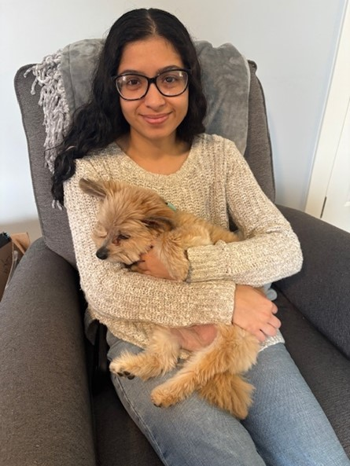
Layla
“By the time I left Project SEARCH, I had a job and was moving into my apartment with a roommate. I have been at my job for almost a year now and I love it!”
Began working with OVR’s Norristown BVRS office as a senior in high school.
Participated in Project SEARCH at Phoenixville Hospital.
Prior to exiting Project SEARCH, she met her job goal! She was offered a part time position at Holiday Inn as a housekeeper, working 24 hours a week, earning $11/hour. She is also able to continue to receive follow along job support through her waiver.

Slide 4

Transition Services Data (7/1/23-6/30/24)
21,861 students received Pre-ETS
OVR Staff attended 8,230 Individualized Education Plan (IEP) Meetings

Slide 5




Agenda
Introduction to OVR and Pre-Employment Transition Serivces (Pre-ETS)
Understanding the continuum of services available to students.
Potentially Eligible (PE) Cases
What they are, how to open them, and why they’re a valuable first step
VR Cases
How VR cases differ from PE and when a student is ready for the next step
Benefits for Students & Schools
Why starting with PE cases helps students build readiness and saves schools' time

Slide 6
Introduction
Introduction to OVR & Pre-ETS

Slide 7
OVR Mission Statement
To assist Pennsylvanians with **disabilities**
to secure and maintain
**employment** and independence.

Slide 8
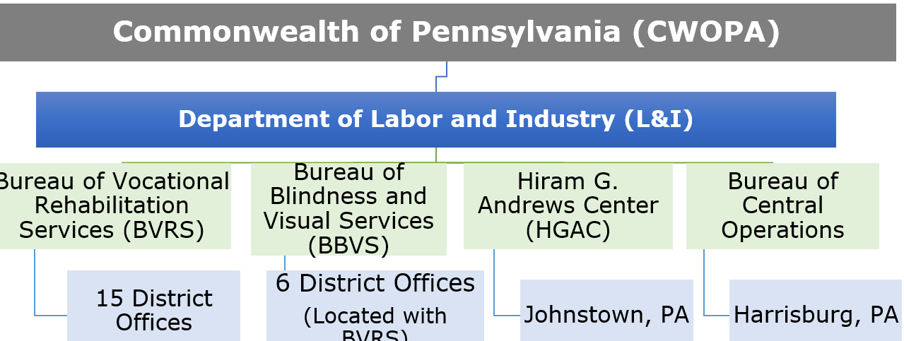
OVR Agency Organization

Slide 9
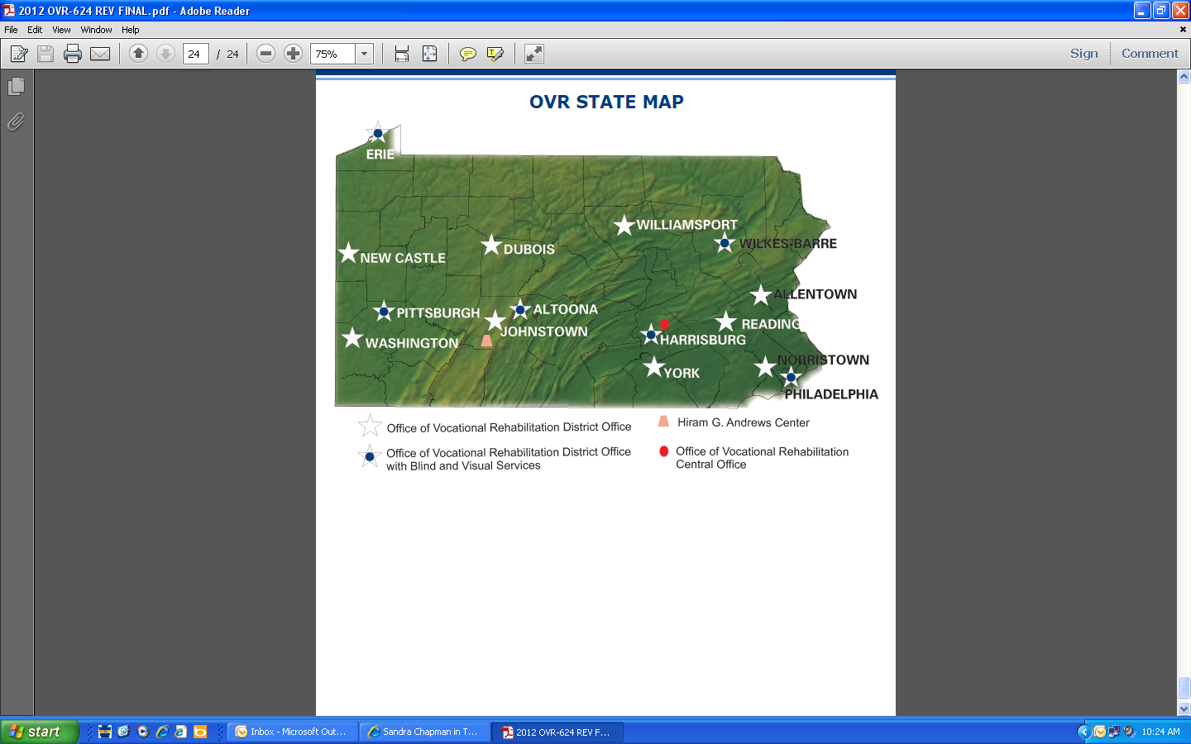
OVR District Offices (Map)

Slide 10
OVR District Offices (List)
Allentown
Altoona (+ BBVS)
DuBois
Erie (+ BBVS)
Harrisburg (+ BBVS)
Hiram G. Andrews Center (HGAC)
Johnstown
New Castle
Norristown
Philadelphia (+ BBVS)
Pittsburgh (+ BBVS)
Reading
Washington
Wilkes-Barre (+ BBVS)
Williamsport
York

Slide 11


OVR Staff You Currently Collaborate With
Early Reach Coordinators (ERCs)
Vocational Rehabilition Counselors (VRCs)
OVR 101
Group Presentations on Pre-ETS Topics in your classrooms.
Attend IEPs
Host OVR tables at your events.
Meet with your students (and families) individually.
On-site at your school with set frequency.
Attend IEPs
Accept Referrals

Slide 12



Introduction to Pre-ETS: Who has access?
Age 14-21
Enrolled in high school, college, or other training
Have an IEP, 504 Plan or Self-Identified Disability

Slide 13
Introduction to Pre-ETS: What are they?
The 5 Required Pre-ETS
Self-Advocacy Instruction
Counseling On Postsecondary Options
Job Exploration Counseling
Workplace Readiness Training
Work Based Learning

Slide 14



OVR Continuum of Services: 3 Phases of Pre-ETS
  Experiential Learning & Instruction
  Introductory opportunities to learn about, explore, and try out job activities.
  (available to students who are potentially eligible or have an open VR case)
  Paid Work-based Learning Experiences
  Get paid while gaining work experience
  (must complete a VR application or have an IPE)
  Enhanced Exploration Opportunities
  Specialized programs that offer more in-depth job exploration
  (require an IPE before starting)

Slide 15
Pre-ETS Examples By Phase
ELI Examples:
Group Instruction on the 5 Required Pre-ETS
Job Shadowing
Travel Training
Informational Interviews
Fab Lab
Professional Connection Foundation (PCF)
Summer Post Secondary Experience (PSE)
PWBLE Examples:
Community Work Instruction (CWI)
Paid Work Experience (PWE)
MyWork
Enhanced Examples:
Project Search
Youth Ambassador
College Work Experience
Transition Achievement Program (TAP)

Slide 16





Recommended Pre-ETS by Age/School Exit
Age 14+
  Experiential Learning & Instruction (EL&I): Group Instruction on 5 Required
2 Years Prior to Exit
  Add paid Work-Based Learning
Post-secondary
3 Years Prior
  Add Individual EL&I such as Job Shadowing, and group services such as Professional Connections Foundation (PCF)
1 Year Prior
  Add Enhanced Exploration

Slide 17
PE Cases
Potentially Eligible (PE Cases)

Slide 18

What is Potentially Eligible (PE)?
A Potentially Eligible (PE) student is enrolled in high school or post-secondary training, has an IEP, 504 plan, or self discloses a disability, and ages 14-21.
They have not yet applied for full VR services.
PE students can only receive Pre-ETS.

Slide 19

PE Cases: Opening Doors for Students
One simple form (OVR-244 Pre-ETS Request)
Gives students access to large menu of Pre-ETS
Signature on Pre-ETS Request is the only required documentation of disability.

Slide 20
The Benefits of a PE Case
PE=Access
Quick Entry
Large Pre-ETS Menu
Prep for VR
Minimal Paperwork

Slide 21
The Benefits of a PE Case Accessible
Quick Entry
Large Pre-Ets Menu
IPE = Access
Minimal Paperwork
Prep for VR

Slide 22

Pre-ETS Request OVR-244 Form
Documents that the student has a disability and wants to participate in Pre-ETS
Opens a PE case and allows OVR to authorize services
Required before any student can receive Pre-ETS
Authorizes the Release of Information between OVR, provider, and school

Slide 23

Using the OVR-244 Correctly
Parent must sign if under 18
If applicable, provider section is completed to release information for Pre-ETS
2 witness signatures can be used if parent or student is only available by phone
Must be submitted before services begin, whether OVR or provider delivered.

Slide 24

VR Case
Vocational Rehabilitation (VR) Case:
The Next Step Toward Employment

Slide 25

The Role of VR Cases
PE Opens the door to exploration & skill building
VR takes students deeper—planning, training, and permanent job placement
Both pathways work together for long-term success

Slide 26

When Students Are Ready for the Next Step
A student should open a VR case when:
  They are nearing graduation and are ready for more intensive planning
  They need intensive supports (e.g. assistive technology, job coaching, accommodations, training to obtain competitive, integrated employment upon exiting high school
  They require a VR service to access or participate in a Pre-ETS

Slide 27
VR Service Examples:
VR Services to Access & Participate in Pre-ETS
  Assistive Technology
  Foreign Language Interpreting
  Personal Care Attendant
VR Services Post-High School
  Diagnostic Services
  Vocational Evaluation
  Counseling and Guidance
  Restoration Services
  Training Services
  Placement Assistance
  Supported Employment

Slide 28

Benefits of Transitioning from PE → VR
Ensures continuity—no service gap. Students can immediately access Pre-ETS with a PE case
Builds trust and confidence through established relationships
Uses Pre-ETS data to inform VR planning and eligibility

Slide 29

Scenario #1: Mallory
Mallory is a 9th grade student that is interested in Pre-ETS Group Instruction with an Early Reach Coordinator.
She does not need a VR service to access/participate in Pre-ETS.
What would you do?

Slide 30

Answer: Mallory
Complete an
OVR 244 and refer for a PE case.

Slide 31

Scenario #2: Henry
Henry is an 11th grade student who is 2 years from high school graduation. He plans to graduate at age 18.
He is interested in connecting with OVR but is not quite sure if he is ready for a Paid Work Based Learning Experience.
He has not worked with OVR before and does not have an existing case.
What would you do?

Slide 32

Answer: Henry
Complete an OVR 244 and refer for a PE case. After Henry receives group instruction or an experiential learning Pre-ETS, OVR staff can determine if he is ready for a VR referral.

Slide 33

Scenario #3: Jillian
Jillian is a 10th grade student that requires an VR Service to access and participate in Experiential Learning and Instruction Pre-ETS.
What would you do?

Slide 34


Answer: Jillian
Complete a OVR 244. Submit to your assigned ERC or VRC. OVR will determine internally if a PE or VR referral is the best fit.

Slide 35
Then and Now
Then:
Now:
Age 14+: Pre-ETS Request Form to work with ERC, and/or Provider. PE case opened.
Last 2 years of high school: VR Referral to VRC, and OVR Application. VR case opened.
All grades: Begin with Pre-ETS Request form to open PE case.
OVR staff decide when and if VR referral is needed.
  Student needs a VR service to access/participate in Pre-ETS.
  Student has participated in experiential learning and instruction Pre-ETS and is ready for or could benefit from a Pre-ETS that requires a VR application, or IPE.

Slide 36

Questions?

