Slide 1

What Special Education Administrators Need to Know about Data Collection

Slide 2
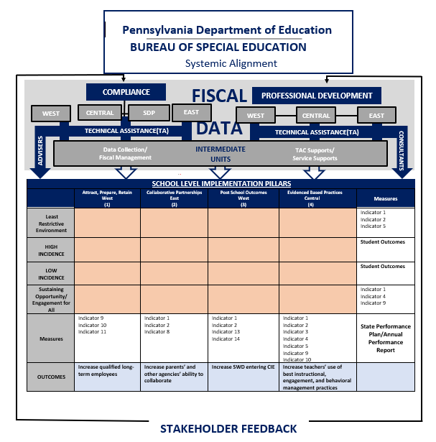
Notes:
Does this still matter?

Slide 3
Pennsylvania's Student Population
Total Enrollment: 1,676,994
Total Special Education Enrollment: 347,519
Special Education Percentage: 21%
December 1, 2024 Child Count

Slide 4
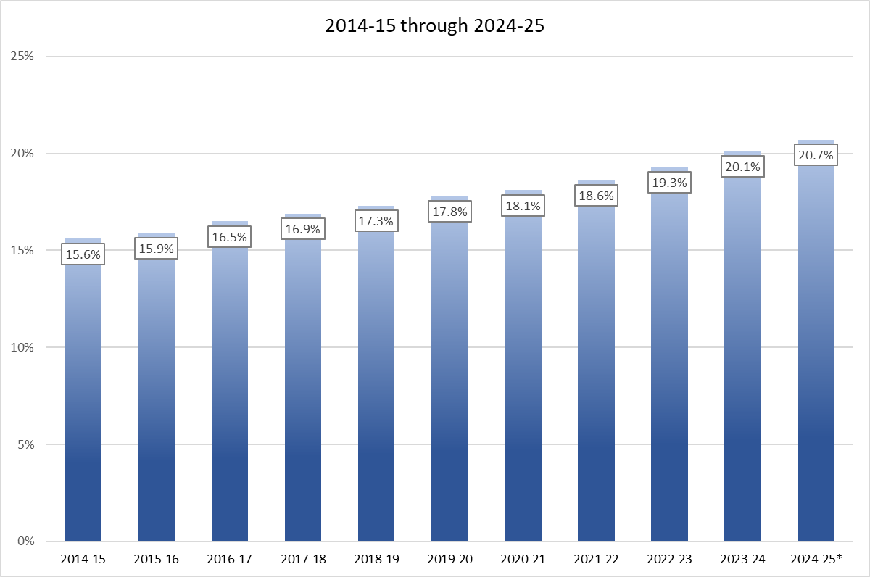
Percentage of School-Age Receiving
Special Education Services

Slide 5
Data Systems Used for General Supervision
System | Data Collected
PIMS – PA Information Management System | Child Count Educational Environment Exiting Discipline
IMS – Integrated Monitoring System | Monitoring (Cyclical, Targeted, Focused) State Complaints RISC Deaf-Blind Census
FRCPP – Future Ready Comprehensive Planning Portal | Special Education Plans
E-Grants | Fiscal Equitable Participation
CFRS - Consolidated Financial Report System | Fiscal
Penn State Data Center | Child Find Discipline Public Reports
ODR Database | Dispute Resolution
Resource Account Management System Data Base | Constituent Inquiries

Slide 6
Data Used for General Supervision
Federal IDEA Funding and Federal Reporting
State Performance Plan
Annual Performance Report
Special Education Data Report Targets
Compliance Monitoring
Corrective Action Verification
LEA Determinations
Significant Disproportionality
Dispute Resolution
Training and Technical Assistance
Notes:
PA has different funding mechanisms for charter schools. Do we want to bring to life?
Funding is connected to data…

Slide 7
Data for Continuous Improvement
Training & TA
Annual Determinations
Corrective Action Verification
Improvement Planning
Public Reporting
Student
Outcomes

Slide 8
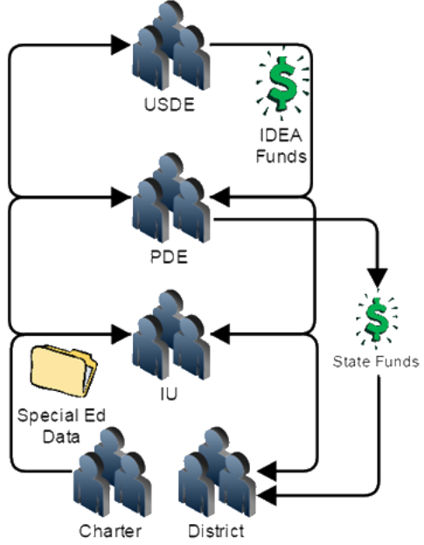
Why is Data an Important Part of Fiscal?
LEA Funding
  Federal-IDEA
  State-Act 16
State Performance Plan/Annual Performance Report
Indicator Targets
Compliance Monitoring
Corrective Action
LEA Determinations
Significant Disproportionality

Slide 9
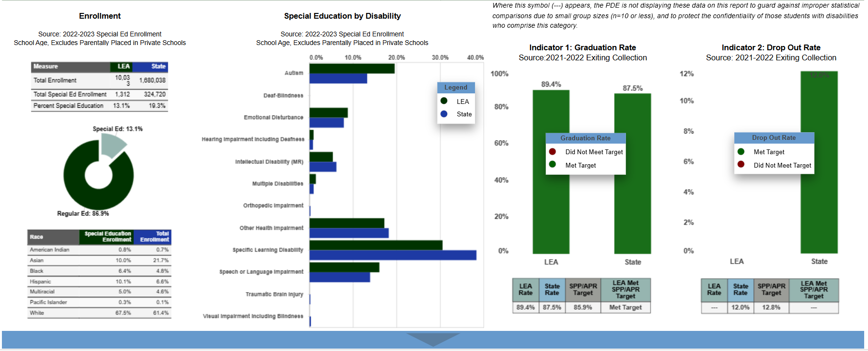
Public Reporting
PennData https://penndata.hbg.psu.edu
Special Education Data Reports (SEDR) by LEA and IU
Statistical Summaries
Notes:
Edit as needed. I used Cumberland Valley’s first section of the SEDR from 22-23 in the image.

Slide 10
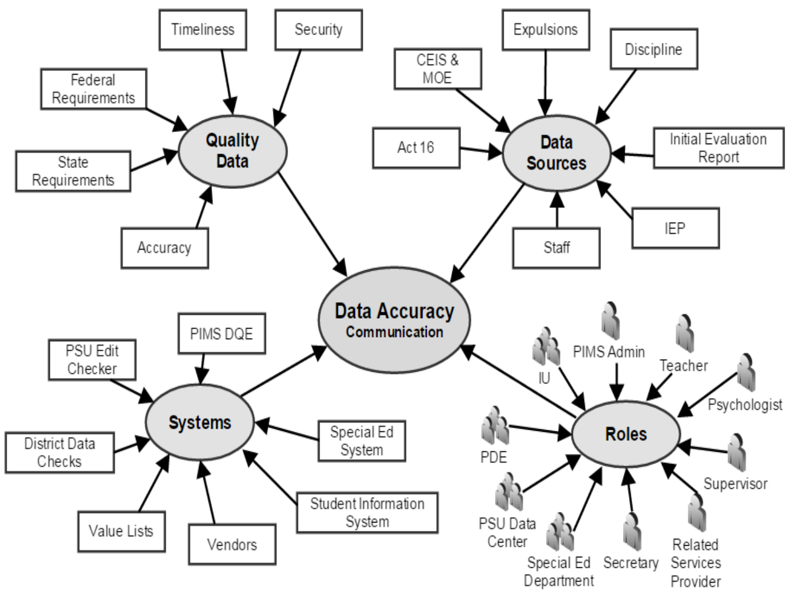
Data is an LEA-Wide Team Effort

Slide 11
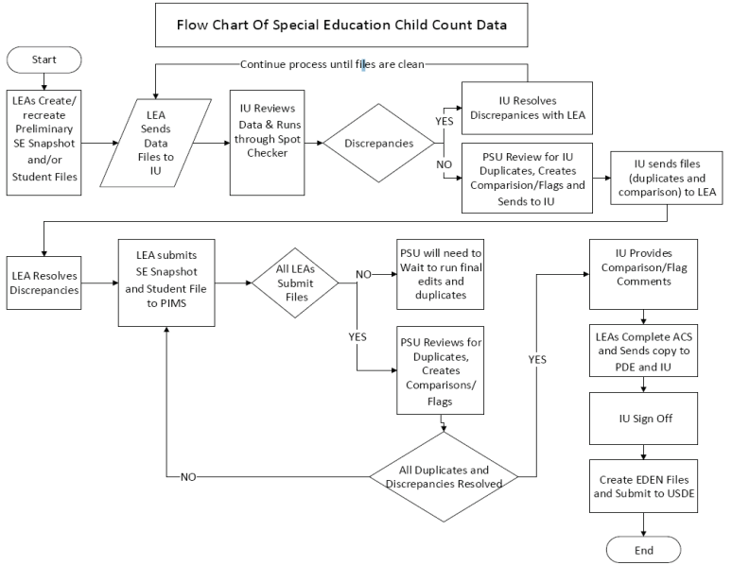
Collection Process

Slide 12
Data Collections
PIMS/PennData – December
  Child Count
  Personnel, Fully Certified
  Parentally Placed Private School Students-Intermediate Unit
PIMS/PennData – June 30
  Exiting Students (14 or older)
  Disciplinary Removals
  Post Secondary Transition
  Initial Evaluations (Annual)
PIMS – October
  Act 16
Spring/Summer
  Maintenance of Effort/Comprehensive Coordinated Early Intervening Services (MOE/CCEIS)

Slide 13
Child Count – December 1
SD/CS Federal IDEA Funding
  ~$1,000 per student
All Special Ed Students with a valid IEP on 12/1
Reported by:
  District of Residence
  Charter School
  Foster District
  Dept. of Corrections (State Juvenile Facilities)
Penn Data Demographics
SPP Indicator 5 – Educational Environment
SPP Indicators 9 & 10 – Disproportionate Representation
Significant Disproportionality
  Identification
  Placement/Ed. Environment

Slide 14
Exiting & Discipline Collections – June 30
Submission includes:
  Students 14 or older as of July 1
Collection reports on:
  Exiting Students age 14 or older as of December 1
Exit Reason and Exit Date
SPP Indicators 1 & 2 – Graduation & Drop-Out Rates
Disciplinary Removals
  In School Suspensions
  Out of School Suspensions
  Unilateral Removals
  ODR Hearing Officer Removals
SPP Indicator 4 – Suspension & Expulsion
Significant Disproportionality
  ISS/OSS Less than 10 days
  ISS/OSS 10 or more days
  Total Removals

Slide 15
Other Submissions
Personnel (With Child Count)
  Teachers and Paraprofessionals
  Related Service Providers
Parentally Placed Private School (With Child Count)
Act 16 (October)
MOE/CEIS (Spring)
Act 26 Transition Questions (with Exiting)
  Post-Secondary Transition plan in IEP
  Competitive Integrated Work Experience?
  Job Coaching?
  Competitive Integrated Employment Goal?
  Employed in Competitive Integrated setting upon exiting?

Slide 16
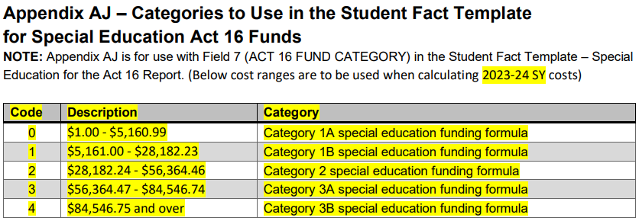
Act 16 Reporting Category Codes
Notes:
Barry:
--The category ranges for students are found in the PIMS Manual Volume 2, Appendix AJ. There are currently five reporting categories from 1A through 3B. For purposes of the funding formula and the category weights, students whose costs fall into categories 1A and 1B are combined, and students whose costs fall into category 3A and 3B are combined.
--These ranges are updated annually based on the change special ed expenditures per adjusted weighted student.

Slide 17
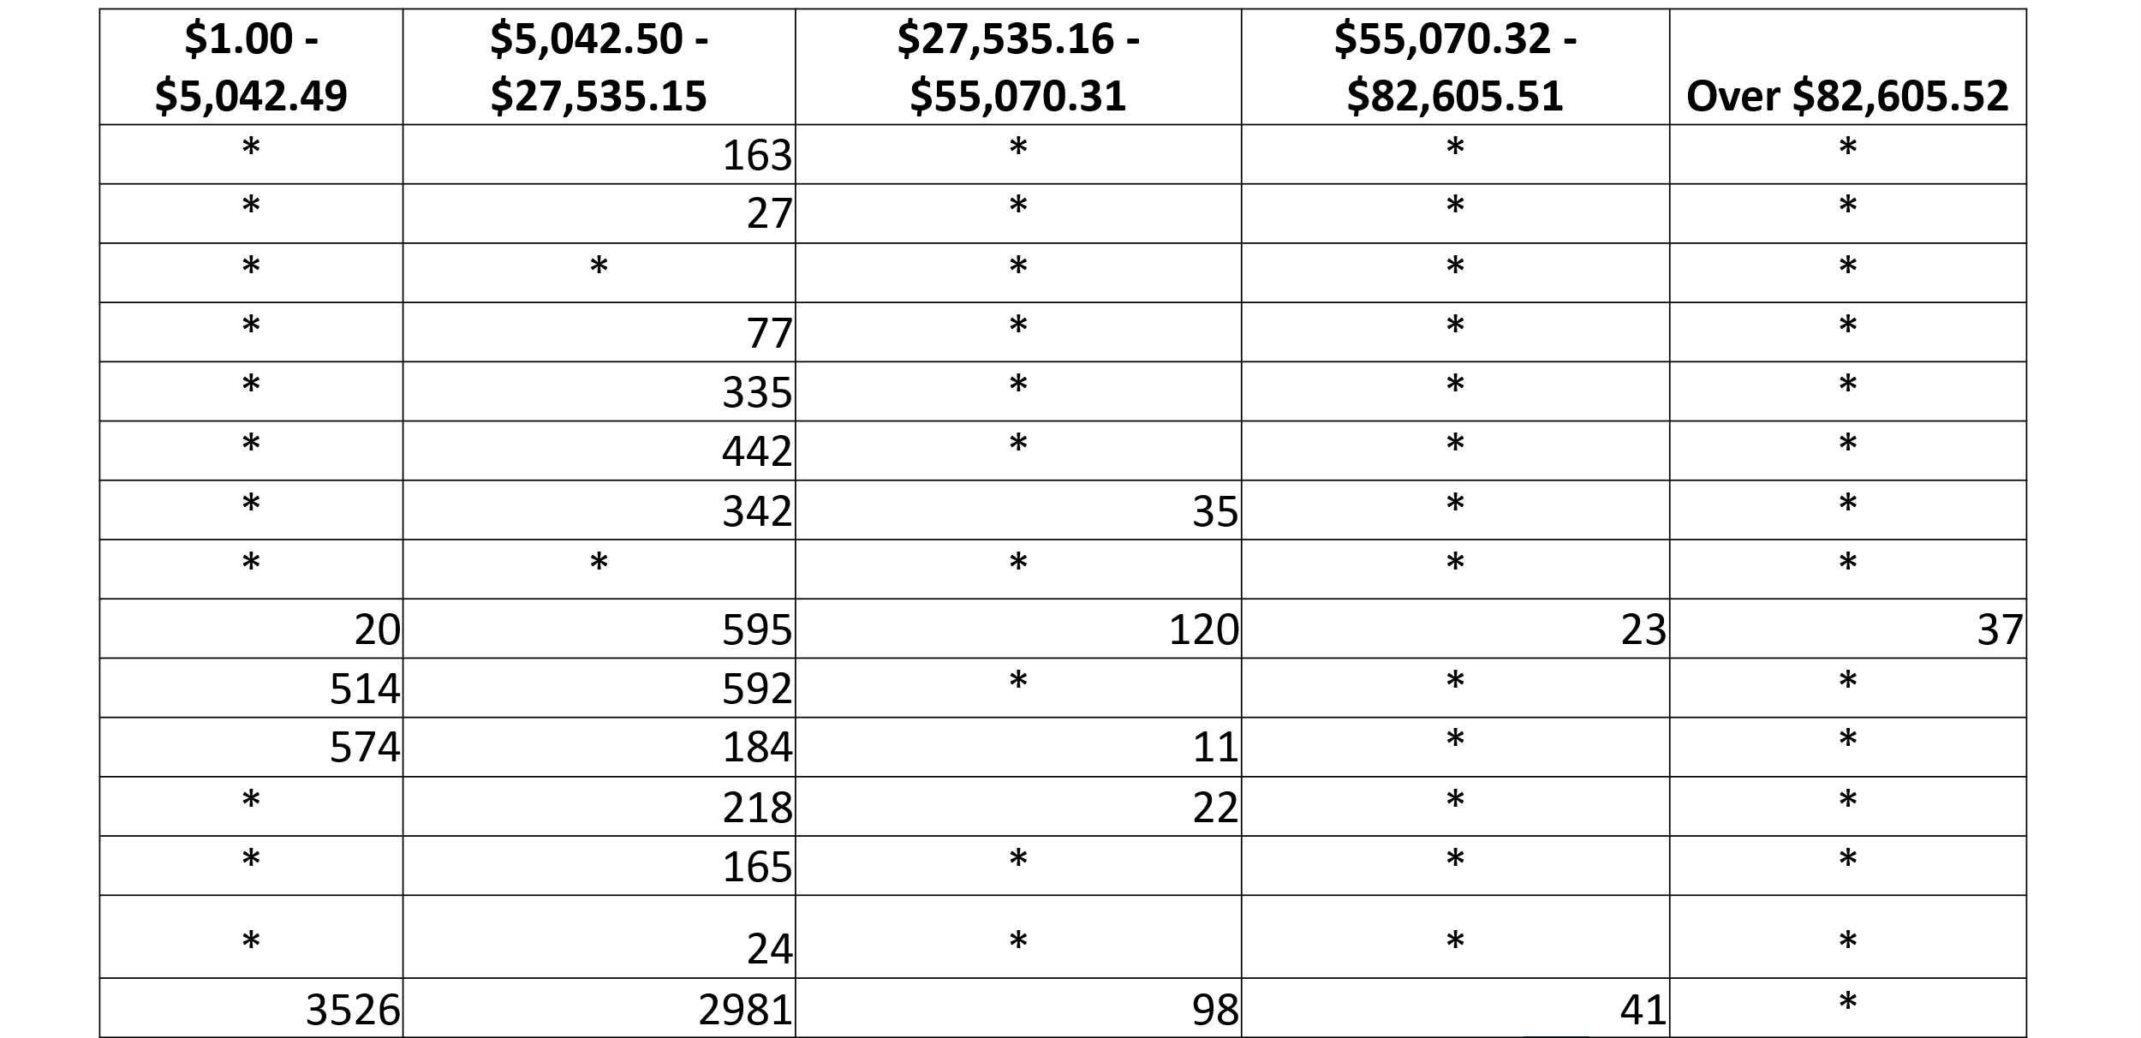
Act 16 Data Needing Corrections
Notes:
Here is an example of data from a previous year that after initial reporting required correction, to note, any asterisk indicates that there were less than 11 students reported in that category. These LEAs were contacted well after the C1 collection closed.

Slide 18
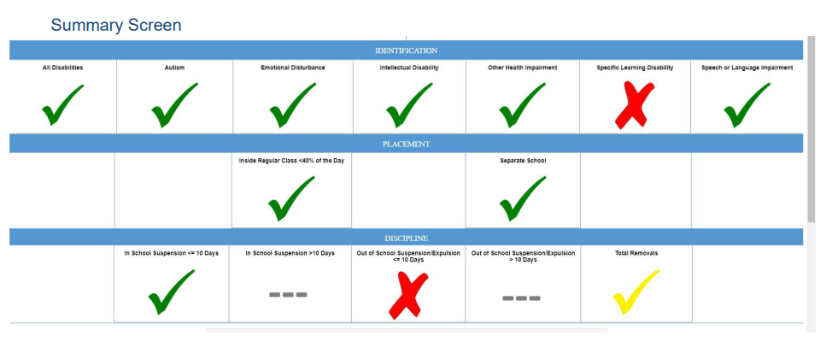
Significant Disproportionality Dashboard

Slide 19
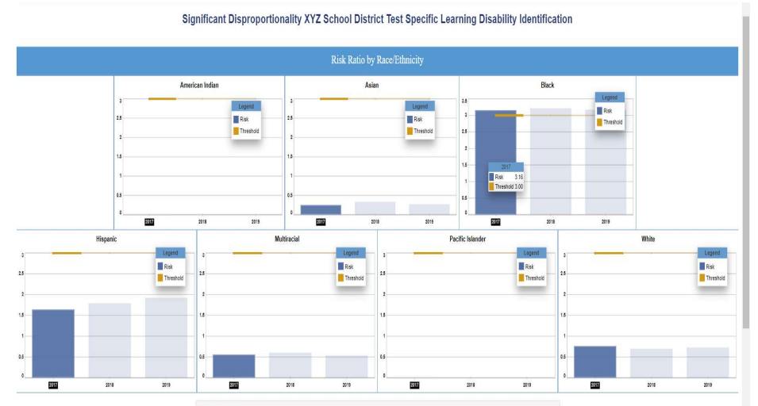
Significant Disproportionality Dashboard

Slide 20
Importance of Data & Best Practices
Compliance with Regulations
Accuracy in Funding
Annual Determinations
Public Reports
Set Conditions for Review
  Timelines and Preparation
Coordinate with your SD/CS Data Team
Leverage your IU Data Manager

Slide 21

Preventative Measures
Have a basic understanding of Excel
Partnership between SE data manager and the PIMS manager
Have a basic understanding of the data points collected and where they pull from in your documents and system.
  Special Education 101 at Data Summit
Run data reports monthly to reduce errors that accumulate and have staff correct as needed.
Set Conditions for Ease of Reporting and Limited Activity During Data Pull
Maintain a yearly chart of data for comparison

Slide 22
Prior to Collection
Have a code sheet available and visible from work area.
Have IU data manager and BSE data manager numbers visible from work area.
Run data checks weekly prior to submission to know where areas of concern maybe.
Review collection schedule with your district calendar and create a district schedule, avoid having to work over Holiday break.
Meet with your LEA Data Manager to review the collection schedule and timelines. Block time on your calendar to dedicate to the data collection based on district needs.
Be aware of the potential Spot Checker errors and how to correct them. Spot Checker open way before PIMS open and do comparison.

Slide 23
During Collection
When working on pulling the submission, try to arrange a condition where there will be minimal people working in the system.
  System lock out
  Window of arranging timing of IEPS so activity in system is reduced.
Ensure the SIS data and the SE data match.
Begin the data correction by correcting everything in the system first and then pulling new extracts. Use the SANDBOX.
Once you feel the extract is systemically clean with scattered errors, make corrections in the extract and correct the system.
Are they really drop-outs?

Slide 24
Codes

Slide 25
Contact/Mission
Dr. Carole L Clancey
Director, Bureau of Special Education
caclancey@pa.gov
Barry J Frank
Chief, Division of Analysis and Financial Reporting
barfrank@pa.gov
For more information on the Special Education Funding please visit PDE’s website at www.education.pa.gov
The mission of the Department of Education is to ensure that every learner has access to a world-class education system that academically prepares children and adults to succeed as productive citizens. Further, the Department seeks to establish a culture that is committed to improving opportunities throughout the commonwealth by ensuring that technical support, resources, and optimal learning environments are available for all students, whether children or adults.

