Slide 1
Academic Equity for Students with Disabilities: High-Leverage Practices
Part 3: Collaboration and Assessment
Notes:
Welcome to the High Leverage Practices in Special Education webinar. In our last webinar we took a deeper dive into the domain of instruction. Today we will explore the domains of collaboration and assessment.

Slide 4
Individuals attending this webinar must arrive on time and stay the duration of the workshop in order to receive Act 48 Professional Education hours.
Participants must complete all 3 webinars in this series to receive a total of 3 Act 48 hours.
Notes:
Individuals attending this webinar must arrive on time and stay the duration of the webinar in order to receive Act 48 Professional Education hours.
Participants must complete all 3 live webinars in this series to receive a total of 3 Act 48 hours.

Slide 5
Notes:
If you have any questions during the webinar, please type them in the area called Q&A. This will allow us to have a record of the questions if we need to refer back to them.

Slide 6
https://highleveragepractices.org/
Notes:
The content of this webinar comes from the Council for Exceptional Children. They have developed and published a set of High Leverage Practices (HLPs) for special educators and teacher candidates, in partnership with the Collaboration for Effective Educator Development Accountability and Reform also knows as (CEEDAR). We have the web address here.
Some of the content in this webinar may not be new or something you have never heard before, but they are proven research-based high leverage practice strategies that provide successful outcomes for students with disabilities as well as, non-disabled students.

Slide 7
Learning Outcomes
Describe and apply the three observable High Leverage Practices of assessment and the three Practices of collaboration within an inclusive educational setting.
Explain the characteristics of a successful framework of collaboration that is inclusive of all stake holders.
Discuss the process of data-based decision making to support students with disabilities within inclusive educational settings.
Identify practical tools for collecting and analyzing, strengths and needs of HLP’s within your current educational programing.
Notes:
Read slide….

Slide 8
Collaboration
What does collaboration look like in your school and what are some barriers?
Notes:
Let's start with collaboration. Pose questions to participants.

Slide 9
Collaboration
1. Collaboration with professionals to increase student success.
2. Organize and facilitate effective collaboration meetings with professionals and families.
3. Collaboration with families to support student learning and secure needed services.
Notes:
There are 3 areas of collaboration in High Leverage Practices that are necessary if we want students to be successful..
Read Slide….
Effective special education teachers collaborate and communicate with a wide range of professionals, families, and caregivers to ensure that educational programs and related services are effective and meeting the needs of each student with a disability.

Slide 10
HLP#1 Collaboration with professionals to increase student success
Collaboration with general education teachers, paraprofessionals, and support staff
Collaboration with individuals or teams
Notes:
The first is collaboration with professionals to increase student success…
Collaboration with general education teachers, paraprofessionals, and support staff is necessary to support student learning and to facilitate student social and emotional well-being across all school environments and instructional settings. Collaboration with individuals or teams requires interpersonal skills such as sharing ideas, active listening, questioning, planning, problem solving, and negotiating—to name a few. Through collaboration, teachers develop and adjust instructional and/or behavioral plans based on student data; they also coordinate expectations, responsibilities, and resources to maximize student learning. Effective and purposeful collaboration should enlist support from district and school leaders, who can foster a collective commitment to collaboration, provide professional learning experiences to increase team members’ collaborative skills, and create schedules that support different forms of ongoing collaboration.

Slide 11
Reflection
If you want team members to gather and assist each other in identifying community-based services and resources that meet the needs of a child and family, who will you invite to be members of the collaborating team?
Notes:
Here we have a reflection question that pertains to HLP#1, please provide your response in the chat. Read slide..
A service coordinator learns about reimbursement policies and helps families, as needed, to understand the impact of using non-public funds to pay for services.
A social worker compiles a resource book on programs, funding options and policies to be used by families and other team members.
A case manager invites contributions and perspectives of each team member about placement options to meet a child and family’s needs.

Slide 12
HLP#2 Organize and facilitate effective meetings with professionals and families
Meetings that identify clear and measurable student outcomes
Develop a meeting agenda
Building Relationships
Notes:
The next component is to organize and facilitate effective meetings with professionals and families. When a collaboration meeting has no end goal in mind, that is when we run into issues.
Special education teachers lead and participate in a range of meetings with the purpose of identifying clear and measurable student outcomes. They develop a meeting agenda, allocate time to meet the agenda goals, and lead in ways that encourage consensus building (e.g., demonstrating positive verbal and nonverbal communication. Special education teachers need to facilitate meetings, so they run smoothly, involve others as equal participants, and accomplish the goals of the meeting. These tasks require communicating effectively with others and being able discuss aspects of the individual child’s program.
When teachers work together to diagnose what they need to do, plan and teach interventions, and evaluate their effectiveness it has shown a strong effect on student achievement. Effective meetings are facilitated by building trust, communicating clearly, listening carefully to others’ concerns and opinions such as active listening, soliciting feedback, and inviting multiple perspectives.

Slide 13
Reflection
What communication and group facilitation strategies do you use to enhance a team’s functioning and interpersonal relationships?
Notes:
Here is a reflection question that pertains to HLP#2. Read slide.
Acknowledge gaps in communication among teachers and teacher aides and develops a plan to remedy the problems.
Uses a round robin technique in a group meeting to ensure that all team members, including those who typically are quiet, have a chance to express their perspectives and ideas on an issue.

Slide 14
HLP#3 Collaboration with families to support student learning and secure needed services
Ensure that families are informed about their rights.
Communicate by considering such things as family background, socioeconomic status, language, culture, and family priorities.
Work with families to self-advocate
Notes:
Finally, collaboration with families to support student learning and secure needed services for the family as a whole is essential for student success.
The importance of collaborating with families to promote participation in educational decision making has been identified as one of the key principles of IDEA. Family–professional partnerships have been defined as a relationship in which families (not just parents) and professionals agree to build on each other’s expertise and resources, as appropriate, for the purpose of making and implementing decisions that will directly benefit students and indirectly benefit other family members and professionals. Special education teachers collaborate with families about individual children’s needs, goals, programs, and progress over time. Teachers ensure that families are informed about their rights as well as about special education processes. Effective special education teachers respectfully and effectively communicate by considering such things as family background, socioeconomic status, language, culture, and family priorities. Teachers advocate for resources to help students meet instructional, behavioral, social, and transition goals. In building positive relationships with students, teachers encourage them to self-advocate, with the goal of fostering self-determination skills over time. Teachers also work with families to self-advocate and support their children’s learning.

Slide 15
Reflection
How do you ensure collaboration with families and multiple professionals to plan for and implement supports and services for students with unique and complex needs?
Notes:
We have a reflection question pertaining to HLP#3…..….Read slide
A physical therapist, special educator and OT meet to talk with the family about the child’s current abilities and progress and modify current strategies to align with the child’s current level of performance.
An early childhood teacher discusses her ideas and concerns about a child’s progress with the consulting speech language pathologist and they develop additional teaching strategies.

Slide 16
Reflection
What are the strategies you are using to continue the collaboration between professionals and families, without the ability to physically meet?
Notes:
Our last reflection question in the domain of collaboration is Given the current implementation of continuity of education and FAPE within our non-typical environment, we would like to reflect on …read slide…

Slide 17
Assessment
What types of assessment (benchmark, formative, summative, etc.) does your LEA use to inform educational programing?
Notes:
Assessment plays a foundational role in special education. Effective special educators understand that students with disabilities are complex learners who have unique needs that exist alongside their strengths. This requires knowledge about assessment and skills to use and interpret data; it also requires knowledge and skills to use informal assessments to develop students’ individualized education programs (IEPs), design and evaluate instruction, and monitor student progress. Effective teachers are knowledgeable about how context, culture, language, and poverty might influence student performance. They use this knowledge when navigating conversations with families and other stakeholders, and when choosing appropriate assessments given a student’s profile.

Slide 18
Assessment
1. Use multiple sources of information to develop a comprehensive understanding of a student’s strengths and needs.
2. Interpret and communicate assessment information with stakeholders to collaboratively design and implement educational programs.
3. Use student assessment data, analyze instructional practices, and make necessary adjustments that improve student outcomes.
Notes:
To develop a deep understanding of a student’s learning needs, special educators compile a comprehensive learner profile through the use of a variety of assessment measures and other sources (e.g., information from parents, general educators, other stakeholders) that are sensitive to language and culture, to
analyze and describe students’ strengths and needs and
analyze the school-based learning environments to determine potential supports and barriers to students’ academic progress.
The three areas that we will be discussing include…
Read Slide..

Slide 19
HLP#4 Use multiple sources of information to develop a comprehensive understanding of a student’s strengths and needs.
Use a variety of assessment measures
Use data-based decisions
Multiple data sources
Notes:
The first area is to use multiple sources of information to develop a comprehensive understanding of a student’s strength and needs.
Special educators compile a comprehensive learner profile by using a variety of assessment measures and other sources (information from parents, general educators, and other stakeholders) that are sensitive to language and culture.
They use this information to analyze and describe students’ strengths and needs and analyze school-based learning environments to determine potential supports and barriers to students’ academic progress. Effective teachers collect, aggregate, and interpret data from multiple sources, such as, informal and formal observations, work samples, curriculum-based measures, functional behavior assessment, school files, analysis of curriculum, information from families, and other data sources, to create an individualized profile of the student’s strengths and needs.

Slide 20
HLP#5 Interpret and communicate assessment information with stakeholders to collaboratively design and implement educational programs.
Communicate with stakeholders
Understand how culture and language influence the data
Collaborate to design assessment accommodations
Notes:
Second, area of assessment is to interpret and communicate information with stakeholders to collaboratively design and implement educational programs.
Teachers interpret assessment information for stakeholders, such as, other professionals, families, and students, and involve them in the assessment, goal development, and goal implementation process. To do this, special educators must understand each assessment’s purpose, help key stakeholders understand how culture and language influence the interpretation of the data generated, and use data to collaboratively develop and implement IEP and transition plans that are aligned with student needs.
Understanding the assessment challenges of students that are from culturally and linguistically diverse backgrounds is vital because this population of students is disproportionately represented in special education. For some team members, assessment data may need to be interpreted with regard to its importance to developing goals, choosing appropriate accommodations and modifications, and identifying fair grading practices. Finally, special education teachers are tasked with communicating initial and ongoing assessment data with other teachers and support staff. Students’ IEPs are continually revised based on assessment data. Teachers and staff use assessment data to understand if interventions are effective and adjust instruction accordingly.

Slide 21
Reflection
What are some ways that you design and communicate assessment accommodations?
Notes:
We have our reflection question for the domain of assessment. Read slide

Slide 22
HLP#6 Use student assessment data, analyze instructional practices, and make necessary adjustments that improve student outcomes.
Ongoing adjustments
Progress monitoring
Reflect on instruction
Professional Development
Notes:
The last area in the HLP domain of assessment is to use student assessment data, analyze instructional practices, and make necessary adjustments that improve student outcomes.
After special education teachers develop instructional goals, they evaluate and make ongoing adjustments to students’ instructional programs. Once instruction and other supports are designed and implemented, special education teachers have the skills to manage and engage in ongoing data collection using curriculum-based measures, informal classroom assessments, observations of student academic performance and behavior, self-assessment of classroom instruction, and discussions with key stakeholders. Formative assessment is only effective when coupled with sound instructional decision making and effective interventions.
Teachers also study their practice to improve student learning, validate reasoned hypotheses about salient instructional features, and enhance instructional decision making. They retain, reuse, and extend practices that improve student learning and adjust or discard those that do not.

Slide 23
Summary
Effective instruction for students with disabilities depends on teachers who are adept at using assessment data to inform, guide, evaluate, and adjust instruction.
Notes:
In summary, assessment data can be used to guide instructional decision making toward more effective instructional strategies for students who are struggling with academic content. Read slide….
Examples of effective instructional strategies include direct instruction, strategy instruction and student feedback (Hatti, 2008).

Slide 24
Next Steps: Tools to Guide Additional Professional Development and Action Planning
Notes:
Throughout this 3-part Webinar series, we have offered an Overview of the 4 domains of High Leverage Practice. You now have some surface-level information regarding all 22 practices associated with Collaboration, Assessment, Instruction, and Social/Emotional/Behavioral (domains). But what does this really mean for your role as an educator? How will these practices influence your planning and instruction. An ultimately, what do you need to do next so that your students benefit for these practices?
In this next section, I want to share some additional resources and tools with you. I think these tools will be an asset for you as you determine where this goes next…whether that be for your own classroom, for your department, or for your school and district at large.
Let’s begin with taking a look at a tool that can help determine what internal needs may exist within your school team.

Slide 25
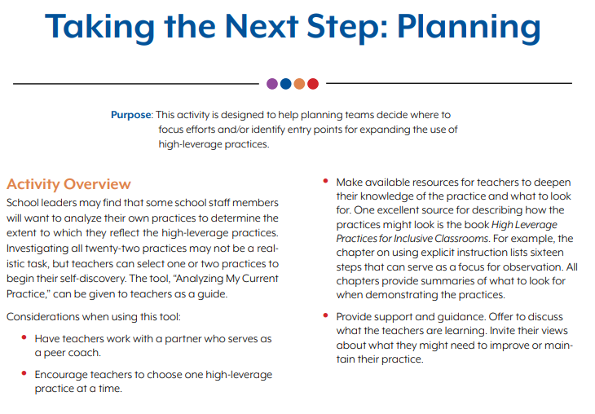
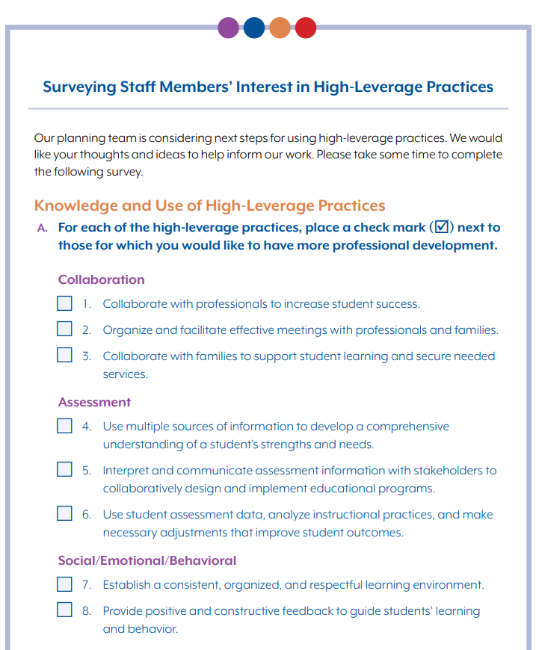
Identifying Internal Needs
Notes:
Perhaps you’ve already started talking to your principal,, special education director, or even some of your colleagues…about these High Leverage Practices and how they can benefit your students. The conversation likely turned to, “sounds good, but we didn’t participate in the Webinar…so what exactly are these high leverage practices and what should we do next?”
You may feel compelled to start sharing your knowledge about all 22 HLPs. However, it may not be a realistic task to investigate all 22 practices with your peers. In fact, whether they realize it or not, they likely already have some working knowledge on several of these practices. Therefore, it might be helpful to use this survey tool to help focus your internal professional development and exploration.
This brief survey is available (thanks to the Council for Exceptional Children and the CEEDAR Center) on the highleveragepractices.org website and can be found within section 3 of the Professional Development Guide. It will help to prioritize which HLPs your school team will focus upon first.
Some possible ways to use this tool include:
Have teachers work with a partner, mentor, or peer coach to go through the survey together and establish priorities
Complete in a focus grade-level team or department team where PD can also be coordinated
When reviewing survey responses, allow for multiple stakeholders from a variety of educational roles to analyze and discuss next steps
Let me show you where this is on the actual website.
Note: Pictures above are linked to https://highleveragepractices.org/ – Professional Development guide Section 3. Click on one of the pictures and walk participants through the survey. Spend approx. 1 minute highlighting the benefits of this form to guide internal PD efforts.

Slide 26
Taking Action
Notes:
Once your team has set some direction on which HLPs to explore further, you will want to articulate your professional development plan. This next tool is also available at https://highleveragepractices.org. The tool itself is called the HLP Planning Form. Like most action planning documents, it will guide the user in selecting a specific HLP for further exploration, setting a specific goal for this HLP, identify the activities and resources needed to sustain your growth toward this goal, and provide an opportunity to document when you have reached your goal and highlight the outcomes.
For those of you who are part of a Differentiated model of Teacher Effectiveness and Evaluation, this tool may support your professional learning goals as established by your LEA leadership.
Note: Again, click on either picture and show the live version of the tool on the website. Each picture is linked. Highlight the examples of this form before showing the blank version.

Slide 27
Diving Deeper into HLPs
Notes:
The action planning form allows you to list activities and resources needed for achieving your goals in HLP growth and development. But you might be wondering where to start with such activities and resources. The IRIS center is a national center dedicated to improving education outcomes for all children, especially those with disabilities birth through age twenty-one, through the use of effective evidence-based practices and interventions. This is a great resource for learning more about High Leverage Practices and connecting these practices with the scope of your current practices and methodologies.
Through the IRIS center, teachers can access numerous learning modules. These are designed to be self paced and can be used individually or within groups of varying sizes.
So how can this site help you? Let’s take a closer look. Let’s pretend that once your team completed the survey and started setting gals through the planning form, you determined that one area of focus would be HLP #13 (Adapt Curriculum Tasks and Materials for Specific Learning Goals). You could go to the IRIS Center, and through the Resources Tab, you would find an option for High Leverage Practices. When you open the domain of Instruction, you see all HLPs of instruction listed. If you click on HLP #13, you will find additional learning modules that are available. Let’s walk through that sequence together so you can see what I mean.
Note Click on the picture above which is linked to the IRIS Center. Go to Instruction, then to HP #13 – and show the 5 additional modules that dive deeper into HLP #13. Draw attention to the module for UDL. Note that this might connect to existing initiatives within the LEA and therefore you want to strengthen the connection between UDL and HLPs.
Point out that each module shows the estimated duration to complete the module work. Also mention that as they explore this resource, they may “accidentally” find learning modules that are a bigger priority for their individual learning than what they were originally looking for. Express that this is OK, and they can simply amend their PD goal on the planning form.

Slide 28
Aligning Current Practices with HLPs
Notes:
Once you have spent some time setting priorities for your professional learning, and you have also spent some time diving deeper into that learning, it is wise to consider what that practice currently looks like in your role and how your practices may change as a result of what you have learned. This tool help you do just that.
It can also be found on the highlevereagepractices.org website within Section 3 of the Professional Development Guide. This tool can be used individually; but there may also be benefit in working through this tool with a peer or within a small Professional Learning Community (PLC). This tool will elicit reflection as well as consideration to modifications/revisions to your current practices. This tool might compliment your use of the planning tool if being used for a differentiated model of teacher evaluation.
Let me show this tool via the website so that you can see the document better.
Note: Click on either picture above to go to the website version of this tool. Remind participants that these are editable documents through the website, which can then be saved to your own digital files.

Slide 29
Identify Your Inventory of Resources
Notes:
Over time, your department, grade-level, or school team will begin to accumulate numerus resources that support and enhance your work with High Leverage Practices. Some of these resources may already exist in your schools while others you may find online. While resources are always helpful, they are only truly helpful is they are accessible when you need them. The final tool that I am going to show you this afternoon is a tool that you can use to document and inventory the resources that you have found to be valuable in your work.
Not only will this documentation of resources improve ease of access for you and your peers, it will also serve as a means for monitoring what is missing and still needed within the inventory.
Note: Click on either picture and show the web version of the form via highleveragepractices.org

Slide 30
https://iris.peabody.vanderbilt.edu/resources/high-leverage-practices/
https://highleveragepractices.org/
Notes:
And again, we want to remind you that to learn more about High Leverage Practices, please go to High Leverage Practices or IRIS Center websites. They are a wealth of information and helpful resources which can sustain your future professional growth.

Slide 31
Notes:
At this time, could you please enter any questions you may have into the Q&A section of the webinar. We will take a few moments to address some of your questions. If we don’t get to you question during our remaining time together, we will follow-up via email with a response to your question.

Slide 32
Act 48 Survey link:
https://www.surveymonkey.com/r/HighLeverage04162020
If you have any questions or concerns regarding the survey, please email Kristen Olszyk at:
kolszyk@pattanpgh.net
Notes:
Don’t forget, if you have participated in all 3 of the live webinars, you can receive Act 48 credit. To access the survey for Act 48, please go to the following link. The link is posted on the screen. I will also copy this link into the chat box. Please copy this link to your browser or write it down so that you can access it at your convenience.
If you have any questions or difficulty with the link, please email Kristen Olszyk at the address listed on the slide.
https://www.surveymonkey.com/r/HighLeverage04162020

Slide 33
Contact Information
PaTTAN – Pittsburgh
Jeffrey D. Mathieson, M.Ed.
412.826.6883
jmathieson@pattan.net
PaTTAN - East
Dr. Lisa Russo
610.878.7245
lrusso@pattan.net
Commonwealth of Pennsylvania
Tom Wolf, Governor
Pennsylvania Department of Education
Pedro A. Rivera, Secretary
Matthew Stem, Deputy Secretary, Elementary and Secondary Education
Carol Clancy, Director, Bureau of Special Education
Notes:
I want to remind you that this recording will be posted to the PaTTAN website, along with the recordings from webinar 1 and 2. If you missed a session or would like to refer back to a session for future use, all 3 will be available to you.
In closing, Thank you all for taking time out of your afternoon to learn more about High Leverage Practices. We wish you well as you continue to plan and deliver high quality learning opportunities to the students in your care! Have a great afternoon!

