Slide 1

It’s my life, and this is how I want to live it: self-directing waiver services in PA
Jamie Ray-Leonetti, Associate Director of Policy
Institute on Disabilities at Temple University
March 30, 2021

Slide 2
This project, Person-Directed Services and Supports, is supported in part by a grant from the Pennsylvania Developmental Disabilities Council, through grant number 1901PASCDD-02, from the U.S. Administration for Community Living, Department of Health and Human Services, Washington, D.C. 20201. Grantees undertaking projects with government sponsorship are encouraged to express freely their findings and conclusions. Points of view or opinions do not, therefore, necessarily represent official ACL policy.

Slide 3
We want to Acknowledge -
This project is supported by a grant from the Pennsylvania Developmental Disabilities Council.
Our project partners are Values Into Action, Pennsylvania Health Law Project and Self-Advocates United as One (SAU1).
All of YOU for joining us to talk about Self- Directed Services!

Slide 4
Institute on Disabilities at Temple University
Vision
Mission
A society where all people are valued and respected,
and where all people have the knowledge,
opportunity and power to improve their lives
and the lives of others.
The Institute on Disabilities at Temple University learns from and works with people with disabilities and their families in diverse communities across Pennsylvania to create and share knowledge, change systems, and promote self-determined lives so that disability is recognized as a natural part of the human experience.

Slide 5

Agenda
Why are we here? – the
PDS grant
Person-Directed Services
ODP
Who Can Help?
Person-Directed Services OLTL
PDS Stories
Brief Q & A

Slide 6
What is Person-Directed Services (PDS)?
Home and Community-Based Services
Help People of All Ages and Across All Disabilities to Maintain Independence and Make Their Own Choices
Sometimes Called Consumer-Directed or Self-Directed Services, or Person-Directed Services and Supports (PDSS)

Slide 7
The Person-Directed
Services and Supports Grant
We continue to strive to make "person directed services and supports" a common household phrase;
Over the span of this grant, we hope to provide ways for people with disabilities, families and the generic community to learn from one and other through community conversations;

Slide 8
The Person-Directed
Services and Supports Grant (cont.)
We continue to expand resources for individuals who want to learn more about person directed services and supports. One way we continue this work will be the development of PDS "Regional Resource Councils," and;
We will provide ways for individuals using PDS to share their stories of both success and challenges.

Slide 9
Self-Direction under Office of Developmental Program Waivers
Person/Family Directed Services Waiver
Community Living Waiver
Consolidated Waiver
Adult Autism Waiver (currently no option to self-direct, but. . .)

Slide 10
The Pennsylvania Person-Directed Services (PDS) Model
Participant or their surrogate has decided to self-direct and become a common Law Employer (CLE) or Managing Employer (ME)
The participant is living in their own home or a family home
Must use a Financial Management Service (FMS)
The FMS is either Agency with Choice (AWC) or Vendor Fiscal (VF)

Slide 11

The Key to Self-Direction -

Slide 12
Having your team support you to get the life you want is
Person-Centered Planning.
Who picks the people on the team?
Who should be driving the plan?

Slide 13
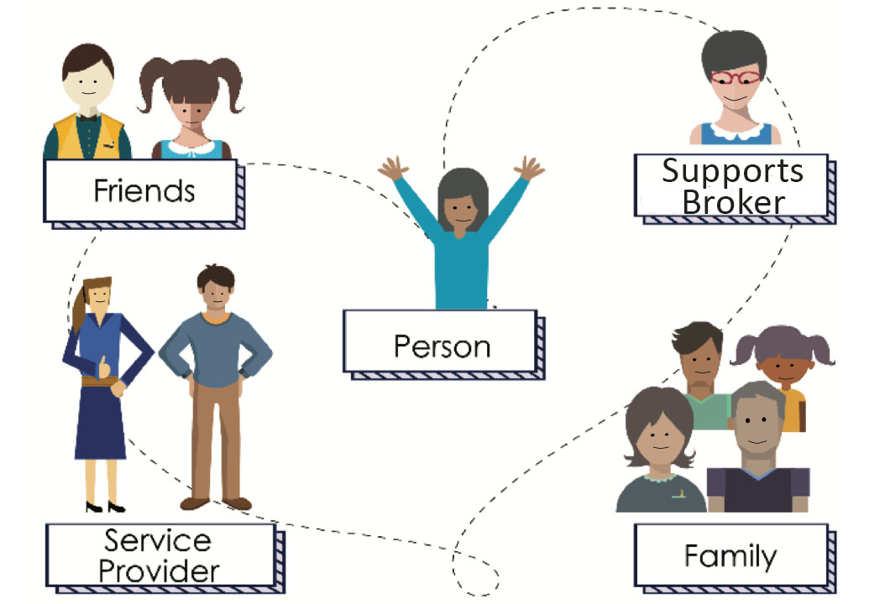
Your Person-Centered Planning Team

Slide 14
Who Can Help Me Explore Self-Direction?(
A CERTIFIED SUPPORTS BROKER - An individual who assists participants or their designated surrogate with employer-related functions in order to be successful in self-directing some or all of their needed services.
An ally to people who want to control their own lives and services.

Slide 15
What Can a Supports Broker Do?
Enhance natural supports
Provide support with employer-related functions
Assist to ensure compliance with program rules and planning

Slide 16
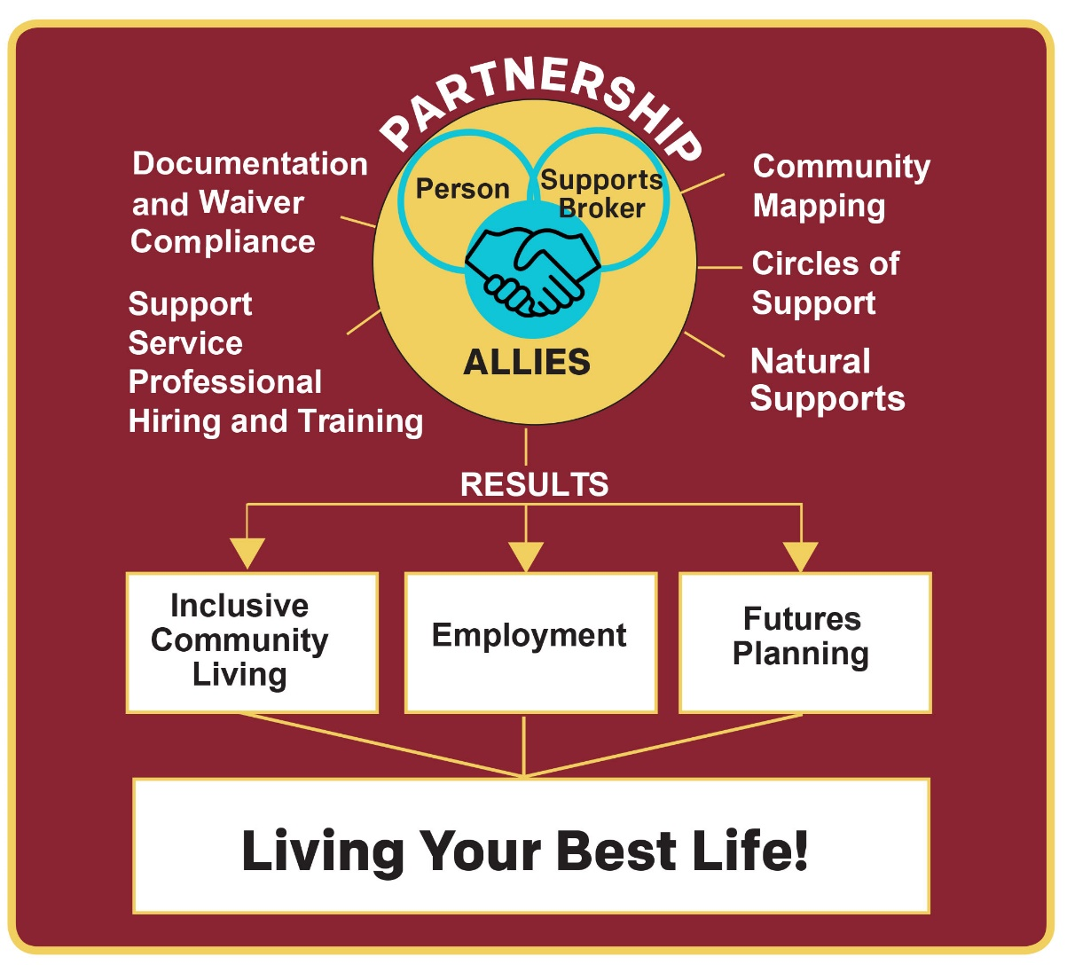
How Does Partnership with a Supports Broker Lead to Inclusive Community?

Slide 17
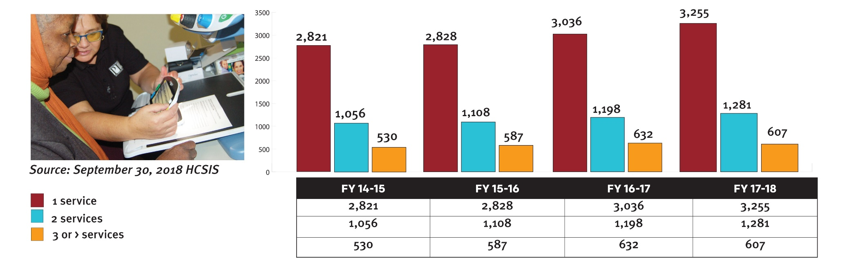
PA Successes and Challenges
Number of Self-Directed Services per Individual/Self-Advocate; will include support broker.

Slide 18
Office of Long-Term Living Waivers
Community Health Choices (CHC)
OBRA Waiver

Slide 19
Community HealthChoices
  It provides supplementary medical coverage for individuals who have both Medicare & Medical Assistance; and .
  It also provides in home and community-based waiver services for older adults and adults age 21+ with physical disabilities or brain injury who meet a disabilities standard called "nursing facility clinically eligible”
  Self directed services are only available under the waiver component

Slide 20
OBRA Waiver
  This waiver is for youth ages 18 to 59 who have significant disabilities occurring before age 22 other than an intellectual disability and who do not have medical needs that meet the definition of nursing facility clinically eligible.
Notes:
Difference between CHC and OBRA: OBRA limited to those youth ages 18 to 21 and adults 21 and older who do not have physical disabilities that meet the nursing facility clinically eligible requirements but have disabilities that occurred prior to age 22

Slide 21
Self-direction under OLTL Waivers
Vendor/fiscal option for OLTL Waivers is PPL (public partnerships)

Slide 22
Services My Way
This provides the means to have more control over your services.
Your service coordinator calculates your “budget” by multiplying the number of PAS hours you have times the hourly wage set by your MCO.

Slide 23

Community
Notes:
Instructor
Community means a lot of different things to different people and everyone has a different approach to how we get connected to our communities.
Community connection exists when a person becomes a valued member of the group, his/her ideas are appreciated and respected, relationships exist (people get to know each other), there is supportive growth. Perhaps the easiest way to know that community has been created is that the person is missed when they are not there. Someone asks about him or her.
This image shows the many, many different things people may think about or get from their communities. It is important to keep in mind relationships help to keep up going, loneliness is a known contributor to poor health and even pre-mature death. Not only that, but it is the eyes of our communities that keep people healthy, safe, and free from abuse. This is especially true for those people that don’t use words to communicate. The more people that know a person, the more people around to speak up – and despite what you many think, there are people that will speak up.

Slide 24

Have a PDS story to share?
We want
to hear
from you!
  https://disabilities.temple.edu/pds/share-your-story.html

Slide 25
Any Questions?

Slide 26
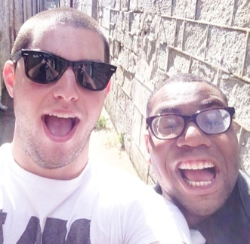
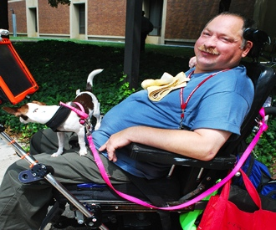
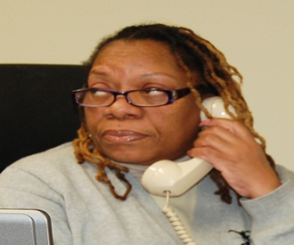
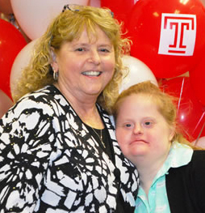
Institute on Disabilities at Temple University
1755 N 13th Street
Student Center, Room 411S
Philadelphia, PA 19122
Tel: 215-204-1356 Fax: 215-204-6336
Email: PDSS@temple.edu
Web: https://disabilities.temple.edu/programs/pds/#new
MY contact information: Jamie Ray-Leonetti
Email: Jamie.ray-leonettti@temple.edu

